Slide 1
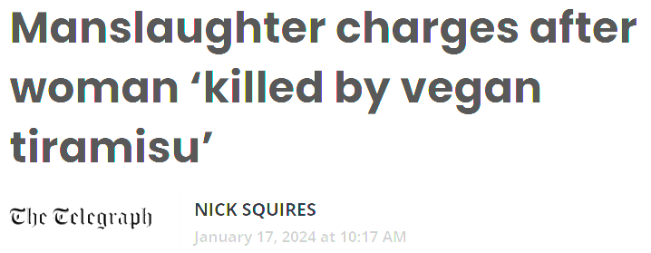
Truth in Labeling: It’s Anyone’s Guess
Menu mislabeling …
Daniel Engeljohn, PhD
dlengeljohn@gmail.com
March/April 2024
Notes:
Slide #1A – Welcome --
Note that in January of this year, a restaurant presumably identifying both vegan and non-vegan items, sold an item “labeled” as vegan to an individual that died from anaphylaxis due to an intolerance for dairy products.
Food labeling is more than helping the consumer decide which product to purchase.
Food labeling can mean the difference between life and death for some people.
It is too soon to know all the specifics of the deadly tiramisu, whether the incident was intentional, incompetence, or purely accidental.
Regardless, labeling matters regardless of when it is on a food or a menu.
We will discuss the ins and outs of labeling policy and what is “truth” and how truth is verified and enforced.
There are many reasons as to why the labeling of food in the marketplace may appear misleading or, at times, inaccurate.
Oftentimes, the reasons are for technical reasons and, thus, are not in violation of the applicable regulation.
For example, you may have heard about a new labeling policy that was issued, yet the “old label” is still in the marketplace.
This may cause you to question what’s going on.
Part of the explanation could be due to what is called the Uniform Compliance Date for food labeling regulations.
Beginning in 1996, the Food and Drug Administration (FDA) and, shortly thereafter, the U. S. Department of Agriculture (USDA) Food Safety and Inspection Service (FSIS), adopted this new approach to food labeling to reduce industry cost for changes to food labels.
In essence, all food labeling regulations that become effective within a specified two-year period must comply with the new requirements anywhere from one to two years after their effective date.
Consequently, if a manufacturer produced product for which more than one labeling change became effective, the cost for changing all labels to comply with all the labeling changes would be more cost-effective than making the changes independently.
The latest update to the Uniform Compliance Date, which was published January 3, 2024, clarifies that for any food labeling regulation that published between January 2, 2023, and December 31, 2024, the uniform compliance date is January 1, 2026.
However, other reasons for why a product’s labeling may appear to be misleading or even inaccurate could be because of unintentional errors or even intentional errors.
We will focus on all these aspects.

Slide 2
Weekly class notes posted
With slides and my notes
Break midway for 10-minutes
Short Q/A before break and end
Submit questions via the portal during the week
I will post weekly answers for all to see
Lots to cover over 6-weeks
Will comment on many actual labels
…for you…
Week 1 – Overview
Truth versus puffery…
2
Notes:
Slide #2A – Major topics for the class all geared at discerning truth from puffery, ultimately.
Week 1 Overview – (Thursday, 2PM – 4PM, March 14, 2024) –
This course will cover a huge amount of information relative to most all aspects of food labeling.
My intent is to take a 10-minute biological break by the end of the first hour of class.
If you have questions that the whole class could benefit from hearing, please submit your questions through the class portal and I will capture pertinent questions each week and provide answers for everyone to view.
If there appears to be something lacking in the design of the course that I can correct, also put that suggestion in the class portal and I will do my best to address the suggestion in a timely manner.
Each week, by the week prior to the beginning of class, I will post the powerpoint presentation that also includes my detailed slide notes.
Topics –
Genesis of the need for labeling and regulatory oversight in the United States (US) and internationally.
Defining food, labeling, and pertinent terminology (e.g., misbranding, adulteration, economic adulteration, intentional adulteration).
Week 2 (Thursday, 2PM – 4PM, March 21, 2024) –
Topics –
US government labeling authorities at the Federal, State, and local level.
International food labeling issues.
Labeling specifics, including standardized foods, the Nutrition Facts panel features, and menu labeling.
Week 3 (Thursday, 2PM – 4PM, March 28, 2024) –
Topics –
Use of labeling by consumers
Identification and management of consumer expectations (e.g., limitations of religion and the need for public health protection versus preference, and use of surveys).
Overview of ingredients and uses.
Week 4 (Thursday, 2PM – 4PM, April 4, 2024) –
Topics –
Common misunderstandings or lack of understanding about labeling terms (e.g., sugars, “healthy,” GMO, “natural,” and animal raising practices).
Challenges in verifying label claims.
Trusting food labels (e.g., impact of frequent food recalls).
Week 5 (Thursday, 2PM – 4PM, April 11, 2024) –
Topics –
Deception for fraud and financial gain.
Using actual labels to demonstrate misleading information and to focus on fine print.
Getting help on labeling issues.
Week 6 (Thursday, 2PM – 4PM, April 18, 2024) –
Topics –
Discussion on cultured animal cells, petitions, and other ways to find out what current food labeling issues are being considered nationally.
Discussion on assigned reading associated with the ins-and-outs of how a recent labeling rulemaking was designed, including a look at the cost-benefit analysis and the substantive issues that had to be considered in creating the policy --
Gluten-free labeling of Fermented or Hydrolyzed Foods -- (FDA Docket No. FDA-2014-N-1021).
Wrap-up.

Slide 3
Genesis of the need for labeling
Defining food
Defining labeling and terminology
What is truth?
Who do you trust?
What is a reasonable consumer?
What are reasonable actions?
Chaos, law, then justice
Week 1 – Topics
3
Notes:
Slide #3A – Chaos, law, then justice --
Week 1 Topics –
Genesis of the need for labeling and regulatory oversight in the United States and internationally --
As with many things, inconsistency and unfairness in the marketplace create chaos.
Generally, long thereafter and especially if there are deaths or undue economic pressure, law and order sets boundaries for the marketplace.
For non-food safety labeling policy, consumer expectation is a critical parameter.
However, the devil is in the details.
Industry wants to make a buck and sell product; marketing campaigns play on consumer misunderstanding, confusion, and “trust.”
For food safety labeling policy, deaths often are the driver for policy and government generally sets the parameters with incidental consumer input on implementation aspects; industry concerns are given more weight but are not the deciding factor for the ultimate policy.
Our discussion about food safety labeling features will focus mostly on allergens, as well as handling and preparation instructions.
Labeling policy is one of the most frequently litigated issues worldwide.
Ultimately, the courts get the final say on interpretation of what labeling means.
Virtually everything associated with truth in labeling, especially in resolving litigated cases, boils down to –
“What a reasonable consumer believes when acting reasonably under the circumstances.”
We will parse out how consumer confidence is built into food labeling as we progress through this course.
Meanwhile, we will stick with the basics –
The purpose of food labeling is protective in two ways –
Ensuring that the qualities associated with a product are not deceptive, and
Preventing false claims that create unfair competition for businesses.
Internationally, food traded must comply with consensus agreements in the form of Codex Alimentarius food labeling standards.
Codex standards are managed by a joint effort of the Food and Agriculture Organization and World Health Organization.
The Codex guiding principle on food labeling descriptively state:
Prepackaged food shall not be described or presented on any label or in any labeling, as follows --
In a manner that is false, misleading, or deceptive or is likely to create an erroneous impression regarding its character in any respect;
By words, pictorial, or other device that refer to or are suggestive either directly or indirectly of any other product with which such food might be confused; or
In such a manner as to lead the purchaser or consumer to support that the food is connected with such other product.
As a former regulator of food labeling for all meat, poultry, and processed egg products in the U.S., government is concerned about consumer perceptions of labeling.
As you will learn, there are significant limitations as to how far government can verify the truthfulness of food labeling.
In a recent survey by DigitalHubUSA titled “Americans Don’t Trust Food Labels” –
Approximately half of Americans (53 %) feel like food labels are sometimes misleading.
Mistrust in food labels extends to 11 % who find labels completely untrustworthy.
Feeling tricked by nutrition labels extends to 82 % of Americans due to the label being vague and causing the label to be misleading.
Nearly 44 % of Americans felt that brands are misleading consumers as a way to sell products, such as use of health claims purported on food labels.
Clearly, getting to what is “truth” regarding labeling is an issue.
I will sum up this dilemma in a very simple phrase —
“Money is the root of all evil.”
Money can be made with the most subtle turn of a phrase, insertion of a word, absence of a word, or reference to a condition that means different things to different people.

Slide 4
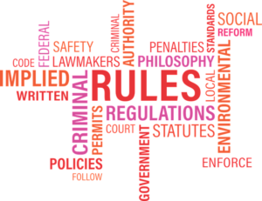
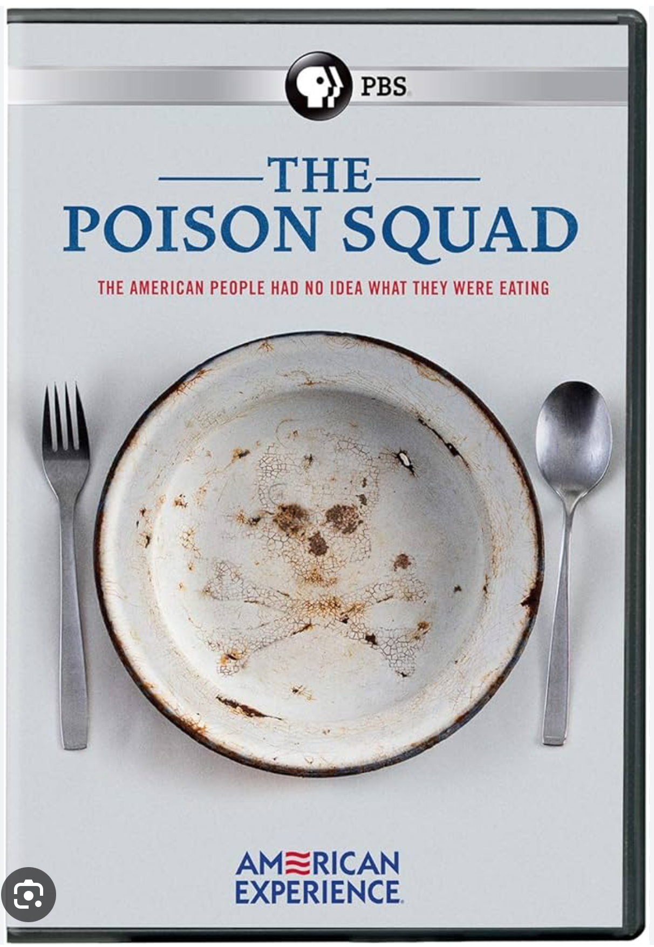
Economic fraud
in 372 BC
Fraud ruled without law
Artificial flavorings in plants…
Addition of ground peas…
Common law emerged
Consumers on their own…
Ingredients were toxic…
“The Poison Squad” stepped in…
The King’s proclamation in the 13th century
This Photo by Unknown Author is licensed under CC BY-SA
This Photo by Unknown Author is licensed under CC BY-SA
Statutory law after 1890
1883
Week 1 – Topic
Genesis of need
4
Notes:
Slide #4A – Genesis of need --
Week 1 Topic –
Genesis of the need for labeling and regulatory oversight in the United States and internationally --
A look at the historical record on food labeling policy development can help to better appreciate the challenges with present day food labeling.
Pre-government intervention –
As early as 372-287 BC, Theophrastus noted in his writings collectively titled “Enquiry into Plants” the use of artificial flavorings in food, which today would constitute adulterants for economic reasons (i.e., fraud).
No laws were known to have been written at that time, nor were there labels on foods.
Initial proclamation on food labeling --
The King of England, in early thirteenth century, proclaimed in an Assize of Bread, a prohibition against mixing ground peas and beans into bread dough.
Such a law was intended, in part, to regulate the bread weight.
Interestingly, today, consumers would willingly pay a premium for such a “fortified” bread although in today’s marketplace, the ingredient statement would include reference to the peas and beans.
Common law (up to 1906) in the U.S. –
Food labeling emerged haphazardly around the country out of a plethora of acute illnesses that followed from foodborne contamination affecting localized populations.
This included undisclosed, harmful ingredients, particularly when an ingredient was unsafe to consume over time.
Muckrakers (“reform-minded journalists”) helped expose dangerous qualities of food.
The focus on food by the U.S. government first targeted policies to address economic adulteration.
In 1785, Massachusetts passed a food law aimed at the selling of unwholesome provisions, whether meat or drink.
In 1883, President Abraham Lincoln appointed a chemist to raise public awareness about food poisoning.
The chemist was assigned to work at the U. S. Department of Agriculture (USDA), a Federal Cabinet agency.
The U. S. Department of Agriculture was first created In 1872 by President Lincoln.
At the time, a fairly large number of individuals in the general population died after consuming suspect products before the chemist was alerted to begin investigating.
The chemist’s job was to review food products suspected of being formulated with unsafe compounds.
The chemist (Harvey Wiley) famously assembled a group of young, healthy human male government employee volunteers and tasked them with eating steadily increasing amounts of a suspect additives, carefully tracking the impact on their bodies.
For example, capsules of borax, formaldehyde, and other preservatives were consumed alongside daily meals.
[See “The Poison Squad” by Deborah Blum for more details about the work of the chemist and his staff.]
Examples of some of the issues investigated included:
Over-the-counter nostrums, particularly milk whitened with chalk dust; fruit and vegetables preserved and colored with copper sulfate; and bread permeated with saw dust.
Common law prevailed as an ineffective way for States to regulate food, whether for safety or truthful labeling.
Although it was a crime to sell diseased meat as early as 1860, individuals had to bring a lawsuit against a seller even though there was no enforcement mechanism to assist in litigation or in get product removed from commerce.0
Litigating individuals had the burden of investigating the situation and covering the cost of litigation.
In addition, States were powerless when tainted food crossed State lines; private individuals also had to bring a suit outside the State.

Slide 5
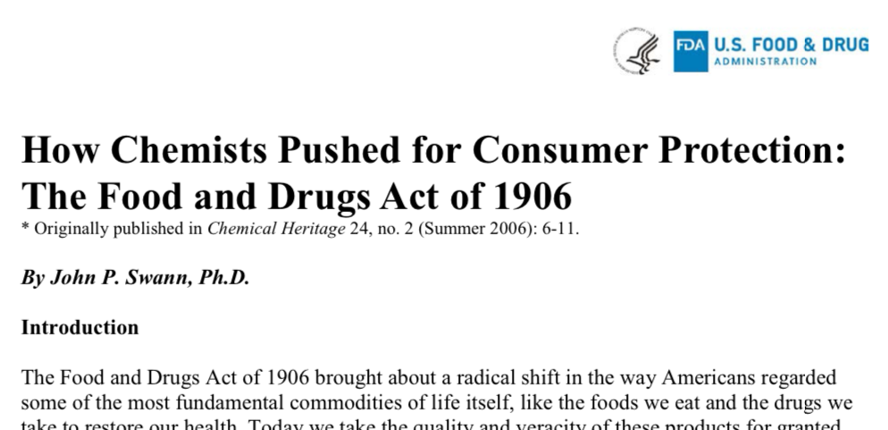
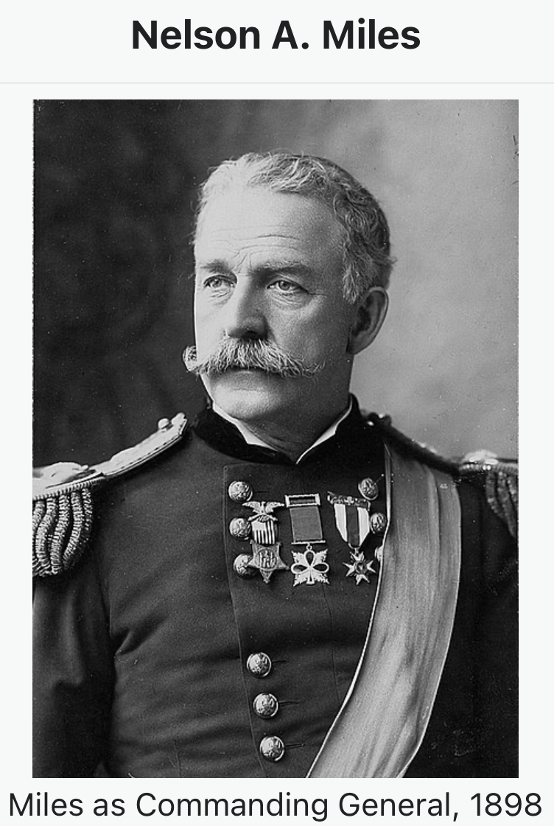
1906
1890
Statutory law enacted
By 1890, beef for export inspected
By 1906 --
First interstate law for livestock
First interstate law for labeling
To prevent unsafe ingredients
This Photo by Unknown Author is licensed under CC BY-SA
1906 – crackdown on deceptive marketing and labeling practices
1906 – beef with an “embalmed dead body odor” fed to troops
Week 1 – Topic
More genesis of need
5
Notes:
Slide #5A – More genesis of need --
Week 1 Topic –
Genesis of the need for labeling and regulatory oversight in the United States and internationally --
Statutory law (1890 forward) –
By 1890, President Benjamin Harrison signed the first law requiring the U. S. Department of Agriculture to inspect live animals and meat products solely for export purposes.
Inspection was for animal disease control and protecting agriculture – not public health.
Congress enacted this law because our foreign trading partners refused to purchase meat from the U. S. without government inspection, fearing disease would be “imported into their country.
The law applied solely to exported livestock meat.
By 1906, two national, precedent-setting laws were passed by Congress and enacted (signed) by the President, followed by statutes pertaining to specific species and food-related issues —
The Pure Food and Drug Act (PFDA) proscribed dangerous foods and drugs and curtailed deceptive marketing and labeling practices nationwide.
Two major weaknesses in this precedent-setting law were later corrected --
First, this new law failed to address premarket testing or review procedures for regulated products and their ingredients (i.e., products were allowed to enter commerce — the marketplace — without a review by government); and
Second, the presumption that consumers can protect themselves from fraud.
This law gave the Food and Drug Administration the authority to prescribe the safety and use provisions for food ingredients.
For a perspective on the difficulties with writing and enforcing a national food law, between 1879 and 1905, over 100 food and drug bills were debated by Congress but none passed.
One crisis that spurred action by Congress to address food ingredient safety and labeling was the “embalmed beef scandal” associated with the Spanish-American War.
The commander of the Army (General Nelson A. Miles) provided testimony to Congress describing that available beef for the soldiers had an “odor like an embalmed dead body.”
Shortly thereafter, Congress passed the 1906 Pure Food and Drug Act.
The Federal Meat Inspection Act (FMIA) was the first national prohibition of uninspected, adulterated, or misbranded livestock meat products.
This Act ensured healthy animals were processed under sanitary conditions and gave the U.S. Department of Agriculture authority to inspect and issue food standards for meat.
Each individual animal and its associated edible product are inspected both before and after slaughter.
Note: Just prior to 1906, “The Jungle,” a novel by Upton Sinclair, portrayed the harsh conditions of immigrants in the Chicago meatpacking industry.
The author urged President Theodore Roosevelt to require inspectors in meat slaughter facilities in which the meat was destined for the domestic marketplace.
It was the filthy conditions described in horrific detail that caused a public furor and moved government to action to pass the FMIA.
By 1926, the Poultry Products Inspection Act for poultry was enacted.
This law was designed similarly to the livestock statute.
Each individual animal and its associated edible product are inspected both before and after slaughter.
However, there are several important differences.
Because many people in cities owned poultry and were easily able to slaughter them for personal use in their own home, the law exempted inspection unless a large number (i.e., several thousand) was to be routinely slaughtered. A similar exemption holds for restaurants and commercial markets, which also is tied to revenue restrictions that are associated with an annual cost-of-living change..

Slide 6
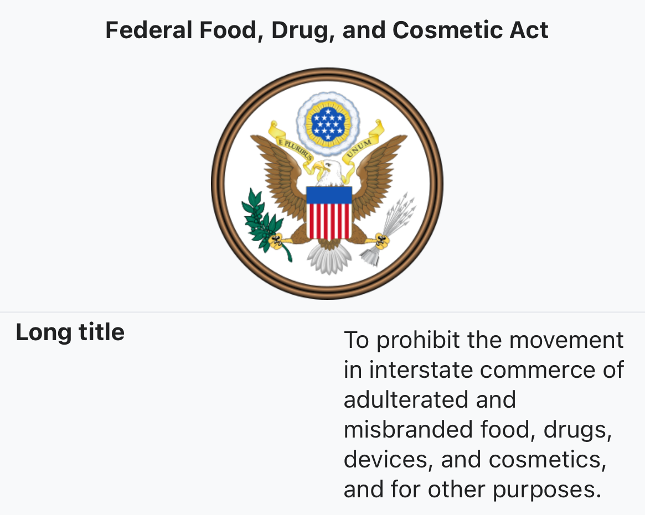
“Elixir of Sulfanilamide” not tested before marketed, killing ~100; Congress responded.
Congress concluded –
Consumers could not protect themselves from fraud.
Courts should favor consumer protection in their interpretations of the law.
FFDCA was enacted to correct the 1906 PFDA
Week 1 – Topic
Labeling enhancements
6
Notes:
Slide #6A – Labeling enhancements --
Week 1 Topic –
Statutory law (after 1906) –
By 1938, the Federal Food, Drug, and Cosmetic Act (FFDCA) was enacted.
Just prior to 1938, a new cure-all was placed on the market called “Elixir of Sulfanilamide.”
The manufacturer added a combination of chemicals used in paint, varnish, and antifreeze to disguise the bad taste, smell, and appearance of the product.
Nearly 100 people, mostly children, died due to toxic effects of the chemicals used that were never tested for harm prior to use in the product and placement in commerce.
The FFDCA addressed three important lessons learned from passage of the 1906 Pure Food and Drug Act:
Congress indicated courts should broadly construe the new Act to protect the public;
Congress rejected the 1906 statuary assumption that consumers could protect themselves; and
The objective of this new Act not only addressed protecting public health, but also added emphasis on defending consumers by preventing fraud (i.e., the first comprehensive labeling law issued in the U.S.).
From a personal perspective, both my parents were born prior to 1937 and could have been exposed to some of the unconscionable incidents that we now know were commonplace.

Slide 7
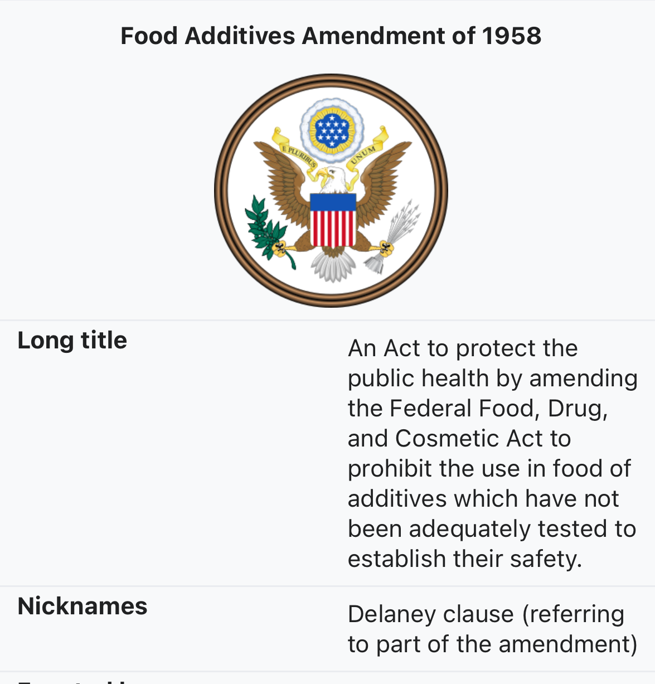
By 1967 --
Pre-market review for safety –
All food additives; and
All colors, natural or synthetic.
Plus, provisions for fair packaging and labeling
Bans additives causing cancer in humans or animals
Week 1 – Topic
Further labeling enhancements
7
Notes:
Slide #7A – Further labeling enhancements --
Week 1 Topic –
Statutory law (after 1906) –
By 1946, the Agricultural Marketing Act for exotic species and voluntary inspection (fee-for-service) for food commodities was enacted to ensure fair and competitive trading.
Commodities are graded and assigned quality grades (e.g., USDA Prime beef, Grade AA eggs), along with specific restrictions for how products can be labeled using U. S. Department of Agriculture grades names.
By 1958, the Food Additive Amendment was incorporated into the Federal Food, Drug, and Cosmetic Act.
This labeling enhancement added the Delaney Clause.
This clause requires the Food and Drug Administration to ban food additives that are found to cause cancer or induce cancer in humans or animals,
In addition, this Amendment requires that any substance intentionally added to food is a food additive and is subject to pre-market approval process by the Food and Drug Administration for safety and use unless the use of the substance is generally recognized as safe.
By 1960, the Color Additive Amendment was incorporated into the Federal Food, Drug, and Cosmetic Act.
This labeling enhancement brought approval of all colors, natural and synthetic, into a pre-market approval process by the Food and Drug Administration for safety and use unless the use of the substance is generally recognized as safe.
By 1967, the Fair Packaging and Labeling Act (FPLA) was enacted and ensured truthful and transparent labels on consumer commodities, including food.
Although the food provisions are specifically applicable to products under the jurisdiction of the Food and Drug Administration, the Food Safety and Inspection Service adopted the tenets of this Act by deeming foods misbranded and/or adulterated if not complying with the Fair Packaging and Labeling Act.
Consumer commodities other than food are under the jurisdiction of the Federal Trade Commission for ensuring compliance with the law.

Slide 8
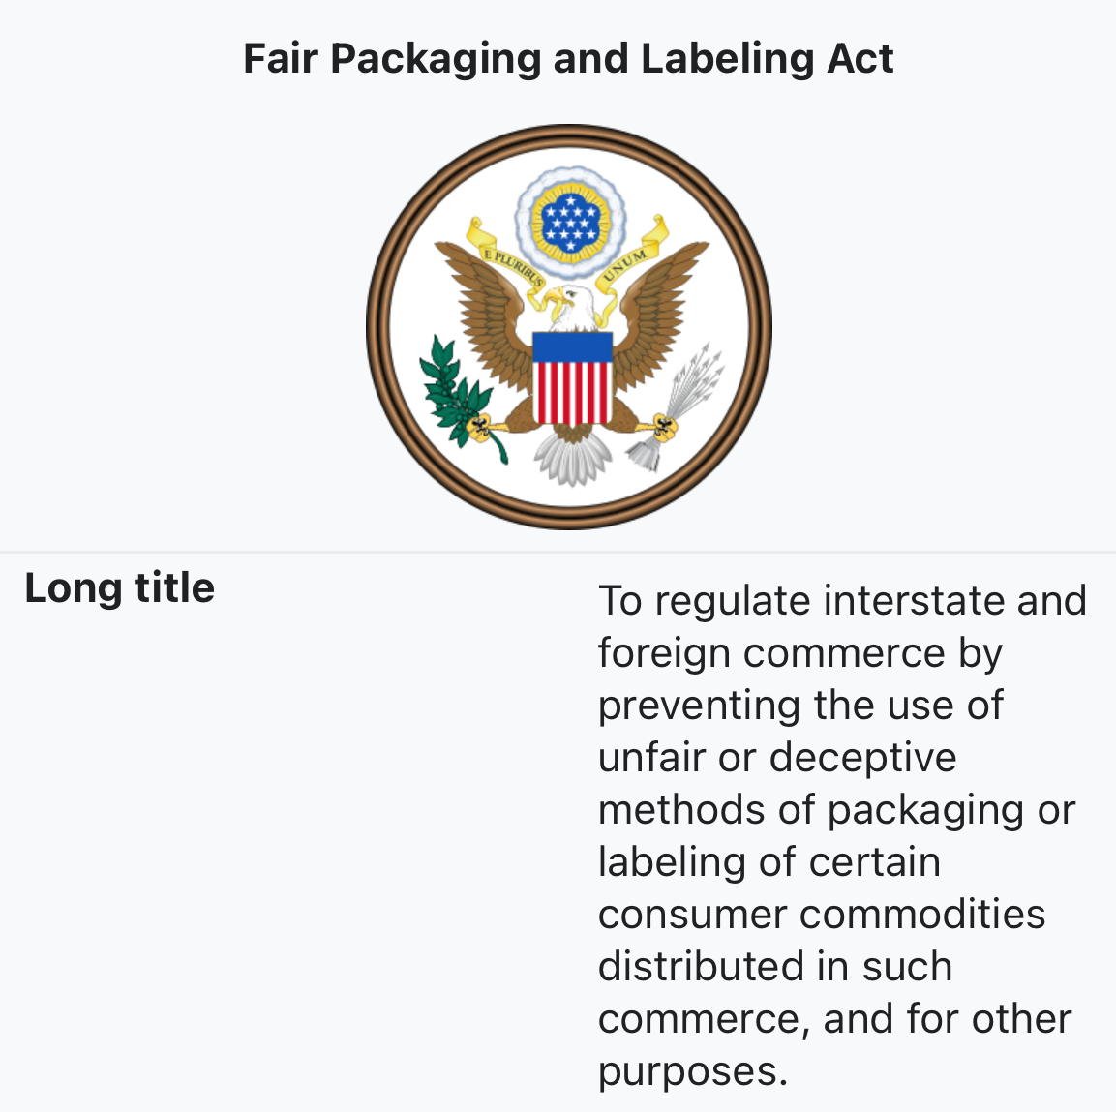
The 1967 Act –
Required on labels --
Net contents
Net quantity of serving
Identify of commodity
Name/address of manufacturer
Warnings of risk
Instructions for use
Defined misbranding
Ordered ingredients by weight
…commercial speech is protected to prevent deception...
Week 1 – Topic
Foundational labeling
8
Notes:
Slide #8A – Foundational labeling --
Week 1 Topic –
Statutory law (after 1906) –
The 1967 Fair Packaging and Labeling Act was foundational because it established the basic provisions for what must be on all food labels for sale.
The law required that labels disclosed:
Net contents;
Net quantity of each serving;
Identity of commodity; and
Name and place of business of the product’s manufacturer, packer, or distributor.
At the time, most products were subject to standardized labeling requirements, and some had a mix of safety warnings, instructions, and factual information.
Warnings generally described risks that may not have been obvious to a reasonable consumer.
Instructions explained how to use the product and reduce risk of injury.
Generally, a food intended for sale to consumers is considered misbranded if:
It has a false or misleading label;
It is misnamed;
Is an imitation but does not so state;
The container is itself misleading in some way;
The container does not disclose the name and place of business of the manufacturer, packer, or distributor;
It does not state the quantity of the contents;
Required information is not prominently displayed;
It misrepresents to be a food with a standard of identify;
It does not disclose the ingredient list using common usual names of ingredients;
It does not meet standards of quality prescribed by regulations (e.g., pasteurization);
It misrepresents that it is for special dietary use;
It does not list artificial flavoring, coloring, or chemical preservatives; or
It does not disclose –
The eight major food allergens (Note: This was changed to nine in 2023);
Nutrition information; or
Health- and nutrition-related claims according to regulations.
Ingredients must be disclosed in descending order of predominance by weight until the product contains 2 % or less by weight of an ingredient (in which case, the manufacturer may use a quantifying statement, such as “Contains _ % or less of _. ).
NOTE: The first amendment to the U.S. Constitution creates a labeling consideration in that Congress shall make no law “abridging the freedom of speech.”
Labeling is speech --
Protection is not limitless in that the government can limit speech --
Commercial speech is protected with intermediary scrutiny – not haphazard – to prevent being false, deceptive, or misleading.
It is defined as the proposal of a commercial transaction such as factual disclosure for advertising, labeling, and other types of commercial solicitations (e.g., brochures).
If the information is “potentially misleading” but can be explained through disclaimers or factual disclosures to become non-misleading, such speech cannot be banned.
Vendors have no constitutional right to sell goods without giving the purchaser fair information of what it is that is being sold.
Safety and health generally suffice for maintaining government interest in preventing deception and, thus, limiting speech.
However, consumer curiosity alone is not sufficient to require disclosure.
By 1970. the Egg Products Inspection Act for processed egg products was enacted and included labeling provisions specific to this product and its use.
By 1983, the Federal Anti-Tampering Act issued to help prevent intentional contamination of product spurred by the deliberate poisoning of bottles of Tylenol in the Chicago area.

Slide 9
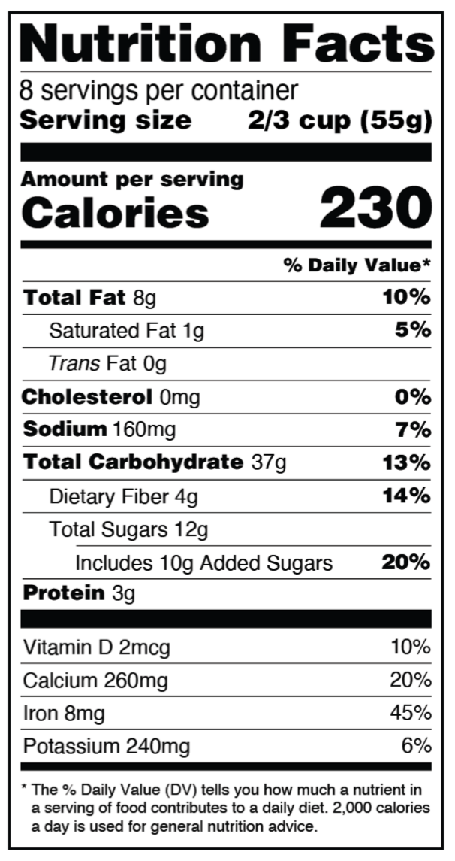
OFPA of 1990 –
Standards for organic foods
NLEA of 1990 --
Nutrition content to encourage dietary practices
Product misbranded if required nutrients missing
Allowed certain claims for levels of nutrients (e.g., “low”)
Week 1 – Topic
Nutritional labeling
9
Notes:
Slide #9A – Nutritional labeling --
Week 1 Topic –
By 1990, the National Organic Program (NOP) and the associated law (Organic Foods Production Act – OFPA) was enacted.
This law provided consistent standards governing the marketing of agricultural products as organically produced.
The implementation of the law is administered by the Agricultural Marketing Service of the U.S. Department of Agriculture.
Food safety is not part of the NOP nor is it within the authority of this Act.
Importantly, products produced and labeled as organic have limited options for the types of process controls, including pathogen reduction treatments, that can be applied.
There have been documented situations in which foodborne illness resulted from products being processed as organic because pathogens survived either at a frequency or level sufficient to cause illness.
Also, by 1990, the Nutritional Labeling and Education Act amended the 1938 Federal Food, Drug, and Cosmetic Act.
This ACT required nutritional content on the label.
The product would be considered misbranded unless the Nutrition Facts panel provided:
The serving size based on the amount customarily consumed or common household measure;
Number of servings per container;
Total number of calories;
Total number of calories derived from the total fat;
Amount per serving of total fat, saturated fat, cholesterol, sodium, total carbohydrates, complex carbohydrates, sugars, dietary fiber, and total protein;
Amount per serving of specific vitamins and minerals.
It permits other nutrients for the Nutrition Fact Panel if such information “will assist consumers in maintaining healthy dietary practices.”
Specific claims for levels of nutrients (e.g., “high,” “low,” “reduced,” and “more”) were allowed under certain conditions.

Slide 10
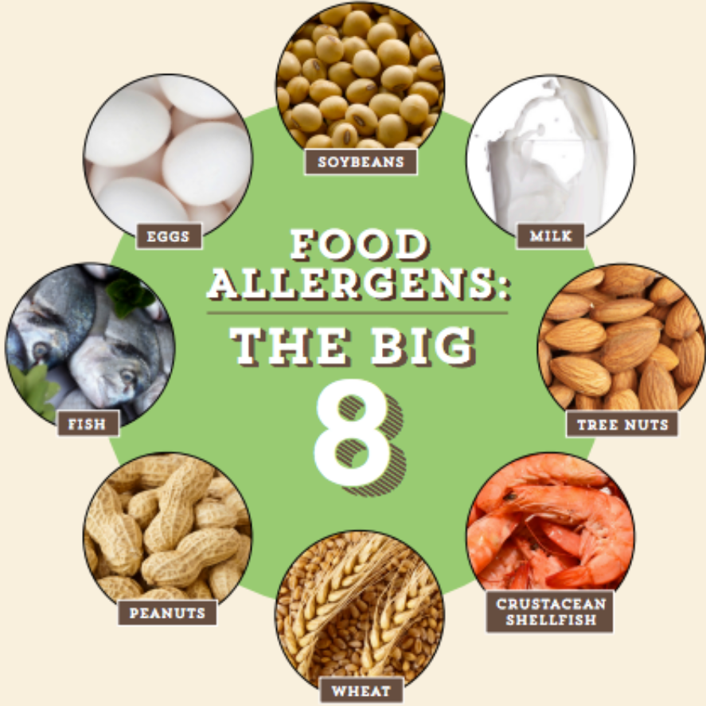
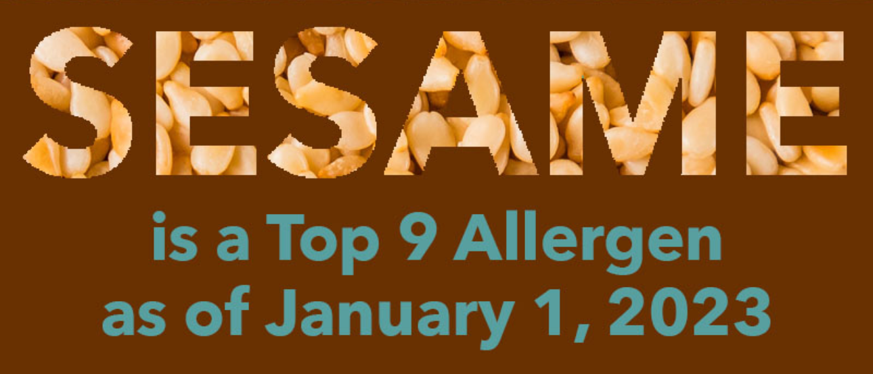
COOL Act of 2002 --
County-of-origin labeling
FALCPA of 2004 –
Disclosure of allergens causing 90 % of illnesses/deaths
FASTER Act of 2023 –
Sesame as an allergen
The full list of food allergens is vast...
Week 1 – Topic
Allergen labeling
10
Notes:
Slide #10A – Allergen labeling --
Week 1 Topic –
By 2002, the Country-of-Origin Labeling (COOL) Act was enacted.
This law, administered by the Agricultural Marketing Service, U. S. Department of Agriculture, was a consumer information program and not a food safety program or a traceability program.
COOL was required for certain perishable agricultural commodities (i.e., fish, shellfish, beef, veal, pork, lamb, chicken, goat, fresh and frozen fruit and vegetables), macadamia nuts, pecans, peanuts, ginseng, and honey.
Labels identified where an animal was born, raised, and slaughtered (designating up to three countries); as well as source of fruits and vegetables for planted, harvested, and processed.
Processed foods and cooked versions of the covered commodities were exempt.
In 2009, Canada and Mexico challenged the U.S. COOL law at the World Trade Organization (WTO).
They argued that COOL distorted trade by reducing the value and number of livestock shipped to the U.S.
A dispute settlement panel reviewed the complaint.
In 2011, the World Trade Organization ruled that certain COOL requirements violated U.S. World Trade commitments.
The U.S. appealed this decision and the appellate body ruled against the U.S., agreeing that COOL partially violated the Technical Barriers to Trade Agreement.
The U.S. modified the final regulations in order that the disputed issues would be corrected.
Canada continued to disagree, causing there to be a Compliance Panel review.
In 2014, the World Trade Organization again ruled against the U.S.
The U.S. again appealed this decision.
Meanwhile, R-CALF (a U. S. cattlemen’s trade group) and others filed a lawsuit in the U.S. Federal District Court against the U. S. Department of Agriculture asserting that the modified regulations violated the COOL authorization and the First Amendment.
R-CALF objected to the importation of live cattle into the US mainly out of fear of bovine spongiform encephalopathy (BSE) or “Mad Cow” disease that had recently been attributed to a cow imported into the US from Canada.
The U.S. Court ruled in favor of the U.S. Department of Agriculture by affirming that the Agency acted within its constitutional authority, thereby passing the Zauderer test (i.e., that the government’s interest was not just enacted to satisfy consumer curiosity);
That is, the government’s interest was substantial -
“To enable consumers to choose American-made products; the demonstrated consumer interest in extending COOL to other food products; and the individual health concerns and market impacts that can arise in the event of a food-borne illness outbreak.”
By 2004, the Food Allergen Labeling and Consumer Protection Act (FALCPA) was enacted.
This law identified eight major food allergens responsible for 90 % of all food allergy reactions.
These allergens must be explicitly disclosed on all food regulated by both the Food and Drug Administration and the Food Safety and Inspection Service.
The label must –
State that the product “contains” the food source from which the allergen is derived;
Be printed immediately after or adjacent to the ingredient list --
Or the list of ingredients must include the common or usual name of the food allergen followed by the name of the food source in parentheses.
The allergen can be incorporated into foods provided its presence is disclosed on labeling.
The “Big 8” included –
Milk, eggs, fish, crustacean shellfish, tree nuts, wheat, peanuts, and soybeans.
By 2011, the Food Safety Modernization Act (FSMA) was enacted.
This law focused primarily on food safety but addressed new, more stringent requirements for food labeling protective of public health (e.g., allergens and cross contact).
By 2023, the Food Allergy Safety, Treatment, Education, and Research (FASTER) Act was enacted.
This law required the disclosure of sesame on food labels as the ninth major allergen.
Implementing regulations have not yet been issued.
Manufacturers are voluntarily including sesame product labels, effective January 1, 2023.
There is controversary regarding the addition of sesame to labeling.
Since sesame is so prevalent in manufacturing operations and the seeds are small and light, preventive measures for ensuring cross-contact is eliminated are magnified. Thus, manufacturers have begun adding sesame to foods that previously did not contain sesame.
The sanitary controls to prevent cross-contact are so costly that some manufactures determined it easier and safer from a litigation perspective for them simply to add the ingredient to product rather than modify the labeling to say “may contain” the ingredient and risk being held liable for an accident.
There are reports of consumers having allergic reactions to foods they previously consumed because the ingredient list changed to now include sesame without the individual being aware.
The full listing of food allergens (International Regulatory Chart) is published by the Food Allergy Research and Resource Program (FARRP) at the Institute of Agriculture and Natural Resources, University of Nebraska – Lincoln) -- https://farrp.unl.edu/documents/Regulatory/International%20Allergens%201-4-23.pdf.
The “primary” list adopted by most all countries (including the USA) includes –
Crustacean shellfish,
Egg,
Fish,
Milk,
Peanut,
Soy,
Tree nuts,
Wheat,
Cereals with gluten, and
Sulfites – but only when present at levels greater than or equal to 10 mg/kg.
The “secondary” list adopted by countries other than the USA includes –
Buckwheat,
Celery,
Lupin (a legume),
Molluscan shellfish,
Mustard,
Bee pollen/propolis,
Beef, and
Chicken.
The “tertiary” list adopted by even fewer countries (e.g., Australia, Brazil, New Zealand, South Korea, and Taiwan) includes the following but even more refinement for some individual countries is provided at the FARRP website –
Latex (natural rubber; not a food ingredient but a common food contaminant),
Lupine (a legume),
Mango,
Peach,
Pork,
Royal jelly, and
Tomato.

Slide 11
With ~118 years of “truthfulness” intervention --
~53 % find labels misleading
i.e., claims for health and natural) and at both grocery and restaurants
~11.3 % of personal income spent on food (~$187 weekly)
This Photo by Unknown Author is licensed under CC BY-SA-NC
Safety of additives no longer seem a concern…
Week 1 – Topic
Trust, but verify…
11
Notes:
Slide #11 – Trust but verify…
Week 1 Topic –
By 2024, consumers now have a much different perspective about food safety and labeling than they had prior to enactment of food laws and regulations in the early 1900s.
Food law is about public protection and is premised on people trusting both that the food they consume will not make them ill and that the food is what it says on the label.
There are two main aspects associated with food labeling: Adulteration and misbranding.
Adulteration is broadly defined as protection against harmful products although it also encompasses the purposeful addition/deletion of ingredients for financial gain and is, thus, deemed “economic adulteration”..
Misbranding is broadly defined as protection against fraudulent products, generally by accident rather than intention.
The Economic Research Service (ERS) at the U. S. Department of Agriculture estimated expenditures by consumers on food in 2022 –
On average, this amounted to 11.3 % of disposable personal income.
Nearly half of this expenditure was on food prepared and consumed at home versus the other half being spent on food consumed away from home. [USDA ERS Food Prices and Spending — 2022].
Recent survey-based studies show similar results –
A survey conducted by Purdue University in 2023 shows that consumers generally trust the labels on their food.
This trust, however, is significantly lower for claims about the health or naturalness of food.
Food spending averaged $187 per week at grocery stores and restaurants. [Center for Food Demand Analysis and Sustainability, Purdue University, “Consumer Food Insights,” October 2023].
A survey conducted by DigitalHubUSA in 2023 (“Americans Don’t Trust Food Labels”) shows more detail about consumer opinions –
Half of Americans (53 %) feel like food labels are sometimes misleading.
Mistrust in food labels extends to 11 % who find labels completely untrustworthy.
Feeling tricked by nutrition labels extends to 82 % of Americans due to the label being vague and causing the label to be misleading.
Forty-three % of Americans felt that brands are misleading consumers to sell products.
Forty-four % of Americans are skeptical of the health claims purported on food labels.
Clearly, getting to what is “truth” regarding labeling is an issue, of which a large part involves verifying accuracy mostly through a paper trail rather than scientific testing and observation.
Personal perspective on regulated food products –
After 40-years as a policy strategist regulating the food industry, I’ve concluded that the overall focus of the food industry for making significant profit has led to extraordinary influence over Congress.
Unless there are significant numbers of deaths, particularly children, laws are designed to minimizes the cost to manufacturers for making products desired by consumers and to minimize liability assigned to manufacturers.
Granted, there are many well intentioned manufacturers and industry organizations that are responsive to consumer needs. Still, the government’s burden for issuing regulations protective of consumer interests require there to be demonstrable benefits compared to costs for any regulatory action.
If the industry doesn’t want food policies to issues, the policies either don’t issue, don’t issue as effectively, or are delayed until changeover in the political party (i.e., one party is more business-leaning while the other is more consumer-leaning).
For example, several years ago I was involved in trying to issue a food safety policy impacting numerous senior citizens.
The policy was protective of public health but adverse to numerous small businesses.
One such business was in a State with a lawmaker that happened to serve on the appropriation subcommittee overseeing the U. S. Department of Agriculture budget.
Repeated outbreaks and illnesses were investigated since 1998.
I viewed the political appointees within the Department as the roadblock to issuing the policy.
Fast forward many years to April 2023; the U. S. Department of Agriculture was finally successful in taking steps to rectify the problem encountered many years earlier, proposing to consider Salmonella an adulterant in not-ready-to-eat, breaded, stuffed chicken products.
This was the very product that was causing repeated illnesses since 1998.
Interestingly, in the interim period, labeling became the primary mechanism for alerting the consumer that the product, which looked ready-to-eat but was raw, required thorough cooking before consumption.
Obviously, labeling didn’t fix the problem as consumers were not able to safely prepare and consume the product.
Rather, the source materials and the production process had to be changed.
Although a final rule may never issue, regardless, the problem product – and not the consumer -- is now more likely to get fixed.
Another example included the Hazard Analysis and Critical Control Points (HACCP) regulations issued by the U.S. Department of Agriculture following the 1993 Jack-In-The-Box Escherichia coli O157:H7 outbreak in which 732 people became infected and 4 children died.
Industry fought the adulteration determination by the U. S. Department of Agriculture and continued to pushback against holding the meat industry accountable.
The meat industry’s mantra was “if only the consumer would cook the product safely; it’s the consumer’s fault.”
Ultimately, the industry collectively focused on preventive controls.
These days, an outbreak from tainted hamburger is less likely implicated than from other product (e.g., produce).
On the other hand, if industry wants a food policy to issue because such a policy may spur increased trade or impede competition, then the policy gets issued.
Examples that I view as fitting this situation include –
The catfish mandatory inspection regulations (perceived as a mechanism to protect the domestic market from Asian imports into the U.S.), and
The Food Safety Modernization Act (coming on the heels of the Peanut Corporation of America peanut butter contamination outbreak with Salmonella in which 9 people died and 700 were sickened).
Industry collectively pushed for the laws and regulations in both scenarios, with one protecting business revenues and the other restoring consumer confidence in a food safety system mostly policed internally without government oversight until a problem arose.

Slide 12
10-minutes
Week 1 – Topic
Take a stretch…
12
Notes:
Slide #12A – 10-minute break before defining terms.

Slide 13
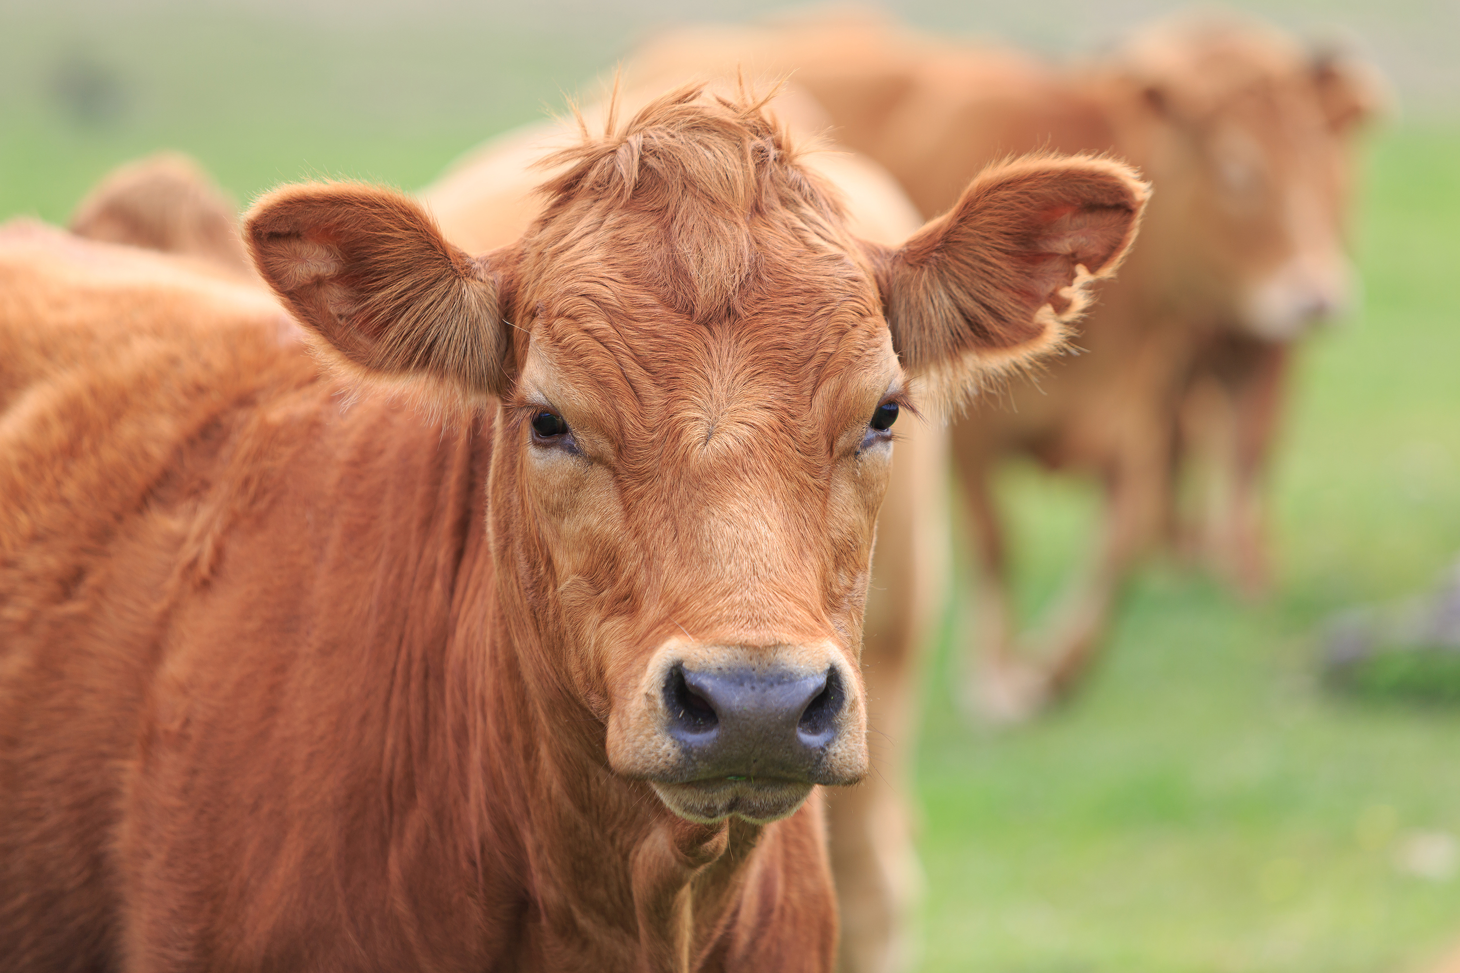
…conventional and non-conventional...
Substance consumed for sustenance –
For humans and animals
Includes –
Beverages
Chewing gum,
Dietary supplements, and
Ice
…regardless of state of readiness for consumption...
Week 1 – Topic
What is “food”…
13
Notes:
Slide #13A – What’s food?
Week 1 Topic –
Defining terms –
Defining food.
Food labeling is a highly litigated topic.
Pulling from the Food and Drug Administration, the Food Safety and Inspection Service, and the Model Food Code for descriptors, this term is not defined in a way that a lay person might expect.
The term is very nuanced when referring to conventional food and takes on a whole new meaning when referring to non-conventional foods (e.g., dietary supplements), which are included within the definition of food.
Dietary supplements are distinctly different from drugs although many marketers and social media influencers create a good deal of confusion and mischaracterization about the purported health benefits of dietary supplements and certain foods.
Food is consumed primarily for taste, aroma, or nutritive value for humans and animals, used for sustenance.
Food is any of the following:
Raw, cooked, or processed edible substances;
Ice;
Ingredients used or intended for use or for sale in whole or in part for human consumption;
Chewing gum; or
Beverages, including water.
Regarding beverages, “beer” may or may not be defined as a “food” depending on how it is made.
For certain beers not meeting the definition of the Federal Alcohol Administration Act (FAA Act) of a “malt beverage” (i.e., not containing malted barley and hops), their labeling is not regulated by the Alcohol and Tobacco Tax and Trade Bureau (TTB) – formerly known as the Bureau of Alcohol, Tobacco, and Firearms (ATF), which also regulates wine and sake (which, like malt beers, are not foods).
These “alternative” beers that are defined as food would be made with sorghum, rice, or wheat.
They are regulated by the Food and Drug Administration using names such as “beer made from rice” or “sorghum beer” and require all the labeling features required for food.
Note: For products such as beer and wine regulated by the Federal Alcohol Administration Act, statements of composition are required like for other foods but there are differences, probably contributing to concerns about the truthfulness of food labeling.
The following non-attributed statement was stated on the web —
“It’s so obvious to say, but without malt, you can’t make beer. In a world obsessed with hops and funky yeast strains, it’s easy to forget how crucial this ingredient is. Malt is to beer what honey is to mead; what apple is to cider. Without malt, you can’t make beer – January 3, 2023.” This, perhaps is a sentiment that is a hard truth to connoisseurs of beer; however, the U.S. government disagrees by allowing a qualifier with the term beer (e.g., rice beer). Again, I’m certain that some see such qualified labeling as an untruth.
The following considerations also are relevant as to discerning when a product is a food or not --
Vitamins and minerals present unique circumstances as to whether they are dietary supplements, which are regulated as food, or drugs due to toxicity concerns primarily of the fat-soluble vitamins (A and D).
These nutrients, at high doses, are classified as drugs.
Government approved health claims are permitted for foods without triggering drug status.
Generally, the following questions help in the assessment of “is it or is it not food” –
Is the product a commonsense food?
If not, is it consumed primarily for taste, aroma, or nutrition?
If the answer to both questions is no, then the product likely is not food.
An example of a product ordinarily considered a food but also could be classified as drugs due to its therapeutic claims –
Honey; vinegar and honey; tea; water; blue-green algae; and mussels.
For products intended to be processed into food, it makes no difference if the products require further roasting or processing prior to being made safe to consumption.
For example, green coffee beans and live cattle are food in their current form.
If products are no longer fit for food (e.g., decomposed), the product is still food although it is inedible.
There is danger that such product may be diverted to edible purposes inappropriately.
The intended use of the product is irrelevant to making a food determination since the product is a food prior to further processing.
Although the statutory language does not expressly address intended use of a food nor does any regulation clarify intended use, several litigated cases have resulted in the Courts adding intended use as a defining concept for food.
The focus on whether the product is food or drug centers on the primary purpose of the product.
Basically, does it act more as a food or more as a drug.
A drug affects the structure and function of the body of man or other animals and is not defined as food.
Drugs are used in the diagnosis, cure, mitigation, treatment, or prevention of disease in man or other animals.
Structure/function claims have historically been included on food labels, including dietary supplement labels.
Such claims describe the role of a nutrient intended to affect the normal operation of the human body –
For example, “calcium builds strong bones.”
They may characterize how a nutrient acts to maintain the body (e.g., “fiber maintains bowel regularity).”
Such claims are not pre-approved by the government.
Rather, a manufacturer intending to apply such a claim to a product label must state a “disclaimer” that the Food and Drug Administration has not evaluated the claim, as well as state that the dietary supplement product is not intended to “diagnose, treat, cure, or prevent any disease;”
The manufacturer must maintain documentation as to the truthfulness of the claim and why the claim is not misleading;
A notification of the text of the claim must be submitted to the Food and Drug Administration within 30 days after marketing the dietary supplement with the claim; and
If the Food and Drug Administration has significant concerns about the claim, then the manufacturer likely will hear from the government for further review.

Slide 14
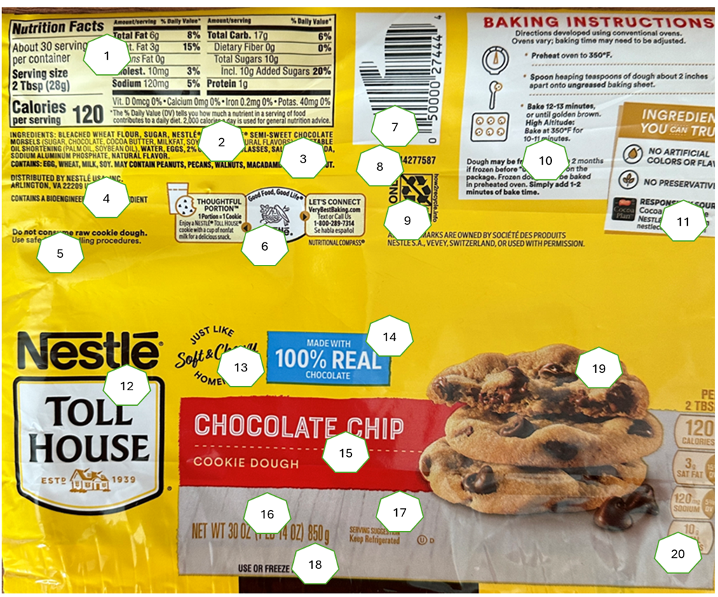
…it’s all of this...
Witten matter on the immediate container
At least in English in the U.S.
Week 1 – Topic
What’s a food label?
14
Notes:
Slide #14A – What’s a food label?
Week 1 Topic –
Food label --
The regulatory definition of label is a display of written, printed, or graphic matter on the immediate container of any article, or any such matter affixed to any consumer commodity or affixed to or appearing upon a package containing any consumer commodity. [21 CFR Part 201(k) – Labeling]
Further clarity on some of the key words includes –
Immediate container (which is synonymous with “package”) is a container in which a product is enclosed for the purpose of display and sale to household consumers.
In some cases, the immediate container is the shipping container.
The terms “article,” “consumer commodity,” and “product” are synonymous with “food” in the context of defining a food label.
The Toll House graphic, containing 20 identifiable features is the food label.
The “label” is the shipping container, as well.
The Food and Drug Administration (FDA) requires prior approval of a limited type of labels before product can be introduced into commerce (e.g., baby food). Otherwise, the manufacturer of the product is expected to meet the Agency’s policies. If product is believed to be non-complying by the agency, steps are taken by FDA (after seeking court approval) to remove product from commerce and the manufacturer is then required to make corrections.
Uniquely, the Food Safety and Inspection Service requires prior approval of all labels before product can be introduced into commerce.
For enforcement, whether for misbranding or adulteration, the following actions can be immediately taken without court intervention:
Approval for the label can be rescinded;
Product can be seized, condemned, or detained;
Product can be voluntarily recalled;
The manufacturer can be –
“Named and shamed” via a public press release, particularly if the establishment is poorly responsive;
Fined;
Subject to criminal prosecution; or
Have their establishment number withdrawn thereby not allowing production.

Slide 15
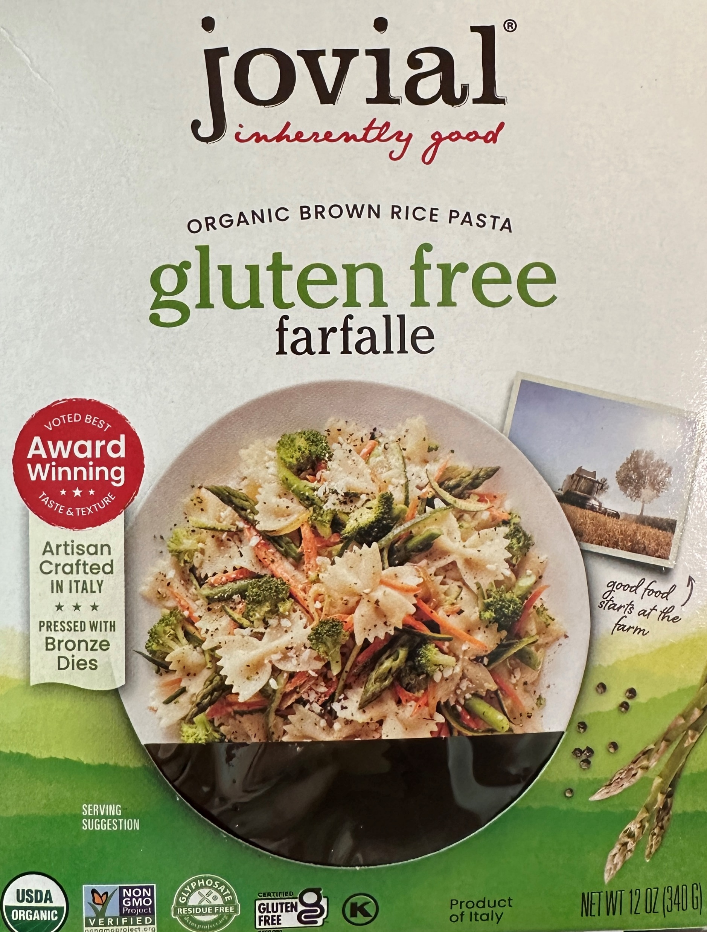
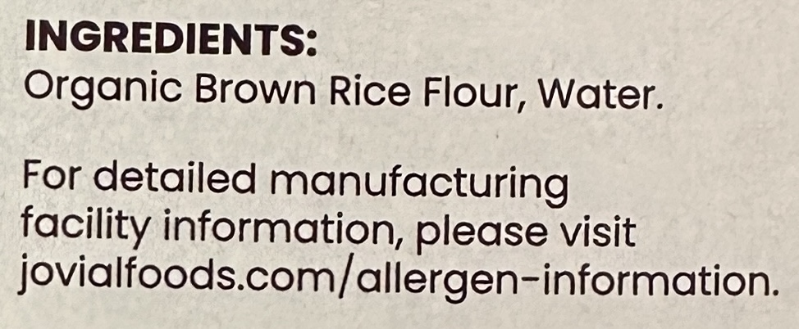
Also, all that is referred at a website, magazine, or radio ad
The Federal Trade Commission takes primary responsibility for addressing such misleading statements.
Go to our website …
Week 1 – Topic
What’s food labeling?
15
Notes:
Slide #15A – What’s food labeling?
Week 1 Topic –
Food labeling –
Although the label itself includes all form of written, printed, or graphic matters upon or accompanying the article, container, or wrapper, food labeling is a bit broader.
It includes things like bills of lading, shelf tags, brochures, flyers, booklets, motion picture films, film strips, sound recordings, and similar pieces of printed, audio, visual matter, or information disseminated over the Internet by (or on behalf of) a regulated company that accompany or are associated with a food.
Note that the Federal Trade Commission (FTC) is the primary responsible Federal agency with authority to discern improper advertising and marketing materials that mislead consumers about a product.
Both the Food and Drug Administration (FDA) and the U. S. Department of Agriculture (USDA) Food Safety and Inspection Service (FSIS) jointly work with the FTC on labeling beyond what is on the product label.
Labeling law and associated regulation policy do not directly require or prohibit certain practices.
Rather, the policy specifies certain labeling practices or lapses in labeling that would render the product misbranded.
Regarding preemption, the labeling laws generally explicitly preempt States from requiring different labeling than that required by the FDA and USDA FSIS.

Slide 16
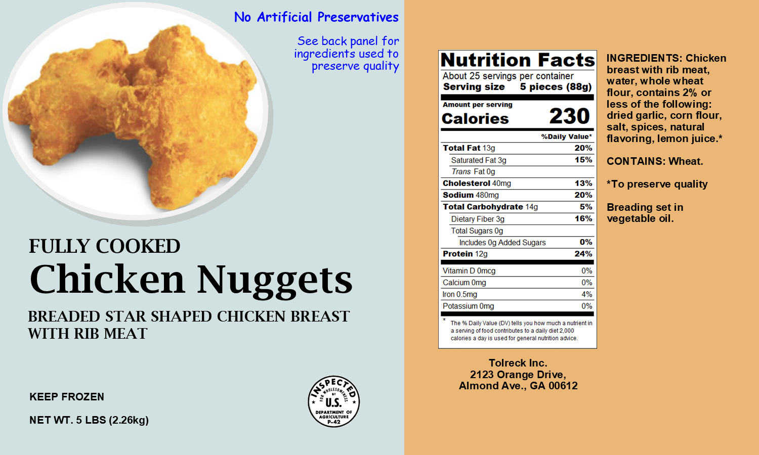
…any of the information could be misleading if not understood...
Protect the economic expectations of consumer and manufacturer
Affirmative requirements
Identity
Quantity
Ingredients (if two or more);
Nutrition labeling;
Responsible party; and
Handling statements
Prohibitive requirements –
Protect against deception
Week 1 – Topic
Label’s purpose
16
Notes:
Slide #16A – Food label’s purpose --
Week 1 Topic –
Food label/labeling purpose –
Is designed to protect the economic expectations of both the consumer and the industry.
Involves both affirmative and prohibitive requirements.
Affirmative requirements –
Require that food manufacturers provide information that they otherwise may not willingly provide.
The requirements provide consumers with information to make informed choices.
All statements encompassed by the label must be either on the outside of the container or wrapper of the retail package or be easily legible through the outside container or wrapper
The affirmative requirement for all food packages are:
Identity of the product’s name;
Quantity (net quantity in weight and, as appropriate, number of units);
Ingredients if fabricated from two or more components;
Nutrition labeling;
Responsible party (name and place of business of the product’s manufacturer, packer, or distributor);
Allergen identification;
Handling statement;
Inspection mark (if a product under the jurisdiction of the Food Safety and Inspection Service).
Prohibitive requirements –
Protect against fraud and deception and focuses mainly on false and misleading statements.
According to the Economic Research Service (ERS)* of the U.S. Department of Agriculture –
Food manufacturers provide much information about the attributes of their products (e.g., comparative prices and taste; convenience; and nutrition).
Labels can provide further information to consumers, increase demand for producers' brands, and promote the marketing of new attributes of products.
However,
If all labeling information was provided only voluntarily, some information that would be valuable to consumers might not be included.
Food suppliers might not offer much information about product attributes that consumers would view as negative, such as nutrition and health information linking consumption of a particular food with a risk of adverse health outcomes.
Food labeling is an area where the Federal Government uses regulatory mechanisms to give consumers more-informed choices where suppliers have no financial incentive to provide full and accurate information about their products.
By mandating disclosure of certain nutrients on the food label, the Federal government increases consumers' access to this information.
Such labeling may help consumers make food selections that better reflect their preferences or encourage them to choose more nutritious foods.
Or it may lead suppliers to reformulate food products to include more healthful attributes.
However, mandated labels can still be misleading –
Consumers may not fully understand label claims, and instead of improving societal outcomes, labels may increase inefficiency in the marketplace.
Questions linger about what information should be provided and who should provide it (public or private sector) so that information helps solve the coordination problem of matching diverse food demands with food supplies.
*Note: ERS studies whether consumers have enough information to make informed food choices, what the private sector can do to provide informative food labels, what role the public sector can play in providing information, and the costs and benefits of mandatory labeling in the food-at-home and food-away-from-home sectors).

Slide 17
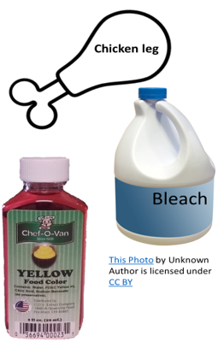
Adverse action against product
Either unintentional or intentional; can be fraud or food terrorism
Is adulterated if --
Injurious substance added (quantity matters)
Animal given harmful additive
Plant exposed to pesticide
Unsafe additive added
Is decomposed
Held under insanitary conditions
Died otherwise than by slaughter
Container is harmful
Valuable constituent omitted/substituted
Week 1 – Topic
What’s adulteration?
17
Notes:
Slide #17A – What’s adulteration?
Week 1 Topic –
Adulteration –
In the most basic form, adulteration means harmful or likely to cause harm.
There are at least eleven circumstances in which product is deemed adulterated.
Product can be unintentionally adulterated or intentionally adulterated.
A food product becomes adulterated if any of the following conditions exist —
If it bears or contains any poisonous or deleterious substance which may render it injurious to health; but in case the substance is not an added substance, such article shall not be considered adulterated under this clause if the quantity of such substance does not ordinarily render it injurious to health;
If it bears or contains (by reason of administration of any substance to the live animal or otherwise) any added poisonous or added deleterious substance other than one which is a pesticide chemical in or on a raw agricultural commodity, a food additive, or color additive which may make such article unfit for human food;
If it is, in whole or in part, a raw agricultural commodity and such commodity bears or contains a pesticide chemical which is unsafe;
If it bears or contains any food additive which is unsafe;
If it consists in whole or in part of any filthy, putrid, or decomposed substances or is for any other reason unsound, unhealthful, unwholesome, or otherwise unfit for human food;
If it has been prepared, packed, or held under insanitary conditions whereby it may have become contaminated with filth, or whereby it may have been rendered injurious to health;
If it is a product of an animal which has died otherwise than by slaughter;
If the container is composed of a poisonous or deleterious substance;
If it was intentionally subjected to radiation that does not conform to regulation;
If a valuable constituent has been omitted or abstracted, or a substance has been substituted; or
If is margarine containing animal fat that is filthy, putrid, or decomposed.
A second type of adulteration is economic adulteration (i.e., food fraud).
This occurs when someone intentionally leaves out, takes out, or substitutes a valuable ingredient or part of a food.
It also occurs when someone adds a substance to a food to make it appear better or of greater value.
Food fraud occurs routinely in the food industry due, in part, to the potential profits that could occur and oftentimes does not get detected because there are no illnesses or deaths.
A third type of adulteration is intentional adulteration (i.e., food terrorism).
This type of adulteration occurs when food products are intentionally adulterated by biological, chemical, physical, or radiological agents for the purpose of causing harm and chaos.
Food terrorism oftentimes is identified by the entities that want to cause harm and, thus, the impact is minimized if addressed before impacting consumer health.

Slide 18
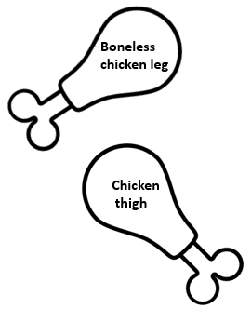
A misleading labeling action
Either missing or incorrectly applied; if intentional, then also likely adulterated
If –
Not what it purports to be; sold as another food
Imitation of another food and not noted
A false quantity of contents
Required information missing (e.g., address)
Amount falls below the fill standard
Ingredients not by common/usual name
For special dietary claim, dietary properties not listed
Handling condition not stated
Artificial flavorings, colorings, or preservatives not listed
Week 1 – Topic
What’s misbranding?
18
Notes:
Slide #18A – What’s misbranding?
Week 1 Topic –
Misbranding –
In the most basic form, misbranding means misleading.
However, there are at least fourteen definitive ways in which misbranding is evidenced for food.
A food product becomes misbranded if the food product has any of the following affirmative labeling requirements missing or incorrectly applied or formulated —
Is not what it purports to be;
Has labeling that is false or misleading;
Is offered for sale under the name of another food;
Is an imitation of another food;
Has a container that is misleading;
Has a label that fails to show the name and place of business that produced the product;
Has a label that fails to contain an accurate statement of the quantity of the contents of the product;
When the label contains missing required information;
Has a label that purports that it was produced in a manner that follows a standard of identity, but the product does not conform to those standards;
When the amount in the container falls below the fill standard;
When ingredients are not represented on the label by the common and usual name of the ingredient
When there is a special dietary claims but does not list the corresponding dietary properties and information required on the label;
When artificial flavoring, coloring, or chemical preservatives are not listed on the label; or
When some type of handling for a wholesome condition is required to be maintained but the label fails to contain that information.
Scope of misbranding can be better explained in the following litigation example --
In Kordel v. United States (355 U.S. 345 (1948)),
This was a landmark case dealing with jurisdiction of labeling authority specific to misbranding. The case involved health foods (compounds of vitamins, mineral, and herbs) that were distributed with brochures and other literature. These health foods were deemed drugs by the Supreme Court because of the way the brochures and other literature purported the intended use of the product. Kordel then contended that the brochures and literature were not “labeling” and, therefore, not subject to misbranding. However, the Court found the petitioner’s argument to be without merit, stating that every labeling is in a sense an advertisement that performs the same function as it would if it were on the article, container, or wrapper. The Court also clarified that physical attachment or contiguity of the information is unnecessary.
Consequently, anything a manufacturer publishes about a product, whether advertisements on the web or in newsletters, is labeling. Oftentimes, it is this extraneous information, separate and apart from the product in the grocery store, that is the source of misleading information.

Slide 19
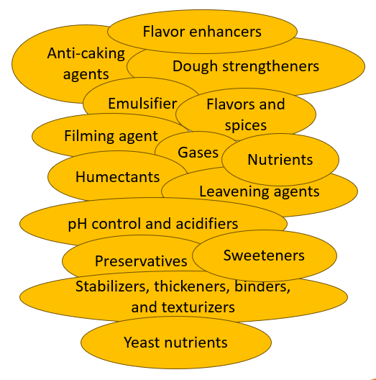
A substance affecting functional characteristics of a food
Improves edibleness
Improves safety
Increases shelf-life
Modifies sensory properties
Preserves nutritive value
…Categories...
Week 1 – Topic
What’s an additive?
19
Notes:
Slide #19A – General terminology – additive
Week 1 Topic –
Additive --
Any substance the intended use of which may reasonably be expected to result, either directly or indirectly, in the substance becoming a component or otherwise affecting the characteristics of any food.
Direct food additives are used in foods to impart specific technical and/or functional purposes (e.g., stabilizers to prevent separation of nutrients in fortified milk products).
Indirect food additives are not intentionally added to food, but they may be present in trace or incident amounts because of the production and packaging processes.
Such a substance is added to achieve a specific technical and/or functional purpose.
The addition, generally, is to processed foods (or other foods produced on an industrial scale).
The substance is intended to do any of the following:
Improve edibleness;
Improve safety;
Increase the amount of time a food can be stored (shelf-life);
Modify sensory properties of food; or
Preserve or increase the nutritive value of a food.
Categories of additives include:
Anti-caking agents;
Color additives;
Dough strengtheners and conditioners;
Emulsifiers;
Enzyme preparations;
Fat replacers;
Filming agents;
Flavors and spices;
Flavor enhancers;
Gases;
Humectants;
Leavening agents;
Nutrients;
pH control and acidulants;
Preservatives;
Stabilizers and thickeners, binders, and texturizers;
Sweeteners; and
Yeast nutrients.

Slide 20
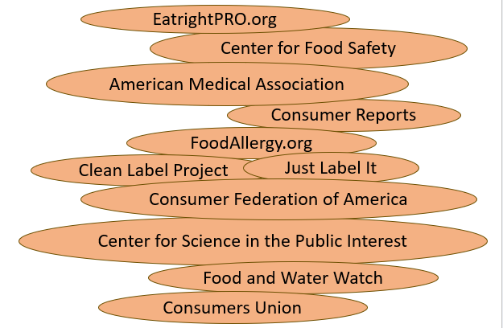
A person who is –
A member of the public
Takes possession of food
Not a food operator
Not selling food for resale
Advocacy organizations --
Have significant influence
Week 1 – Topic
What’s a consumer?
20
Notes:
Slide #20A – More general terminology -- consumer
Week 1 Topic –
Consumer –
A person who is a member of the public, takes possession of food, is not functioning in the capacity of an operator of a food establishment or food processing plant, and does not offer the food for resale.
Note that there are numerous consumer advocacy organizations representing large groups of individual consumers. The advocacy groups often have a presence at the table with policy- and lawmakers. Because the advocacy groups generally represent large numbers of individual consumers, the advocacy groups are perceived to have more influence than a lone consumer’s voice.
Example advocacy groups include:
American Medical Association,
Center for Food Safety,
Center for Science in the Public Interest,
Clean Label Project,
Consumer Federation of America,
Consumer Reports,
Consumers Union,
EatrightPRO.org,
Food and Water Watch,
FoodAllergy.org, and
Just Label It.

Slide 21
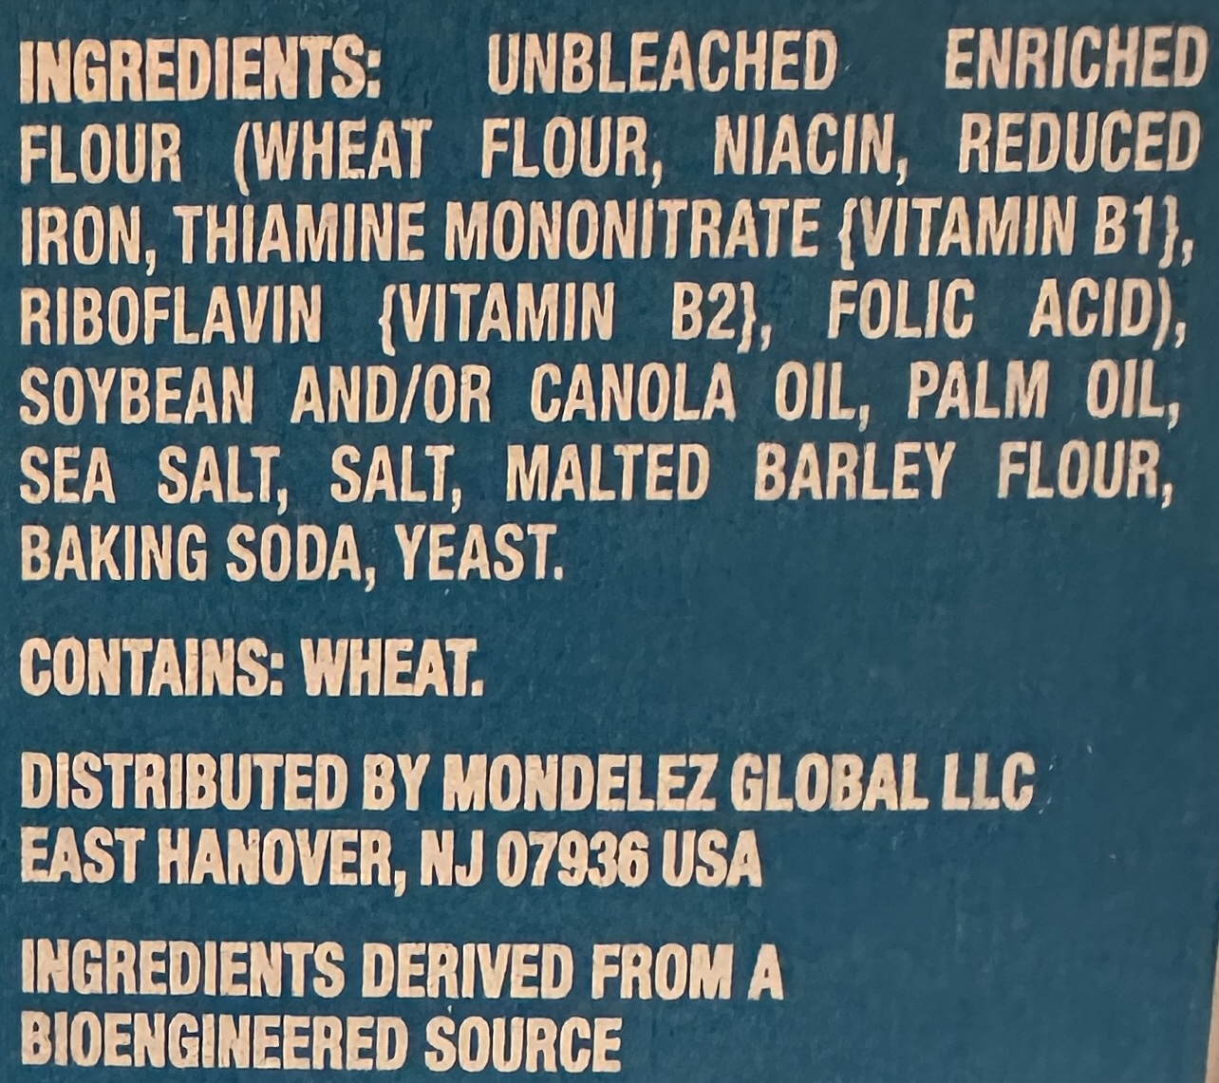
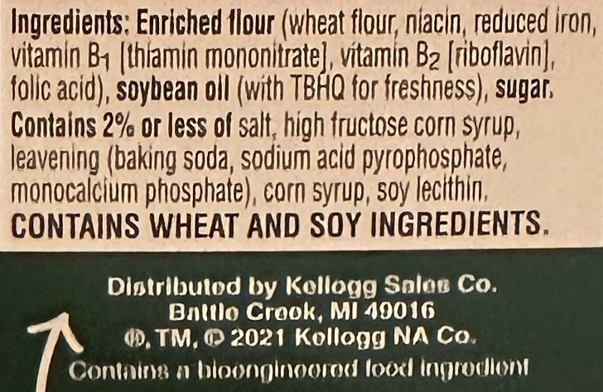
Ingredient –
Substance in food
Forms part of a mixture
Listed by weight (descending order)
Major allergens specially noted
Includes color additives and flavorings
Plus, about 50 other terms …
Saltine crackers
e.g., Yellow No. 5 must be declared – triggers allergic reaction
Club crackers
Week 1 – Topic
Even more general terminology
21
Notes:
Slide #21A – Even more general terminology definitions, including” ingredient”
Week 1 Topic –
Dietary supplement –
Any substance that is a vitamin, mineral, herb or other botanical (e.g., echinacea and ginger), botanical compound (e.g., caffeine and curcumin), amino acid (e.g., tryptophan and glutamine), substances used to increase dietary intake, and a biologic (not including an antibiotic such as probiotics that are live microbials).
Are different from conventional food because they are intended to add to or supplement the diet.
For example, they can help an individual meet daily requirements of essential nutrients beyond a well-balanced diet.
Although they are not labeled as drugs, they are perceived as a means to treat, diagnose, cure, or prevent disease.
They can help improve health but can also have health risks because many dietary supplements contain ingredients that have strong biological effects that may conflict with a medicine.
It is advisable to consult a health care professional to help decide if a supplement is right for you.
Some supplements can interact with medications, interfere with lab tests, or have dangerous effects during surgery.
They are ingested and come in many forms, including tablets, capsules, soft gels, gel caps, powders, bars, gummies, and liquids.
Drinking water —
Water that meets the criteria specified in the National Primary Drinking Water regulations.
It is traditionally known as potable water (as opposed to not potable water such as mop water, rainwater, wastewater, and non-drinking water).
Information panel –
Applies to food in packaged form and is the part of the label immediately contiguous and to the right of the principal display panel observed by an individual facing the principal display panel.
All information on the principal display panel or the information panel must appear prominently and conspicuously, but in no case may the letters and/or numbers be less than one-sixteenth inch in height (unless an exception is provided for).
All information appearing on the information panel must appear in one place without other intervening material.
Ingredient –
Any substance that is added to a food to achieve a desired effect, including an additive.
Such a substance forms parts of a mixture.
All ingredients are required to be listed in the ingredient statement for a food unless the ingredient is subject to an exemption (e.g., an incidental additive).
The listing in the ingredient statement is by descending order of predominance by weight, with the ingredients used in the greatest amount first, followed by those in smaller amounts.
The label must list the names of any certified color additives (e.g., FD&C Blue No. 1 or abbreviated as Blue 1), but some ingredients can be listed collectively without naming each if exempt from certification (i.e., “artificial colors,” artificial flavoring,” “flavors,” or “spices.”
For more specific information, see “Type of Food Ingredients – FDA.”
Ingredient declaration --
This feature is required on all foods that have more than one ingredient and includes all the ingredients in the recipe.
A one-component food would have the “one ingredient” identified in the product name.
Declaration allows consumers to identify allergens, avoid foods with certain ingredients they reject, and select foods with certain ingredients they prefer.
Ingredients must be listed by their common or usual names in decreasing order of their predominance by weight.
Foods with two or more discrete components may alternatively have a separate ingredient list for each of the components (decreasing order of predominance within the component listing, and the components must also be in decreasing order by weight).
Ingredient declaration exception -- color additives –
Those colors certified by the Food and Drug Administration for food (i.e., Yellow No. 5, Red No. 40, Red No. 3, Yellow No. 6, Blue No. 1, Blue No. 2, and Green No. 3 and their lakes – specifically formulated non soluble colors) must be declared on all foods except butter, cheese, and ice cream.
Yellow No. 5 must always be declared for all foods because it triggers allergic reactions in some people.
Colors exempt from Food and Drug Administration certification (i.e., caramel, paprika, and beet juice) do not have to be specifically identified but can be listed simply as “artificial colors.”
The functional purpose of added coloring must always be declared (e.g., “___color” or “colored with ___”).
Ingredient declaration exception -- percent (%) ingredient labeling –
When a certain ingredient is a characterizing component in a food and the proportion of that ingredient has a material bearing on the price (e.g., shrimp in shrimp cocktail), the percent of that ingredient must be part of the common or usual name of the food (e.g., “shrimp cocktail contains 45 % shrimp”).
Voluntary use of percent labeling must be by weight rather than volume to avoid inconsistent calculations, expressed to the nearest 1 %, in parentheses following the name of the ingredient.
Ingredient declaration exception -- spices and flavors –
May be listed generically, without naming the specific source, except that any artificial colors or artificial flavors must be identified as artificial.
Flavor enhancers are not exempt from individual declaration (can’t be generically stated) and must be declared individually in the ingredient statement (e.g., MSG).
Includes —
Protein hydrolysates (hydrolyzed proteins broken down by acid or enzymes into amino acids) and may serve as leavening agents, stabilizers, thickeners).
Caseinate — For foods that claim to be nondairy (coffee whitener), the caseinate must be labeled as a milk derivative in the ingredient statement (and as part of the allergen labeling for the Food Allergen Labeling and Consumer Protection Act – FALCPA
Incidental additives and processing aids —
Present in food at insignificant levels and have no technical or functional effect in that food, and are not required to be listed in the ingredient statement
Defined only for sulfiting agents, which is less than 10 ppm (10 mg/Kg) in the finished food (scientifically established that there is no technical and functional effect at this level, and that a sensitive person would not have an allergic reaction).
Net quantity –
Food in a package must bear a label with an accurate statement of the quantity of the contents in terms of weight, measure, or numerical count. This helps consumers in two ways. It allows them to know how much food is in the container and aids in price comparison.
“Net” refers to the quantity of edible food in a package or container. It excludes any liquid or juice in which the food may be packed unless the liquid is usually consumed as part of the food. It also excludes the weight of the container or wrapper.
The net statement must appear on the principle display panel in terms of the customary inch/pound system of measure and, with a law change in 1994, also in the SI metric system. In addition, the statement must appear in lines generally parallel to the base of the package when displayed for sale. If the area of the principle display panel is larger than five square inches, the statement must appear within the lower 30 % of the label panel. The statement must appear in conspicuous and easily legible boldface print or type in distinct contrast to other matter on the package. Random weight packages, where each package weight is different, need not include a metric weight. Items packaged at a retail store need not include a metric weight.
Moisture loss/gain in packaged product does occur (e.g., dry products packed in a humid climate and then stored in a dry climate). Thus, reasonable variations are tolerated. The specifics of when reasonable becomes unreasonable are determined using the approaches taken by the National Conference on Weights and Measures and the National Institute of Standards and Technology (NIST, previously the Bureau of Standards).
Nutrient content claim variation — expressed nutrient —
Any direct statement about the level (or range) of a nutrient in the food (e.g., “low sodium” or “contains….”. Generally, terms such as “free,” “high,” or “low” are used. However, terms may be used to compare the level of a nutrient in a food to that of another food (i.e., “more,” reduced,” and “lite.” Most use of such claims apply only to those nutrients that have an established Daily Value.
Nutrient content claim variation — implied —
Claims about a food or ingredient or method of preparation that suggests that the nutrient or ingredient are absent or present in a certain amount or claims about a food that suggests a food may be useful in maintaining healthy dietary practices and which are made with an explicit claim (e.g., “healthy, contains X grams of fat”).
The term “healthy” and related terms can be used if the food (i.e., individual food, seafood/game meat, or meal/main dish) meets specific regulatory requirements (e.g., total fat, saturated fat, sodium, cholesterol, beneficial nutrients, and fortification). Beneficial nutrients included those containing a certain percentage of the Reference Amount Customarily Consumed per Eating Occasion or RACC for vitamins A, C, calcium, iron, protein, or fiber. There are exceptions for raw fruits and vegetables or single ingredient or mixture of frozen or canned fruits and vegetables and enriched cereal grain products. [See Appendix B: Additional Requirements for Nutrient Content Claims — in “A Food Labeling Guide – Guidance to Industry” by FDA.]
There are health claims made in labeling already supported and incorporated into regulation and that allow model claim statements (e.g., “development of cancer depends on many factors. A diet low in total fat may reduce the risk of some cancers), including: Calcium and osteoporosis and calcium, vitamin D, and osteoporosis; dietary fat and cancer; sodium and hypertension; dietary saturated fat and cholesterol and risk of coronary heart disease; fiber-containing grain products, fruits, and vegetables and cancer; fruits, vegetables, and grain products that contain fiber, particularly soluble fiber, and risk of coronary heart disease; fruits and vegetables and cancer; folate and neural tube defects; dietary non-cariogenic carbohydrate sweeteners and dental caries; soluble fiber from certain foods and risk of coronary heart disease; soy protein and risk of coronary heart disease; and plant sterol/stanol esters and risk of coronary heart disease. [See Appendix C: Health Claims — in “A Food Labeling Guide – Guidance to Industry” by FDA.]
Additional health claims authorized based on an authoritative statement by Federal scientific bodies include: Whole grain foods and risk of heart disease and certain cancers; whole grain foods with moderate fat content and risk of heart disease; potassium and the risk of high blood pressure and stroke; fluoridated water and reduced risk of dental caries; saturated fat, cholesterol, and trans fat, and reduced risk of heart disease; and substitution of saturated fat in the diet with unsaturated fatty acids and reduced risk of heart disease. [See Appendix C: Health Claims — in “A Food Labeling Guide – Guidance to Industry” by FDA.]
Nutrient content claim variation — qualified health claims —
Claims meet the general regulatory requirements except for meeting the significant scientific agreement standard. Such claims have a mandatory disclaimer for consideration in use of enforcement discretion in removing product from commerce that is placed immediately adjacent to and directly beneath the claim with no intervening material, in the same size, typeface, and contrast as the claim. Examples of the disclaimer statement include: “FDA does not endorse this claim…,” “FDA evaluated the above claim,” “some scientific evidence suggests…,” “evidence is limited and not conclusive…,” “very limited and preliminary scientific research….” The qualified health claim list is quite extensive. [See Appendix C: Health Claims — in “A Food Labeling Guide – Guidance to Industry” by FDA.]
Principle display panel (PDP) –
Applies to food in packaged form and is the part of a label that is most likely to be displayed, presented, shown, or examined under customary conditions of display for retail sale.
Must be large enough to accommodate all the mandatory label information required to be placed thereon, with clarity and conspicuousness and without obscuring design, vignettes, or crowding.
The Statement of identify must appear on the principle display panel. It must be prominent (printed and arranged with prominence and conspicuousness, rendering it likely to be read and understood by the average consumer). It must be in bold print/type. The type size must be reasonably related to the most prominent printed matter on the front panel and should be one of the most prominent features on the principle display panel. Generally, this is interpreted to be one-half the size of the largest print on the label. Also, it must be in lines generally parallel to the base of the package as it is displayed.
Standardized foods –
A set of recipes and naming requirements for a food product listed by regulation. The complete name in the standard of identity must be used, including the common or usual name plus any additional terms required to be declared.
For example:
“Sweet corn” is not a complete identification. It must be identified, at a minimum, as “whole kernel sweet corn” or “whole kernel corn.” The declared name must be either “corn,” “sweet corn,” or “sugar corn.” The style must be declared as either whole kernel or cream style. The color type must be declared if other than yellow (i.e., “white” if white corn). In addition, the words “vacuum pack” or “vacuum packed” must be included, if applicable.
In another example, the Court has ruled against the Food Safety and Inspection Service and allows for a frankfurter to be labeled as “all meat” even though standard of identify allows up to 15 % binders, corn syrup, spice, and curing agents. This is because the “recipe” requires these other ingredients to be present. If a different mixture of meat is used, then the species of the different meats must be included in the ingredient statement but not necessarily in the product name.
For the Food and Drug Administration, there are at least 21 categories of products listed in 21 C.F.R, Chapter 1, Subchapter B, Parts 131-169, with variations within each, as follows: Bakery products; beverages; cacao products; canned fruits; canned fruit juices; canned vegetables; cereal flours and related products; cheeses and related cheese products; eggs and egg products; fish and shellfish; food dressings and flavorings; frozen desserts; frozen vegetables; fruit butters, jellies, preserves, and related products; fruit pies; margarine; milk and cream; macaroni and noodle products; sweeteners and table sirups; and tree nuts and peanut products; vegetable juices;
For the Food Safety and Inspection Service, there are at least 20 categories of products listed in 9 C.F.R., Chapter III, Part 319 with variations within each, as follows: Canned, frozen, or dehydrated meat food products; cooked meats; cooked sausage; cured meats, unsmoked and smoked; dietetic meat foods; dry fermented sausage; fats, oils, shortenings; general, including labeling and preparation of standardized products, products and nitrates and nitrites, mechanically separated (species), and limitations with respect to use of mechanically separated species; luncheon meat, loaves and jellied products; meat baby foods; meat food entrée products, pies, and turnovers; meat salads and meat spreads; meat snacks, hors d’oeuvres, pizza, and specialty items; meat soups, soup mixes, broths, stocks, extracts; meat specialties, puddings, and nonspecific loaves; miscellaneous; raw meat products; sausage generally – fresh sausage; semi-dry fermented sausage; and uncooked, smoked sausage. There are at least 20 categories of products listed in 9 C.F.R., Chapter III, Subpart P, 381 with variations within each, as follows: breaded products; canned boned poultry and baby or geriatric food; definition and standard for “turkey ham”; general; (kind) barbecued; (kind) barbecued prepared with moist heat; (kind) baked or (kind) roasted; (kind) burgers, (kind) patties; (kind) a la kiev; (kind) steak or fillet; limitations with respect to use of mechanically separated (kind of poultry); maximum percent of skin in certain poultry products; mechanically separated (kind of poultry); other poultry dishes and specialty items; poultry dinners (frozen) and pies; poultry meat content standards for certain poultry products; poultry rolls; requirements for substitute standardized poultry products named by use of an expressed nutrient content claim and a standardized term; and standards for kinds and classes, and for cuts of raw poultry.
Statement of Identity –
This is the legally required name of the food.
If the name of a food mentions ingredients, the ingredients must be listed in order of predominance in the name of the food (e.g., “apple-strawberry pie”).
The form of the food must be described unless the form is visible through the container or is depicted in an appropriate vignette (e.g., whole, sliced, or diced).
Statement of identity variation — brand name —
If the nature of the food is obvious and understood by the public, then a brand name (e.g., Pepsi Cola, Coca Cola) can be used.
Statement of identity variation -- common or usual name –
If there is no standard of identity, the common or usual name must be used.
See also “percent ingredient labeling” for additional requirements.
Statement of identity variation -- descriptive phrase for name –
If there is no common or usual name, a descriptive phrase must be used. The descriptor must include, in simple and as direct terms as possible, the basic nature of the food or its characterizing ingredients or properties (e.g., “chocolate-flavored caramel corn” but not “praline cruncher”).
Statement of identity variation -- fanciful name –
If the nature of the food is obvious and understood by the public, then a fanciful name (e.g., “submarine sandwich” for a large sandwich made with a small loaf of bread and containing lettuce, condiments, and a variety of meats and cheeses) can be used.
Statement of identity variation -- imitation food name –
This is any product that resembles and substitutes for a traditional food and contains less nutritional value than the traditional food (e.g., for protein or a lesser amount of any essential vitamin). Such a food must be labeled in type of uniform size and prominence with the word “imitation” immediately followed by the name of the food imitated.
If artificially flavored components are used, these components must be part of the product name and be not less than one-half the size of the name of the food.
If a beverage purport to contain juice, then the total percentage of juice must be declared on the information panel. If a multi-juice beverage states one or more – but not all – juices are present and the predominant juice is in minor amounts, the product’s name must state that the beverage is flavored with that juice or declare the amount of the juice in a 5 % range (e.g., “raspberry-flavored juice blend” or “juice blend, 2-7 % raspberry juice”).
Water —
The Food and Drug Administration regulates bottled water whereas the Environmental Protection Agency regulates public drinking water and tap water. The standard of identify regulations define different types of bottled water (e.g., Artesian well water that is collected from a well that taps an aquifer that is under pressure from surrounding upper layers of rock or clay; mineral water that is from an underground source and contains at least 250 parts per million total dissolved solids; spring water that comes from an underground formation from which water flows naturally to the surface and for which the water must be collected only at the spring or through a borehole that taps the underground formation feeding the spring; and well water that come from a hole bored or drilled into the ground, which taps into an aquifer). Bottled water may be used as an ingredient in beverages (e.g., diluted juices or flavored bottled waters). However, the bottled water standard does not apply to beverages, which are addressed as soft drinks (e.g., “sparkling water,” seltzer water,” “soda water,” “tonic water,” or “club soda”). Further, some bottled water may come from municipal sources that then undergo water treatments (e.g., distillation; reverse osmosis; absolute 1 micron filtration; or ozonation) and can be labeled as “purified water.”

