Slide 1
Overview
Labeling authorities –
International labeling issues –
Labeling specific --
U.S.
International
State and local
Week 2 – Topics
Responsibilities and policies
1
Notes:
Slide #1B (in “Red Violet” coloring; 3-4-24) – Overview – U.S. government…responsibilities and policies
Week 2 Topics –
Federal, State, and local level (e.g., setting standards of identity and structure/function claims);
International food labeling issues; and
Ingredients and their uses.

Slide 2
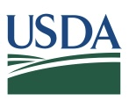
Competent authority
USDA FSIS
Meat, poultry, and processed egg products
FDA
All foods other than those by FSIS
4 core statutes:
FFD&CA -- FDA
FMIA -- USDA
PPIA -- USDA
EPIA – FDA & USDA
Who is responsible for labeling…
Week 2 – Topic
2
Notes:
Slide #2B – U.S. government labeling responsibilities…Federal…who is responsible for labeling?….
Week 2 Topic –
At the highest level of responsibility (i.e., Federal), the primary “competent authority” in the U.S. (i.e., the international designation for the senior-most entity with the authority to make day-to-day decisions about a country’s food safety system) is shared by the Food and Drug Administration (FDA) at the U. S. Department of Health and Human Services (DHHS) and the Food Safety and Inspection Service (FSIS) at the U. S. Department of Agriculture (USDA).
The FDA is the competent authority for all foods other than those regulated by the USDA FSIS.
The USDA FSIS is the competent authority for all meat, poultry, and processed egg products.
Although the Government Accountability Office (GAO) identifies 15 Federal agencies administering approximately 30 laws related to food, there are four core statutes.
One designates sole jurisdiction to the FDA (i.e., Federal Food, Drug, and Cosmetic Act – FFD&CA).
Two designate sole jurisdiction to the USDA FSIS (i.e., Federal Meat Inspection Act – FMIA and Poultry Products Inspection Ac -- PPIA).
One designates dual jurisdiction to both the FDA and USDA FSIS (i.e., Egg Products Inspection Act -- EPIA).
NOTE: For the Egg Products Inspection Act, the FDA has jurisdiction over shell eggs (or “table eggs”) whereas the USDA FSIS has jurisdiction over liquid, frozen, or dried processed egg products (i.e., the content of the shell eggs once removed from the shell and combined for further processing into a processed egg product of which such product can only be sold in a pasteurized – ready-to-eat – condition).

Slide 3
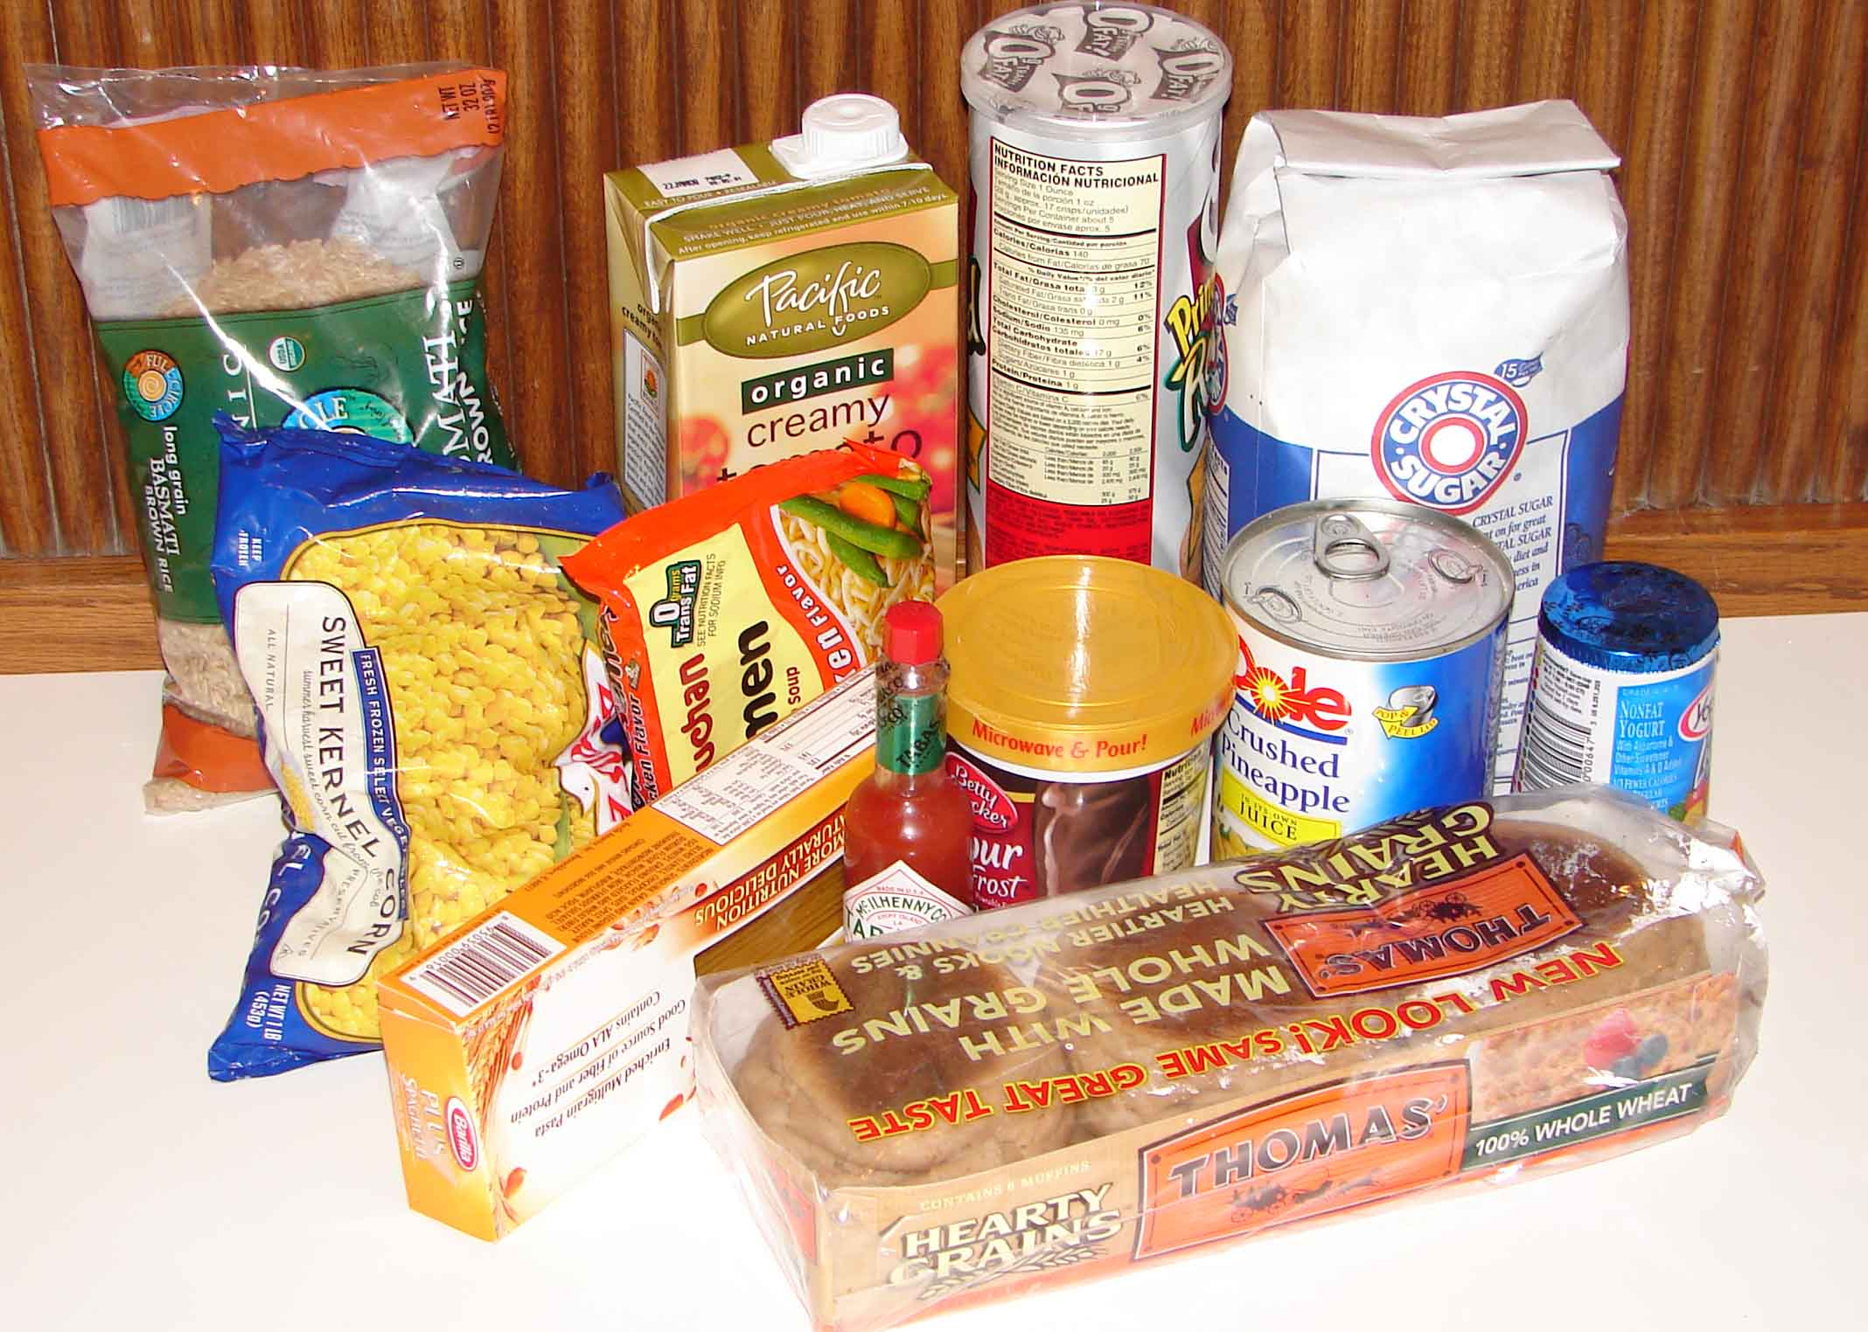
Annual budget - $6.5 billion
18,000 employees
270,000 facilities (half overseas)
Audit-based compliance
Paper trail unless high-risk (i.e., deaths)
In-plant up to once each 3 years if no problems
Stiff enforcement
Fines
This Photo by Unknown Author is licensed under CC BY-SA
All foods but USDA foods
Resources…
Week 2 – Topic
3
Notes:
Slide #3B – U.S. government labeling responsibilities…FDA resources…
Week 2 Topic –
As with all Federal agencies, the FDA maintains its regulations in the form of administrative rules, captured in the Code of Federal Regulations (CFR).
For the Federal Food, Drug, and Cosmetic Act (FFD&CA), this would be 21 United States Code (U.S.C.) 301 et. seq., 21 CFR
For the Egg Products Inspection Act (EPIA), this would be 21 U.S.C. 1031 et. seq., 9 CFR.
For the Public Health Service Act (PHSA), this would be found at 42 U.S.C. 201 et. seq., 42 CFR.
Safeguards more than $1.5 trillion worth of food, cosmetics, and dietary supplements with a budget of $6.5 billion (2022), 18,000 employees (2022), at 270,000 registered facilities of which nearly half are overseas

Slide 4
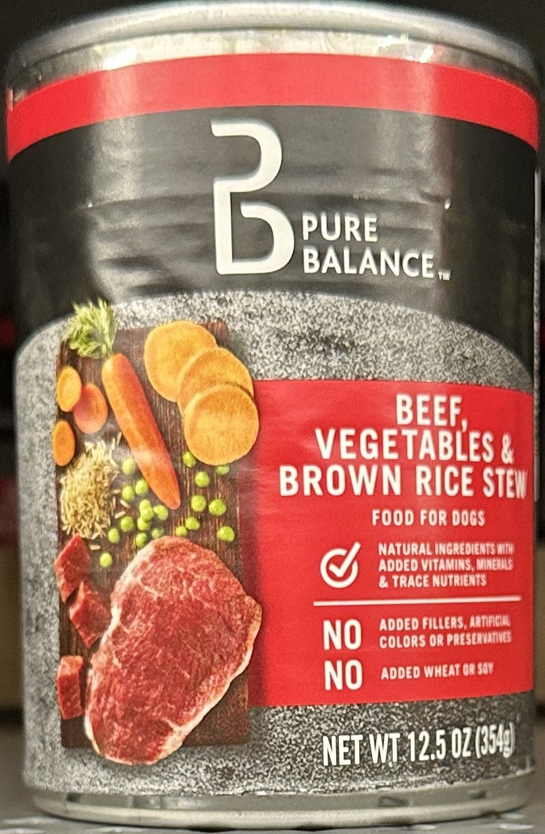
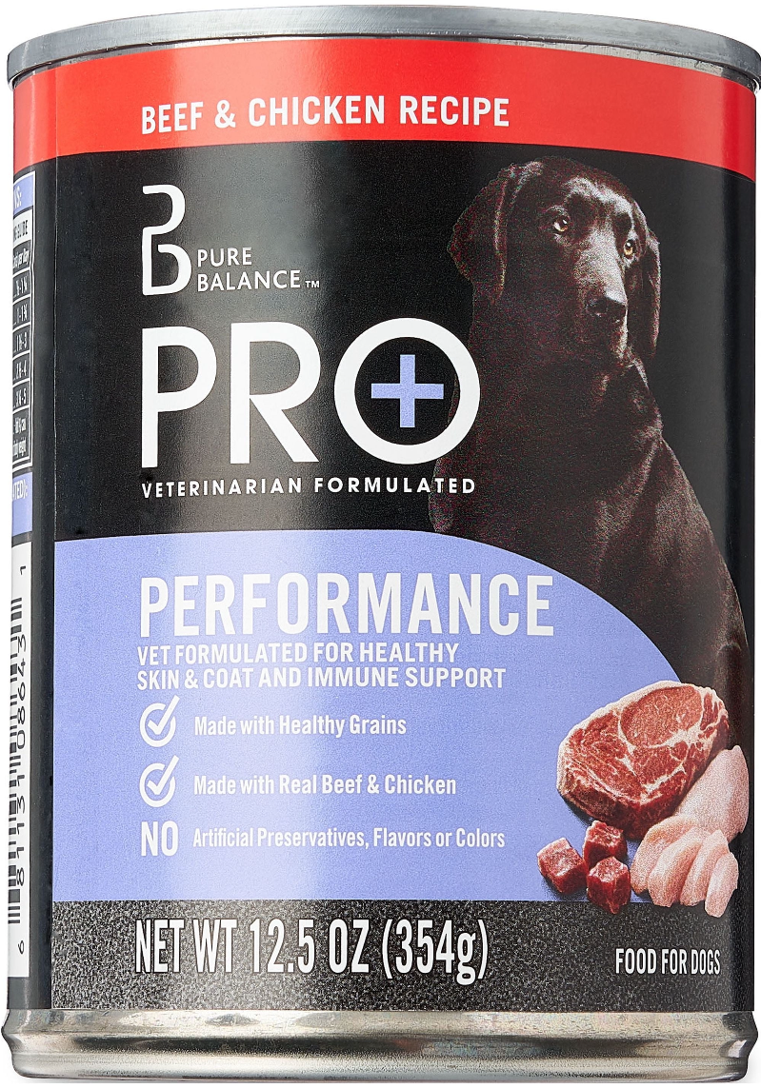
Is the left more misleading than the right?
Also, pet food
Two differences from human food –
Edible by-product
Additives specific for pets
Less cost than human food
No prior-approval of labels
For human or pet foods
Action taken after in commerce; warning letters to “shame”
Pet food…
Week 2 – Topic
4
Notes:
Slide #4B – U.S. government labeling responsibilities…FDA -- pet food…
Week 2 Topic –
The agency encompasses --
Foods program –
Center for Food Safety and Applied Nutrition (CFSAN).
Houses the office and staff responsible for labeling policy.
Field programs –
Office of Regulatory Affairs, and
Center for Veterinary Medicine
Plays a role in animal feed and veterinary drug safety for animals, including those destined for human consumption.
Approves and regulates new animal drugs and monitors their proper use.
Tolerances are established for veterinary drugs, along with action levels that are established for food additives and environmental contaminants.
The same law associated with the labeling of human food is applicable to pet food.
One difference between human and pet food labeling is that for pet food, a Guaranteed Analysis (GA) must be provided on the product label. The Guaranteed Analysis provides product information about nutrients required for certain pets.
Pet food may also contain voluntary label claims made about the product. Pet food labeling is regulated at two levels. There must be proper identification of the product, net quantity statement, name, and place of business of the manufacturer or distributor, and proper listing of all the ingredients in the product from most to least, based on weight.
Pet food containing animal by-product must use edible source material.
Note that these edible materials consist largely of slaughterhouse waste (e.g., skin, bones, horn and hooves, blood, fat, and offal) that would not be used in human food manufacturing.
The Federal government does recognize that humans do eat pet food, which oftentimes is a less expensive protein source for humans.
Although the additives used are not unsafe for humans, most pet foods are unappetizing and contain nutrient profiles specific to the needs of pets and are, thus, not recommended for long term consumption by humans.
As with human food, there generally is no prior-approval of labels for pet food unless specific claims are made on the label before the product is placed in commerce.
[Pic of canned “natural ingredient” dog food] -- As we move forward in this course, we will begin to focus more on examples of misleading labeling. However, today, I am showing a label I recently took while grocery shopping. I was struck by how appetizing the picture on the label looked. If you are a meat and “natural” food lover, doesn’t the picture on the label look appealing? Would you be inclined to purchase this canned item if it was lying in a discount bin loaded with a variety of canned food items? Upon closer look, in very fine print do you see that this is a can of dog food? Of even more concern, this canned dog food item was less expensive than a comparable beef stew canned human food item. The very small print signifying that this is “food for dogs” is hard to read and there isn’t a picture of a dog on the label similar to the other can.

Slide 5
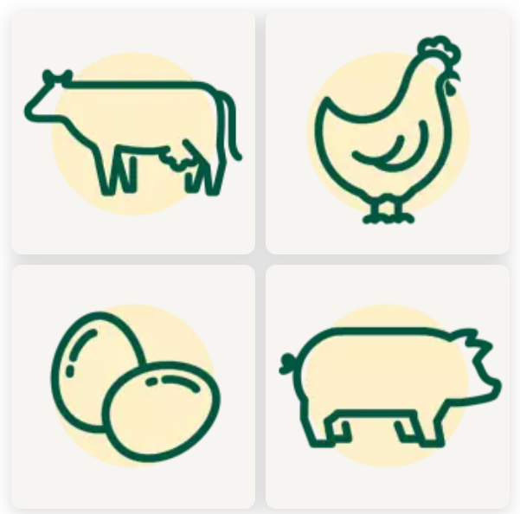
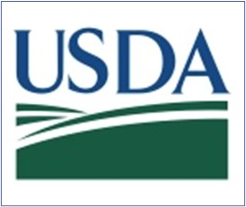
Annual budget -- $1.2 billion
8,600 employees
90 % are frontline
6,600 facilities (all in the U.S.)
Daily inspection
All animals inspected before/after slaughter; all eggs inspected
Prior-approval of all labels before marketed
Meat, poultry, and processed egg products
Resources…
Week 2 – Topic
5
Notes:
Slide #5B –U.S. government labeling responsibilities…USDA resources…
Week 2 Topic –
The USDA FSIS is one of 18 agencies within the USDA, with FSIS implementing the assigned food safety statutes (i.e., EPIA, FMIA, and PPIA) and associated food labeling policies.
The administrative rules implemented by the USDA FSIS are associated with meat, poultry, and processed egg products and are captured in a different set of the CFR than those of the FDA.
For the Egg Products Inspection Act, this would be 21 U.S.C. 1031 et. seq., 9 CFR.
For the Federal Meat Inspection Act, this would be 21 U.S.C. 601 et. seq., 9 CFR.
For the Poultry Products Inspection Act this would be 21 U.S.C. 451 et. seq., 9 CFR.
The EPIA applies to any product capable of use as human food made from the shell egg content from a chicken, duck, goose, and guinea.
Any egg product (shell egg or processed egg) from other sources would be under the jurisdiction of the Food and Drug Administration.
For the USDA FSIS processed egg products, you might be most familiar with whole eggs, egg white, or egg yolks in frozen/refrigerated liquid form or in dried forms, as well as liquid mixtures.
These egg products regulated by the USDA FSIS are pasteurized at inspected plants so that the resulting product is free of harmful pathogens when purchased at the grocery store.
Consequently, the products can be safely consumed without cooking.
The FMIA applies to any product capable of use as human food made from the carcass of cattle, equine, goats, sheep, siluriformes or catfish, and swine.
Even though horse meat is considered meat in the U.S., for at least the past decade, no horse meat can be sold for human consumption due in part to Congressional appropriation language that denies funding for slaughter inspection and, thus, creates a temporary ban.
The law allows for the slaughter of horses for human consumption, but uninspected product cannot be sold. Horse meat product is available for pet food. Note that horse meat is a delicacy in most other countries.
Regarding siluriformes, to ensure that such product is inspected prior to “slaughter,” In 2014, Congress designated this fish product within the Federal Meat Inspection Act’s definition of meat, thus requiring the product to be inspected and technically classified as “meat” for purposes of international trade.
By doing so, Asian countries that were overtaking the U.S. market for “catfish” now must have an inspection system equivalent to the U.S. for trading with the U.S.
Asian countries quickly implemented an inspection system and are exporting the product to the U.S. consumption.
“Meat” from sources other than the livestock species specified in the FMIA (e.g., deer, buffalo, rattlesnake) is referred to as “exotic species meat” and is under the jurisdiction of the Food and Drug Administration.
The PPIA applies to any product capable of use as human food made from the carcass of domesticated chickens, ducks, geese, guineas, ratites (i.e., ostrich), squab (i.e., pigeon), and turkeys.
“Poultry” from any other sources would be under the jurisdiction of the FDA.
Ensures that the commercial supply of these products is safe, wholesome, and correctly labeled.
Monitors domestic and imported products for safety against bacterial contamination, residues of pesticides, drugs, and other chemicals, and for truthful and accurate labeling.
Nearly 6,600 registered facilities (all within the U.S.) are regulated by the FSIS employing 8,600 employees, and has an operating budget of $1.2 billion.
Inspectors are assigned to be present in every inspected facility every day and every shift. The mark of inspection is placed on acceptable products prior to entry into commerce. If product is suspected of being adulterated, unwholesome, or incorrectly labeled, such product cannot enter commerce.
Unlike the FDA, the USDA FSIS conducts pre-market approval of all labeling.
For products in the U.S., labels can include some Spanish language, but certain information must always also be in English.
The assigned inspection legend must be present on all product in commerce, which includes the establishment number producing the product for sale.
Also, a safe handling instruction must be present on not-ready-to-eat product, as well as a “sell by date” or “use by date” or “for best quality date,” which is primarily for quality and not safety.
Baby food, for reasons of optimal nutritional quality, is one of the few foods requiring a “use by” date for a safety purposes.
Note: As part of the managerial process in food establishments, except for foods packaged in a reduced oxygen packaging method, food held for more than 24 hours must be clearly marked to indicate the date by which the food must be consumed on the premises, sold, or discarded when held at a temperature of 41 degrees Fahrenheit or less for a maximum of 7 days. The day of preparation is counted as Day 1. This managerial process does not apply to consumers or to the products they purchase.

Slide 6
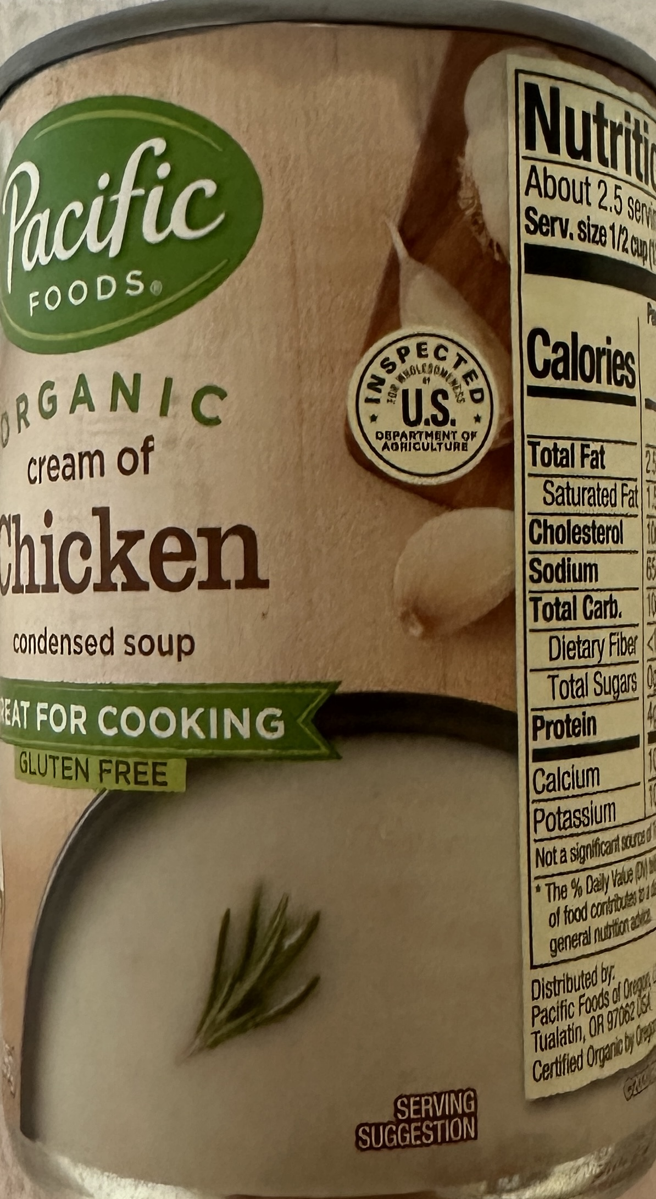
Mixed FDA and USDA product
Product under USDA jurisdiction with 2 % or more poultry, by weight
Note the “mark of inspection” shield
Inspection shield…
Week 2 – Topic
6
Notes:
Slide #6B – U.S. government labeling responsibilities…USDA inspection shield…
Week 2 Topics –
Jurisdictional clarification –
To ascertain whether the USDA FSIS or the FDA is the responsible agency for a food product, the decision resides either by statute or by the amount of animal-based component in the finished product.
If the food contains at least 2 % cooked (or 3 % raw) meat, poultry, or processed egg product or traditionally is viewed as a food product of the livestock, poultry, or egg industry, the food is regulated by the USDA FSIS.
Examples of USDA products containing both FDA and USDA ingredients –
Open-face sandwiches
Lunchables product kits
Caesar salad with broiled chicken, and
Pepperoni pizza
This jurisdictional issue is one that confuses consumers and frustrates the food industry.
For the consumer, there is uncertainty as to who is responsible in case there is an illness.
For industry, the frustration stems primarily from the type of inspection that is required. Specifically, that there is a government inspector in the facility every day of operation albeit at no cost to the facility for the daily inspection. There is increased opportunity for the inspector to find a problem and delay production schedules.
Also, operations must pay for overtime if the operation operates multiple shifts or works outside assigned work hours.
With USDA FSIS, problems are caught every day and product does not enter commerce until corrected.
With the FDA approach, a problem in commerce must be identified (almost exclusively by the consumer) and then affected product must be removed or destroyed.
From my perspective, I don’t have any sympathy for the industry issues and their fear of getting “caught.”

Slide 7
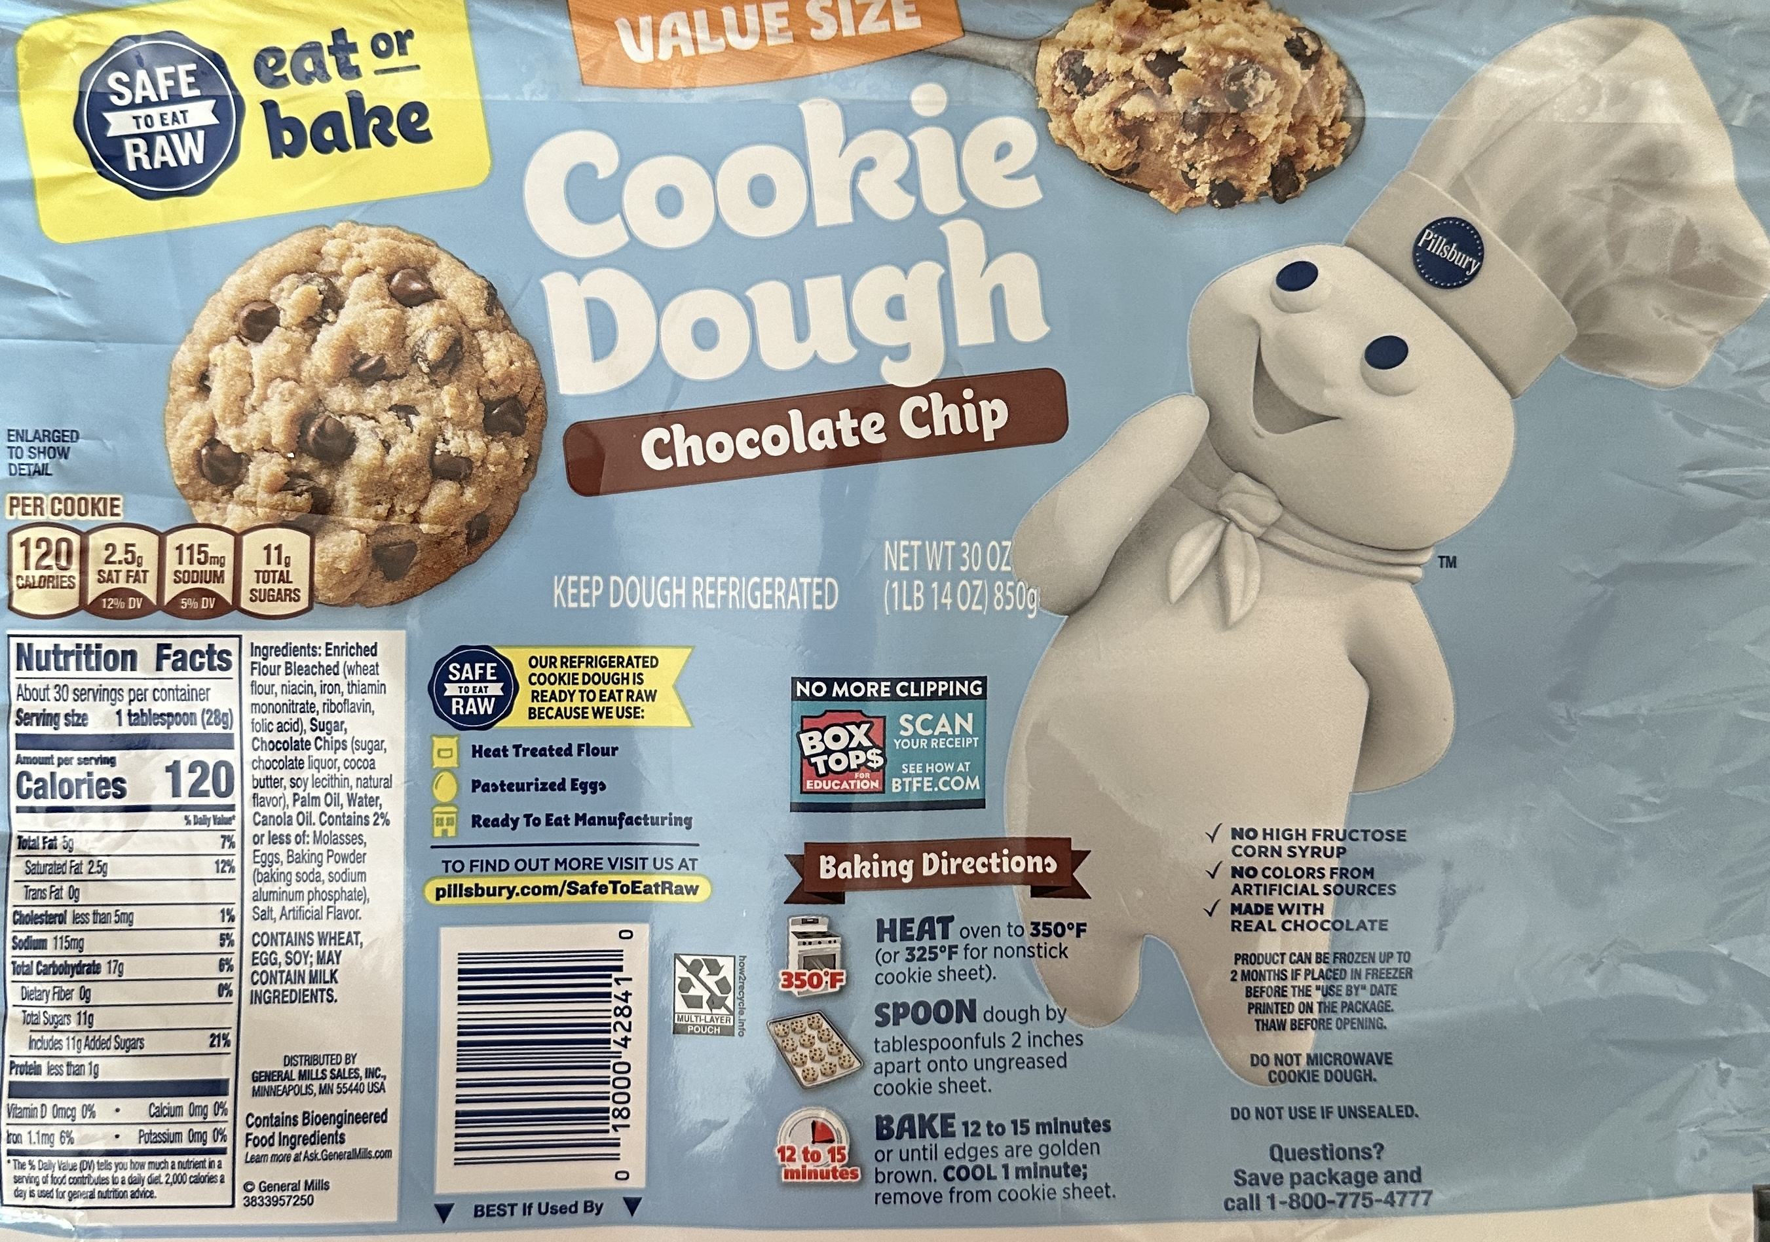
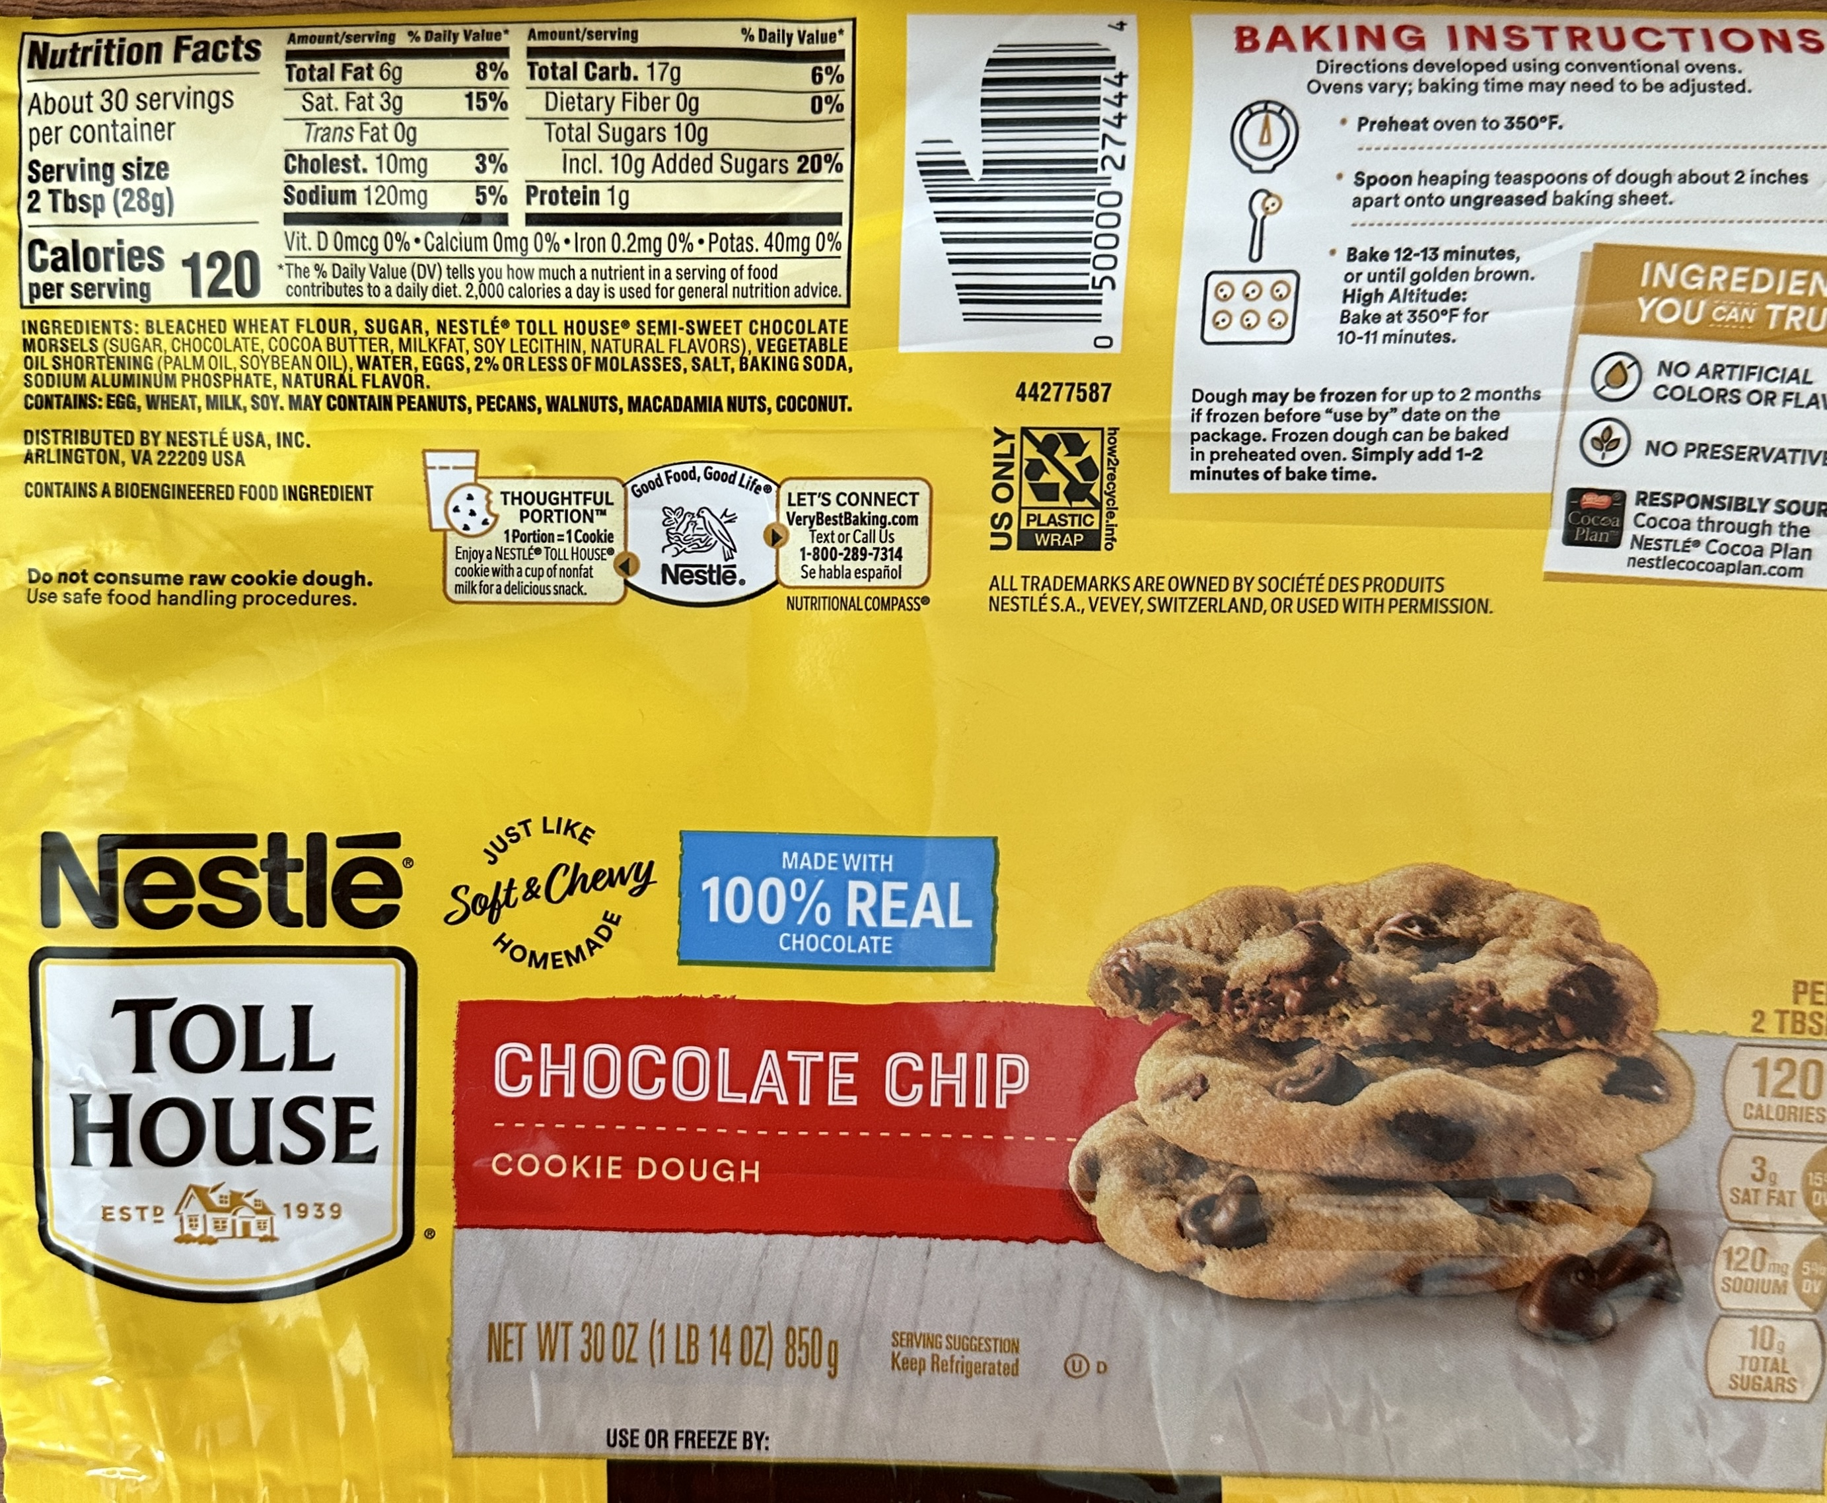
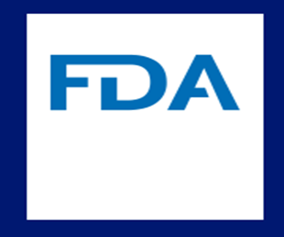
Statement tells you to not eat raw cookie dough
Statements say you can eat “raw” cookie dough because of …
Ingredient…
Week 2 – Topic
7
Notes:
Slide #7B – U.S. government labeling responsibilities…FDA ingredient…
Week 2 Topic –
These two labels are for a similar product – cookie dough.
The “blue” labeled product states that the cookie dough can be eaten “raw” or cooked due, in part, to the use of treated baking flour and the use of pasteurized egg products.
The “gold” labeled product contains regular flour and raw eggs.
Consequently, there is a small warning to not eat the raw cookie dough.
With the “gold” labeled product being less expensive that the “blue” labeled product, one concern I have is that a child might visit someone with sufficient resources to purchase the more expensive “blue” labeled product and be told to eat the “raw” cookie dough.”
Then, later, the child might be told it is not safe to eat raw cookie dough if the “gold” labeled product is being handled.
Noting the differences on the two labels requires a person to be quite attentive to the very small print.

Slide 8
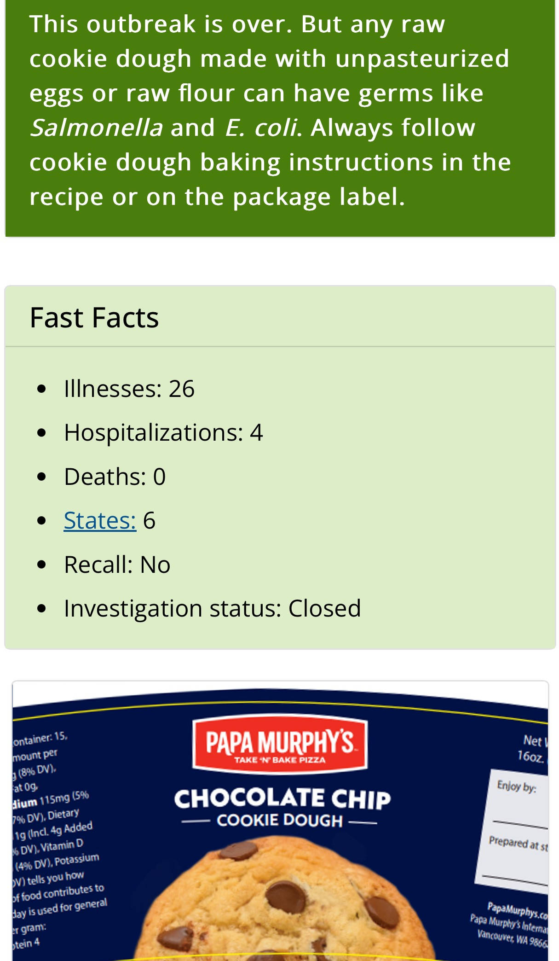
Harvard School of Public Health (2010) --
20 – 50 % ate raw eggs (e.g., cookie dough)
...even if label said not to
Texture and nostalgia create the appeal
1 in 6 at risk for foodborne illness annually in the US.
This outbreak occurred in Spring 2023
Cookie dough outbreak…
Week 2 – Topic
8
Notes:
Slide #8B – U.S. government labeling responsibilities…FDA cookie dough outbreak…
Week 2 Topic –
An outbreak from Spring 2023 left 26 people ill, 4 hospitalized, and no deaths, spanning six States.
The cookie dough was prepared using raw eggs and untreated flour.
Some of the individuals sickened identified that they were aware that “safe” version of cookie dough could be consumed raw.
Still, the individuals ate the raw cookie dough that wasn’t treated for safety.
In fact, none of the sickened individuals identified that they viewed the label of the product prior to consuming the raw cookie dough.

Slide 9
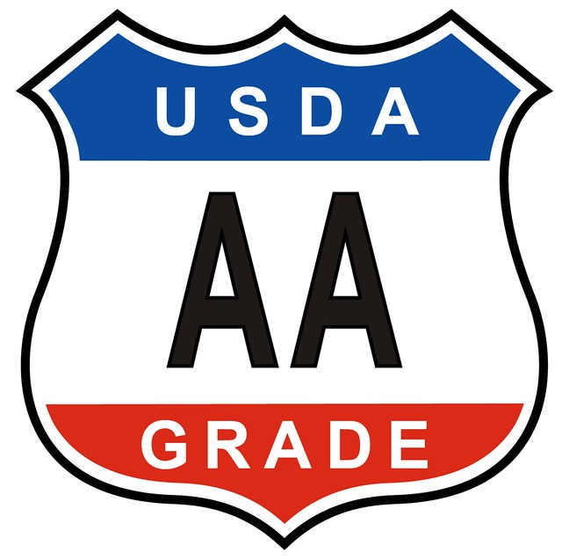
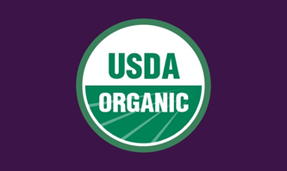
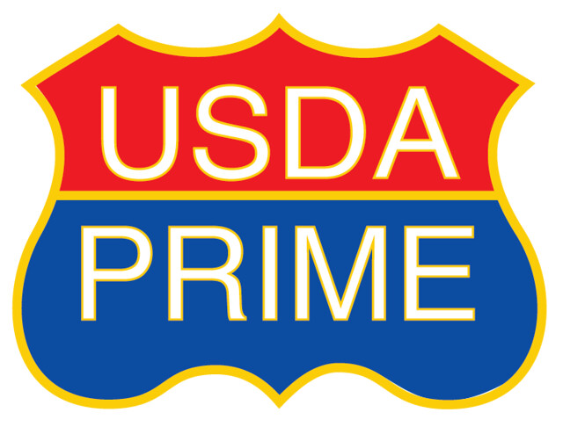
Food logos by government agencies
Represent verification for truthfulness against a standard; some for a fee.
Food Code used by States and local authorities
Other involved agencies…
Week 2 – Topic
9
Notes:
Slide #9B – U.S. government labeling responsibilities…other involved agencies …
Week 2 Topic –
USDA Agricultural Marketing Service (AMS) --
Administers programs that create domestic and international marketing opportunities for U.S. producers of food, fiber, and specialty crops.
As part of its responsibilities, this Agency manages the standards for four food labeling programs:
The National Bioengineered Food Disclosure Standard;
The National Organics Program;
The Country-of-Origin (COOL) standards; and
The quality grading program for commodities such as USDA Prime for beef and US Grade AA for eggs.
Manufacturers intending to apply any of these marketing claims to their labeling must pay a fee-for-service and permit a government employee to come onto their farm or premise and conduct their activities to ensure that the standards are met.
This government third-party certification is well defined, transparent, and accepted by consumer, industry, and trading partners.
This USDA certification is one of the most trusted labeling verification entities.
Center for Disease Control and Prevention (CDC) –
Responsible for monitoring and investigating foodborne illnesses.
It is located within the Department of Health and Human Services, which also is where FDA is housed, and has authority contained within the Public Health Service Act (42 U.S.C. 201 et. seq.).
National Marine Fisheries Service (NMFS) –
Responsible for voluntary seafood inspection and grading programs.
It is located within the U.S. Department of Commerce.
It performs a fee-for-service volunteer seafood inspection and grading program for fish and shellfish.
It has authority contained within the Agricultural Marketing Act (AMS) of 1946 (7 U.S.C 1621 et. seq.).
Environmental Protection Agency (EPA) –
Responsible for clean water and use of pesticide chemicals used on food crops.
This agency establishes the safety standard for potable water, including municipal water.
However, once the water is placed in a container for sale such as a beverage, the FDA is responsible.
Department of Homeland Security (DHS) –
Responsible for customs inspections for foods arriving at the U.S. border.
State, territorial, and local health departments –
These entities are mostly responsible for local regulations involving food safety and labeling.
In addition, they administer food safety education to food handlers, operators, and food service only within their State (i.e., intrastate).
Federal authority applies to interstate movement of product.
If the State has State-only food manufacturing facilities, the State becomes the competent authority over such facilities and the enforcement mimics that of the Federal competent authority.
Local health departments regulate, inspect, and license food service establishments, and the State health departments generally have food testing laboratory facilities.
Although the Federal government (i.e., FDA and USDA FSIS) has the authority to establish national food safety and labeling requirements, local authorities (i.e., States, territories, and municipalities) can establish their unique State requirements.
For foods normally regulated by the FDA and the USDA FSIS but that are prepared and handled within a State-inspected facility (e.g., food establishment, restaurant, or farmers market) and then sold within the State border and not over the internet, such products are under local jurisdiction.
Food Code --
To best ensure consistency from one State to another, States generally codify contents of the Model Food Code for best practices of the safe handling of food in local settings.
The Food Code is maintained by the FDA but the USDA FSIS and designated representatives from each State participate in its development.
Representatives from the appropriate regulating agency within the local authority attend a conference (usually every four years) whereby changes are voted upon.
In addition, local authorities can adopt all or portions of any version of the Food Code.
The adopted portions can then be codified into local regulations.
All fifty States, the District of Columbia, American Samoa, Guam, Northern Marianas Islands, Puerto Rico, and U.S. Virgin Islands are monitored for use of the Food Code.
As for Arizona, the 2017 version of the Food Code was adopted by reference in the State health regulations, with oversight by the Arizona Department of Health Services.
It is this document that sets the sanitary standards for grocery store and restaurants.

Slide 10
Consensus standards for trade
Restrictions are limited
EU
EU countries and USA cannot make and sell Greek feta or feta-style cheese within EU
Proposal underway to restrict parmesan and mozzarella
USA now sells “parmesan” as “hard, grated cheese”
India
Wants to prevent sale of basmati and jasmine rice
USA grows both in USA
USA is one of the 188
member countries
Week 2 – Topic
International labeling issues - 1…
10
Notes:
Slide #10B – International trading issues - 1…Codex consensus standards for world trade…
Week #2 Topic –
The U.S. consumers are not the only strong advocates for food labeling.
Many countries have unique labeling requirements for which U.S. manufacturers must comply when marketing outside the USA.
Meanwhile, foreign countries are required to meet the U.S. labeling requirements when they export food to the U.S.
In order that unfair marketing restrictions are not imposed on trading countries, the Food and Agriculture Organization of the United Nations established the Codex Alimentarius Commission.
The Commission’s main goals are to protect the health of consumers, to facilitate international trade, and to ensure fair practices in international food trade.
Presently, there are 188 member countries, including the U.S., plus one member organization (the European Union -- EU).
These member countries jointly come to consensus on fair standards, such as for food labeling, and abide by the standards when trading internationally.
For foods, standards are established for approved food additives, along with maximum permissible levels in foods.
Under certain circumstances, countries can impose more restrictive requirements than those provided for in the Codex standards.
One example involves cheeses.
The EU has issued legislation that protects many European products, marked with a logo, to certify the product is from the proper region using specific procedures.
In contrast, in the U.S., trademarks are used to protect brand named products.
The EU situation is far more limiting --
For example, Greece, a member country within the EU, has a geographical indication authority for feta cheese.
In Europe, feta cheese can only be labeled as such if it is from Greece.
Consequently, U.S. manufacturers of feta cheese cannot market their products labeled as feta cheese in the European Union.
Even more problematic is that in some cases, the European Union legislation doesn’t allow for a modified name such as “feta-style.”
The EU was successful in challenges at the World Trade Organization – WTO (the “world court”) to this perceived trade barrier by the U.S. due, in part, to the fact that the EU requires this limitation by manufacturers within the EU as well.
For example, France (also a member country of the EU) cannot make and sell a product labeled as feta cheese.
Consequently, WTO determined that there is no trade barrier limiting the U.S. from making and selling feta cheese because even other EU member countries can not make and sell the product they make within their own country
Additional EU efforts are underway to protect parmesan and mozzarella, causing the U.S. government to begin pursuing legal action through the U. S. Trade Office and initiating trade agreements to prevent further restrictions.
Even though American consumers may be confused while traveling in the EU, some US manufacturers already anticipate the EU being successful at the WTO.
Some US manufacturers making “parmesan and mozzarella cheeses” are voluntarily labeling these products for sale in the EU as “hard, grated cheese” and “white Italian-style cheese,” respectfully.
Another restrictive effort underway is by India –
India is trying to own the terms “basmati” and “jasmine” rice, which are two long-grain varieties produced in the U.S. by American farmers
This effort is less likely to survive a WTO challenge due to genetic dispersal of these grains outside of India; however, a legal challenge often resolves unexpectedly.

Slide 11
Consumers “wanted” COOL
Canada and Mexico sued
No U.S. domestic compliance for beef and pork (only)
Products still under COOL with domestic compliance –
Lamb
Chicken
Fish and shellfish
Fruits and vegetables
Nuts (peanuts, pecans, macadamia)
Ginseng
Threat of $4B WTO fine payable in 60 days!!!
After 7 years, beef and pork exempted
This Photo by Unknown Author is licensed under CC BY-SA
Week 2 – Topic
International labeling issues – 2…
11
Notes:
Slide #11B – International labeling issues – 2…COOL commodities…
Week #2 Topic –
In another example of how international trade impacts U.S. labeling of foods, back in 2009, the U.S. issued final regulations to implement mandatory Country of Origin Labeling (COOL) for all muscle cut beef, pork, and ground beef and ground pork.
Consumers and industry had originally strongly supported having foods, especially certain meat cuts, labeled for country of origin.
The law further required documentation to ensure that applicable products identified where the source animal was born, raised, and slaughtered (and, for other commodities -- hatched, grown, harvested, processed, etc.).
If foreign-origin meat was combined with U.S. source meat, then the label was required to identify the mixture origins.
The law required retailers (most all grocery stores and supermarkets) to identify the country of origin on the label.
Meanwhile, Canada and Mexico viewed the legislation as a violation of the World Trade Organization (WTO) Agreement on Technical Barriers to Trade (TBT).
These two countries sued the U.S. through the WTO to prohibit the U.S. law and regulations from proceeding specifically for beef and pork.
The rationale for the lawsuit cited that the U.S. law accorded less favorable treatment to imported cattle and hogs than domestic products and did not fulfill its legitimate objective of providing consumers with information on origin (e.g., Canada and Mexico wanted the U.S. to also require all meat originating in the U.S. to also bear the U.S. as the origin source country, which the COOL legislation did not provide).
Even though the U.S. Congress passed numerous legislative fixes to better define retail labeling requirements resulting in four appeals to the WTO, the U.S. lost its battle for beef and pork
The U.S. was required to pay more than $4 billion in combined retaliatory tariffs within 60 days of the latest WTO ruling.
Consequently, the U.S. Congress fast-tracked a repeal of the legislation specific to beef and pork.
As back history, a Consumer Federation of America survey reported that 90 percent of Americans favored requiring a label with the country of origin on meat.
Notably, the U.S. industry was unwilling to invest in costs to labeling changes and control procedures for the domestic origin meat.
Ultimately, after seven years of the law and implementing regulations, the American consumer was unwilling to pay more for the premiums applied to both domestic and foreign-origin labeled beef and pork product.
There are numerous food products in the U.S. that continue to be labeled with foreign country of origin labels while domestic origin product is not mandated to be labeling as such.
Other countries have not challenged the U.S. on these products –
The products still requiring COOL labeling in the U.S. are --
Muscle cut and ground lamb, goat, and chicken;
Wild and farm-raised fish and shellfish;
Fresh and frozen fruits and vegetables;
Peanuts, pecans, and macadamia nuts; and
Ginseng.
Although there is no domestic requirement to label the U.S. origin commodities, which doomed the beef and pork cuts, other countries –
Do not export significant quantities of these current COOL products,
Foreign countries are not willing to label their own domestic product for domestic sales, and
There is considerable voluntary labeling of most of these products with U.S. as the origin country.

Slide 12
10-minute break
Week 2 – Topic
…take a stretch…
12
Notes:
Slide #12B – Take a stretch…
Week 2 Topic –
10-minute break

Slide 13
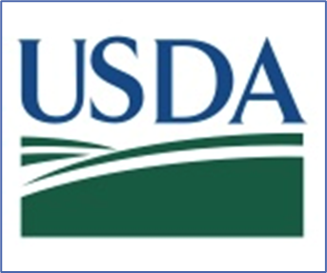
USDA legend and number
Written documentation for claims
Organic and COOL -- on-farm audits
Religious labels -- representative
Buddhist, Confucian, Islamic (Halal), Judaic (Kosher)
All other claims require trusting the manufacturer
Truthfulness is a concern –
Sufficient mistrust may lead to regulation
Week 2 – Topic
…prior-approval…
13
Notes:
Slide #13B – U.S. government labeling responsibilities…Labeling specifics…prior-approval….
Week 2 Topic –
Unlike the FDA, the USDA FSIS is required to review and approve all labeling for all meat, poultry, and processed egg products prior to the product entering commerce.
In addition, due to the daily inspection requirement by inspectors of the USDA FSIS, a mark of inspection is placed on all products prior to product entering commerce, signified by the inspection shield with the assigned establishment number.
Any product in commerce without a prior-approved label is, at a minimum, misbranded.
Labels for products without variation from the minimal required features and with no special claims are generically approved, meaning that they don’t have to be submitted for physical review and approval prior to use.
Such labels and products are subject to routine daily verification by inspectors in-plant to ensure ongoing compliance with labeling requirements.
All other labels falls into three categories and must be submitted for physical review and approval before being applied to product entering commerce, including:
Labels for religious exempt products;
Labels with special statements and claims; and
Labels for temporary approval.
For the special review labels, a “sketch approval” is first conducted whereby a rendering of the label is submitted to a team of label evaluators in Washington, DC.
Once the team’s issues are resolved, the label receives final approval and can be applied to product prior to entering commerce.
The sketch label must reasonably represent what the label will ult0imately look like but need not be the actual final label applied to product.
“Special statements and claims” labels include those that bear a claim, logo, trademark, and other symbols on labels that are not defined within the regulations or in the Food Standards and Labeling Policy Book.
An example of a logo or symbol is a graphic representation of a heart, which may imply healthfulness of the product.
Examples of statements and claims include:
“Natural;”
“Certified gluten free” by a specific entity;
“Health claims;”
“Ingredient and processing method claims” (e.g., high-pressure processing);“
“Animal raising conditions” (e.g., free-range);
“Organic,” and
“Instructional or disclaimer statements concerning pathogens” (e.g., for cooking only or not tested for Escherichia coli O157:H7).
Physical, prior review of labels is required for negative claims relating to the raising of the animal from which the product is derived (e.g., no antibiotics administered”) or negative claims relating to the nonuse of genetically modified ingredients.
For factual claims that can be generically approved, words and phrases include:
Geographical style (e.g., “Italian Style”);
“Extra” or “more” statements (e.g., 10 % more cheese);
Based on the standard for a product;
However, if there is no standard, then data must be provided on at least three comparable brands available in the marketplace where the product is intended to be marketed);
Geographic landmarks (e.g., Statue of Liberty, maps, flags);
Organic ingredients listed in the ingredient statement; and
Allergen statements (e.g., “contains wheat”).
Most negative claims (e.g., “no pork”) or “gluten free” (without an accompanying certification statement) are generically approved.
For special statements and claims, there are numerous intuitive and counterintuitive words and phrases applied to products (i.e., “happy cows” referring to both dairy operations and ground beef production).
Support documentation must be included in the submission.
However, actual verification of the “truthfulness” is, in most cases, entirely in the hands (and pocketbook) of the manufacturer.
There simply are not enough resources in government or otherwise to verify truthfulness, and there generally are not analytical tests to be performed to prove the statement or claim.
Mistrust and lack of consumer confidence is a known outcome.
Examples of such statements and claims include:
Animal-raising claims (e.g., no animal byproducts fed; raised without antibiotics; non gestation crates; and vegetarian fed);
Cage free;
Environmentally raised;
Extra trim;
Family farm raised;
Farm raised;
Fight climate change with your fork;
Free range;
Great for You program;
Hydroponically grown;
Humanely raised;
Labels for religious exempt poultry product not produced under Federal inspection such as Buddhist, Confucius, Halal, Kosher);
Locally raised;
Locally sourced in geographic location;
Minimally processed;
Paleo Friendly;
Pasture raised;
Raised with care;
Real ingredients;
Regenerative claims;
State proposition statements such as California Proposition 12 and Massachusetts Question 3;
Sustainable farming or raised;
Symbols on the label such as arrows and check marks; or
U.S. farm fresh.
In virtually all of the aforementioned examples, government inspectors have no authority to step foot onto the farm where the product is raised, grown, or harvested.
Thus, only the documentation supplied by the manufacturer is used for supporting the statement.
This is a situation in which trust is all that controls actions.
Some manufacturers invest in third-party entities beyond the Agricultural Marketing Service have emerged for fee-for-certification services.
The fees are steep, and the cost is passed onto the consumer.
Generally, these certification organizations post their standards on their website, and they have mechanisms to audit actual production practices against the standards.
Many of the third-party organizations provide form letters that a consumer can send to a supermarket as a way to get the supermarket to carry the particular certified source materials.
Many of these organizations have unique logos and seals of approval.
Examples of third-party animal production certifying organizations include --
American Humane Certified™ animal welfare standards — specie-specific standards grounded on solid scientific research.
Certified Animal Welfare Approved by A Greener World (AGW) — an independent, non-profit farm certification program, claiming to be the only label that guarantees animals are raised outdoors on pasture or range for their entire lives on an independent farm using truly sustainable, high-welfare production practices.
Certified Humane® certification program (CH) — an international program of Humane Farm Animal Care (HFAC), a 501(c)(3) non-profit organization dedicated to improving the lives of farm animals in food production from birth through slaughter.

Slide 14
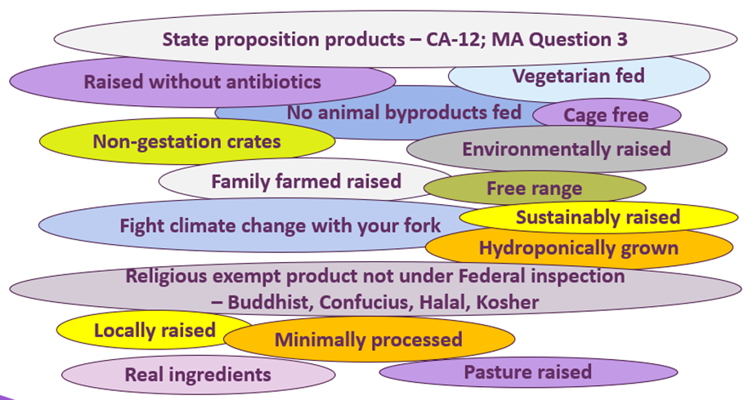
All of these claims rely on “trust”
Week 2 – Topic
…claim examples…
14
Notes:
Slide #14B – Labeling specifics…claim examples…
Week 2 Topic –
Most negative claims (e.g., “no pork”) or “gluten free” (without an accompanying certification statement) are generically approved.
For special statements and claims, there are numerous intuitive/counterintuitive words used (e.g., “Made from happy cows” referring to both dairy operations and ground beef production).
Support documentation must be included in the submission.
Many of such labels have phone numbers or websites listed on the label for obtaining more information about the standards and certifying organization (as applicable).
However, actual verification of the “truthfulness” is, in most cases, entirely in the hands (and pocketbook) of the manufacturer.
There simply are not enough resources in government or otherwise to verify truthfulness, and there generally are not analytical tests to be performed to prove the statement or claim.
Mistrust and lack of consumer confidence is a known outcome.
Examples of such statements and claims include:
Animal-raising claims (e.g., no animal byproducts fed; raised without antibiotics; non-gestation crates; and vegetarian fed);
Cage free;
Environmentally raised;
Extra trim;
Family farm raised;
Farm raised;
Fight climate change with your fork;
Free range;
Great for You program;
Hydroponically grown;
Humanely raised;
Labels for religious exempt poultry product not produced under Federal inspection –
Buddhist,
Confucius,
Halal, and
Kosher;
Locally raised;
Locally sourced in geographic location;
Minimally processed;
Paleo friendly;
Pasture raised;
Raised with care;
Real ingredients;
Regenerative claims;
State proposition statements –
California Proposition 12 and
Massachusetts Question 3;
Sustainable farming or raised;
Symbols on the label such as arrows and check marks; or
U.S. farm fresh.
In virtually all examples (other than previously identified organic and COOL products), government inspectors have no authority to step foot onto the farm where the product is raised, grown, or harvested.
Thus, only the documentation supplied by the manufacturer is used for supporting the statement.
This is a situation in which trust is all that controls actions.
Some manufacturers invest in third-party entities beyond the Agricultural Marketing Service have emerged for fee-for-certification services.
The fees are steep, and the cost is passed onto the consumer.
Generally, these certification organizations post their standards on their website, and they have mechanisms to audit actual production practices against the standards.
Many of the third-party organizations provide form letters that a consumer can send to a supermarket as a way to get the supermarket to carry the particular certified source materials.
Many of these organizations have unique logos and seals of approval.
Examples of third-party animal production certifying organizations include --
American Humane Certified™ animal welfare standards — specie-specific standards grounded on solid scientific research.
Certified Animal Welfare Approved by A Greener World (AGW) — an independent, non-profit farm certification program, claiming to be the only label that guarantees animals are raised outdoors on pasture or range for their entire lives on an independent farm using truly sustainable, high-welfare production practices.
Certified Humane® certification program (CH) — an international program of Humane Farm Animal Care (HFAC), a 501(c)(3) non-profit organization dedicated to improving the lives of farm animals in food production from birth through slaughter.
Religious markings on product also are a claim that requires manufacturers to submit documentation to attest to the truthfulness of the claim, in some cases simply ensuring that the product is not adulterated with non-religious “certified” product.
For poultry, a slaughter or processing facility can apply for an exemption to certain traditional regulatory requirements to meet recognized religious dietary laws.
Products that meet all the inspection requirements and bear the mark of inspection are not religious exempt products. There is no need for a religious exempt certificate when products with religious label claims bear the marks of inspection.
Any poultry products produced under a religious exemption cannot ever bear the marks of inspection, including any parts produced from religious exempt carcasses. Labels for religious exempt items in immediate containers bear the following features —
Statement that the products were processed under a Buddhist, Confucian, Islamic (Halal), or Judaic (Kosher) exemption or equal meaning (e.g., “for Buddhist religion”); name of the religious official or organization under whose supervision the poultry was slaughtered; producing establishments name and address; establishment number; product name along with applicable terminology for non-eviscerated, head-on, or feet intact characteristics; and ingredients statement if fabricated from two or more ingredients.
For example —
Buddhist religious beliefs require poultry to be eviscerated, with the head and feet intact.
Traditional slaughter practices require both the head and feet to be removed and are not used for human consumption.
Confucian religious beliefs require poultry to be non-eviscerated, with the head and feet intact. Traditional slaughter practices require the digestive tract to be removed and examined for disease and other abnormalities, as well as having the head and feet removed and are not used for human consumption.
Islamic (Halal) religious beliefs required the poultry to be eviscerated, head intact, with or without the feet intact.
Judaic (Kosher) religious beliefs require the poultry to be non-eviscerated, with head and feet intact.
Both Judaism and Islam have prohibited eating pork and its products.

Slide 15
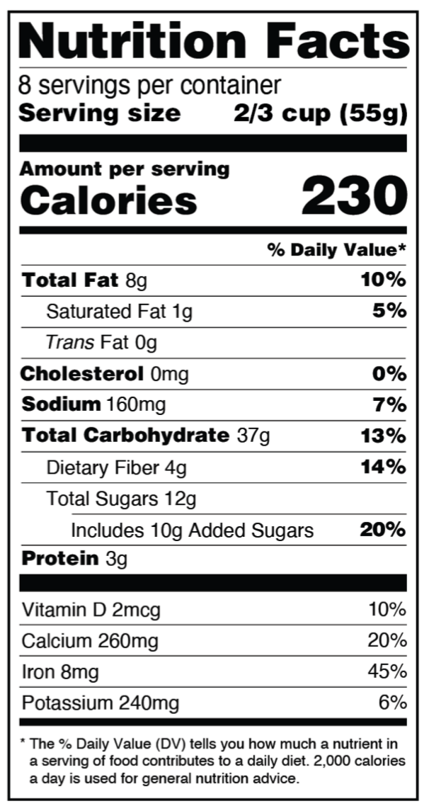
Nutrient levels can be verified by testing
Serving size is a guideline
Based on required FDA/USDA surveys
What’s eaten and not suggested
But -- manufacturer gets to decide what to state
Week 2 – Topic
…Nutrition Facts panel …
15
Notes:
Slide #15B – Labeling specifics…Nutrition Facts panel….
Week 2 Topic –
A required labeling feature for virtually all foods packaged for sale. .
There are exceptions for including the Nutrition Facts panel, such as if an individually wrapped candy but the shipping container is fully labeled.

Slide 16
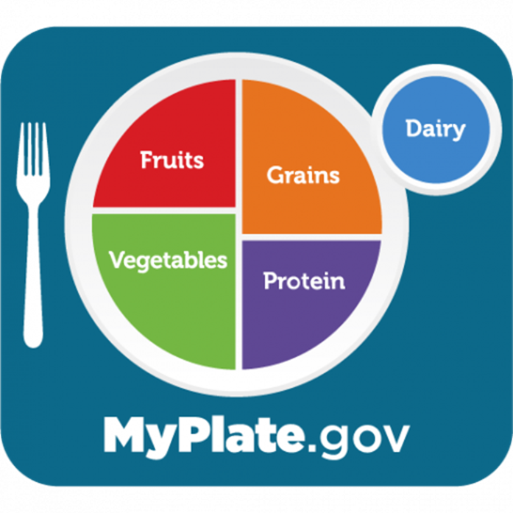
Law requires serving size to be based on actual consumed amount…
2003 – 2008 NHANES and 2016 regulation
USDA’s MyPlate sets the DV for ages 14+
Low -- </= 5 %
High -- >/= 20 %
https://www.myplate.gov/myplate-plan
Week 2 – Topic
… serving size…nutrients…
16
Notes:
Slide #16B – Labeling specifics…serving size…nutrients…
Week 2 Topic –
Serving size is an identification of the recommended servings per container.
The serving size is not a recommendation for how much to eat.
The nutrition information is usually based on one serving of the food.
One package of food may contain more than one serving.
Some containers may also have information displayed per package.
Calories —
Each day, most people should consume 2,000 calories to maintain body weight and function, based as a guide for general nutrition advice.
FDA seeks this advice from its scientific panel of outside experts.
Calorie intake may be higher or lower depending on age, sex, height, weight, and physical activity level.
More specifics can be found at https://www.myplate.gov/myplate-plan.
Note that the information for many of the nutrients are listed as ounces, not grams; grams are required on the label.
This is due, in part, to pure nutrients are likely not being consumed; rather, a meal is being consumed, which is a mixture of multiple nutrients.
Consumers should focus on the weight (in grams) of the serving of food being consumed.
A recent change provided for –
A large muffin now being one serving, not two;
A 20-ounce can of soda is now one serving, not more than one as previously required.
The FDA defines the “Reference Amounts Customarily Consumed” (RACC) tables recommended for use by food manufactures to determine the serving size on the Nutrition Facts panel.
The serving sizes listed on the Nutrition Facts panel are not recommended serving sizes.
By law (i.e., Nutrition Labeling and Education Act (NLEA), the serving sizes must be based on how much food people actually consume, and not on what they should eat.
The RACC tables were based on surveys on food consumption.
The latest RACC tables are based on 2003 to 2008 data from the National Health and Nutrition Examination Surveys.
These data informed the updated regulations in 2016 that had to be fully implemented by January 1, 2021 (except for manufacturers of most single-ingredient sugars such as honey and maple syrups and certain cranberry products had until July 1, 2021, to make the changes.
MyPlate identifies food group amounts for 2,000 calories a day for ages 14+ years —
Food groups —
2 cups fruits, with a focus on whole fruits
2.5 cups vegetables, with a variety of colorful veggies, especially dark green, red, and orange choices
6 ounces grains, with half of grains being whole grains based on the Nutrition Facts panel
5.5 ounces protein, with a variety between seafood, beans, peas, lentils, unsalted nuts, soy products, eggs, and lean meats and poultry
3 cups dairy, with a focus on low-fat or skim types, yogurt; can focus on fortified soy alternatives
Choose foods and beverages with less added sugars, saturated fat, and sodium —
Limit added sugars to less than 50 grams a day
Limit saturated fat to less than 22 grams per day
Limit sodium to less than 2,300 milligrams per day
Be physically active at least 2.5 hours weekly
In visualizing food portions, a cup is approximately the size of a tennis ball; a 3 oz portion (approximately 85 grams) is similar to a deck of cards
Percent Daily Value (% DV) —
Shows how much a nutrient in a serving of food contributes to a total daily diet. A 5 % DV or less of a nutrient per serving is considered low. A 20 % or more of a nutrient per serving is considered high.
Nutrients —
No longer included on current labels since 2016 —
Calories from fat are no longer included because research show the type of fat consumed is more important than the amount.
Vitamin A and C are no longer required on the label since deficiencies of these vitamins are rare today in the U.S.; however, these nutrients may be included on a voluntary basis.
Newly required on current labels since 2016 —
Added sugars —
Consuming too much added sugars can make it hard to meet nutrient needs while staying within calorie limits.
Added sugars include –
Sugars that are added during the processing of foods (e.g., sucrose or dextrose),
Food packaged as sweeteners (e.g., table sugar),
Sugars from syrups and honey, and
Sugars from concentrated fruit or vegetable juices.
Vitamin D and potassium —
Added because Americans do not always get the recommended amounts.
Diets higher in vitamin D and potassium can reduce the risk of osteoporosis and high blood pressure, respectively.
Always required on labels —
Calcium and iron —
Added because Americans do not always get the recommended amounts.
Diets higher in calcium and iron can reduce the risk of osteoporosis and anemia, respectively.
Total fat, as well as saturated fat and trans fat.
Cholesterol.
Sodium.
Total carbohydrate, which includes –
Dietary fiber,
Total sugars, and
Added sugars.
Protein.

Slide 17
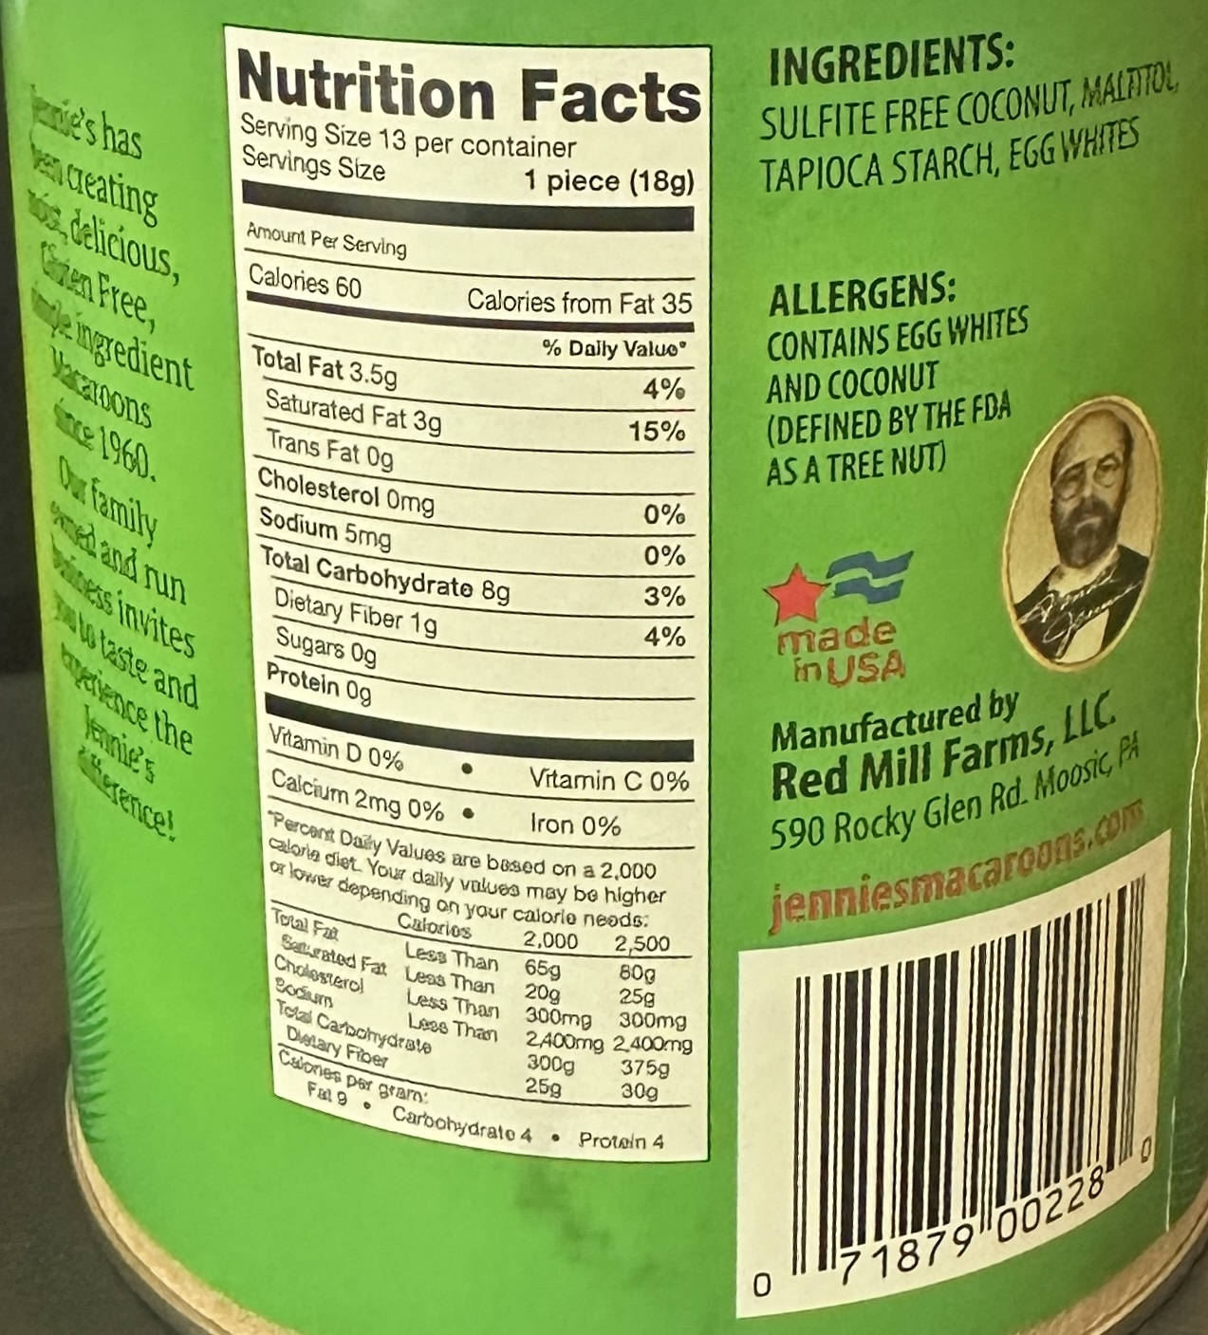
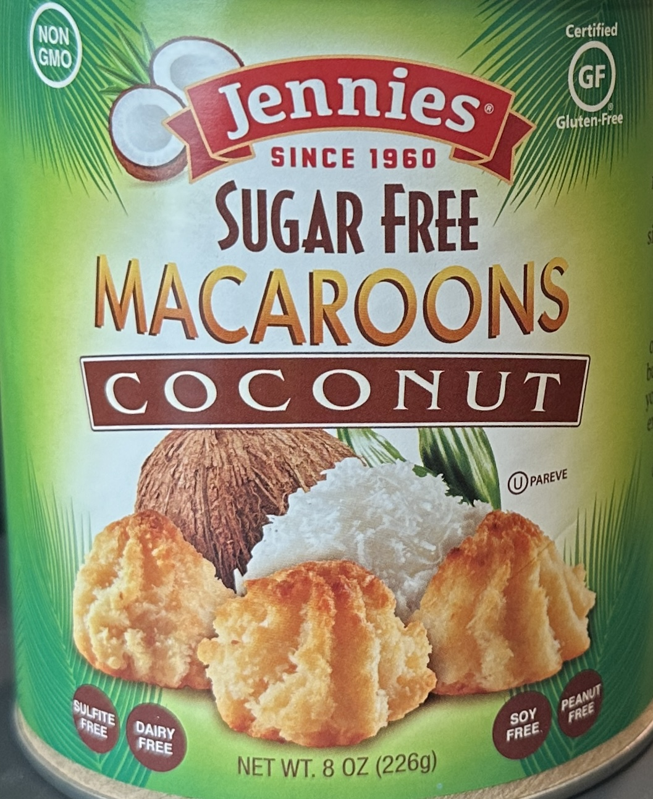
PDP
Principle Display Panel (PDP) --
Statement of identity
Net content
Information Panel (IP) –
Name/address
Ingredient list
Nutrition labeling
Required allergen
IP
Week 2 – Topic
…containers and packaging…
17
Notes:
Slide #17B – Labeling specifics…containers and packaging…
Week 2 Topic –
There are two ways to label packages and containers:
Principal Display Panel (PDP) -- On the front label panel; or
Information Panel (IP) --Immediately to the right of the PDP as seen by the consumer facing the product.
The Principal Display Panel (PDP) must include –
The statement of identify (name of the food) and
The net quantity statement (amount of product).
There are required type size and prominence requirements.
The Information Panel (IP) content must be placed together without any intervening material.
These statements include –
The name and address of the manufacturer, packer, or distributor (with city, street address, zip code included),
For the name and address, if the actual manufacturer’s name is not given, then there must be a qualifying phrase that states the firm’s relation to the product (e.g., “manufactured for” or “distributed by”).
One differences between the foods regulated by the FDA and the USDA FSIS is that for the USDA FSIS foods, all are also required to bear the USDA mark of inspection and establishment number (EST number), which is assigned to the establishment where the product was last handled and produced.
This establishment number may appear on the package with the USDA mark of inspection, or it may appear elsewhere on the exterior of the package container or packaging labeling.
It must be prominently and legibly shown in a manner and size sufficient to ensure easy visibility and recognition.
Further, the establishment number is also permitted to appear off the exterior of the container (e.g., on a metal clip to close casings) or on aluminum trays placed within containers.
If so, a statement of its location must be printed near or connected to the official inspection legend (i.e., “EST. No. on metal clip” or “EST No. on pan”).
The number may not be applied over any required labeling information.
For poultry product, the establishment number for poultry plants can be identified with the prefix “P” for “Poultry” prior to the number.
A reason for identifying the manufacturer’s name includes --
Facilitating a product recall if the is found to be adulterated or misbranded after being placed in commerce.
For example, an allergen was not identified in the product.
Consumers and others handling the product (e.g., grocery stores, warehouses) need a way to identify whether the product is in their possession.
Other information is required to be on the labeling that further identifies a particular production period in which the product was produced –
For example, production lot code, “best by date,” and establishment number).
Ingredient list,
Nutrition Fact panel labeling, and
Any required allergy labeling (usually denoted by the words “Contains – X”).
Only the required (major) allergens are listed in this manner.
However, manufacturers may voluntarily label other allergens, of which there are many.
Unpackaged products typically have no required labeling although manufacturers often include a name/coding such that the items can be scanned at the check-out counter and weighed for pricing.
Consumers can access free USDA published information that manufacturers rely upon for nutrient content determinations if the manufacturer does not analyze their own food items --
See FoodData Central – https://fdc.nal.usda.gov.

Slide 18
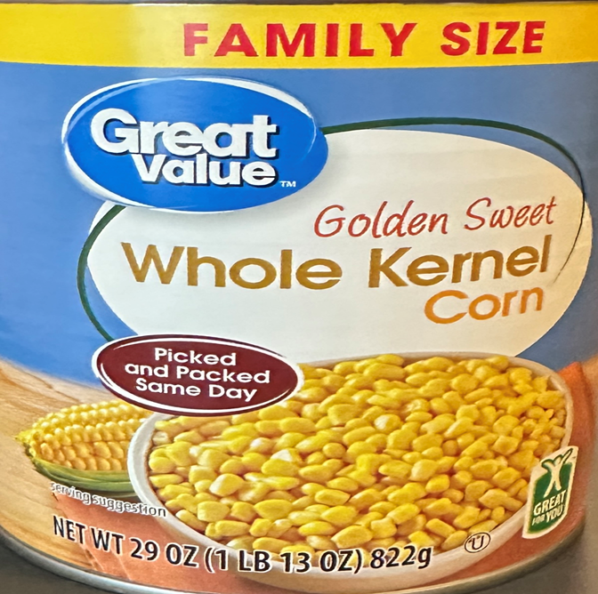
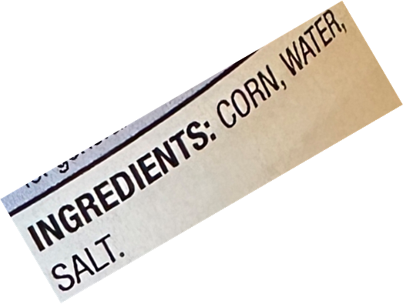
Must use a prescribed recipe
Have a defined name
All ingredients declared
For this product --
Product -- corn
Water and salt are permitted by the standard
Style - whole kernel
Declared name -- sweet
Other naming --
If had been white corn, “white” would be stated
If had been “vacuum packed” instead of canned, then so stated
Week 2 – Topic
…standardized foods - 1…
18
Notes:
Slide #18B – Labeling specifics – standardized foods - 1...
Week 2 Topic –
A standardized food is a food required to be made in a specific way (i.e., a set of recipes and naming requirements for a food product).
The complete name in the standard of identity must be used, including the common or usual name plus any additional terms required to be declared.
For example: “Sweet corn” is not a complete identification.
It must be identified, at a minimum, as “whole kernel sweet corn” or “whole kernel corn.”
The declared name must be either “corn,” “sweet corn,” or “sugar corn.”
The style must be declared as either whole kernel or cream style.
The color type must be declared if other than yellow (i.e., “white” if white corn).
In addition, the words “vacuum pack” or “vacuum packed” must be included, if applicable.
In an example of a litigated case –
A Court ruling makes clear that a frankfurter can be truthfully labeled as “all meat” because the standard of identify allows up to 15 % binders, corn syrup, spice, and curing agents.
If a mixture of meat from different species is used, the name of the different meat species must be included in the ingredient statement but not necessarily in the product name.
For the FDA there are at least 21 categories of products --
Listed in 21 C.F.R, Chapter 1, Subchapter B, Parts 131-169, with variations within each, as follows:
Bakery products;
Beverages;
Cacao products;
Canned fruits;
Canned fruit juices;
Canned vegetables;
Cereal flours and related products;
Cheeses and related cheese products;
Eggs and egg products (these would be whole eggs or egg components and not mixtures regulated by USDA;
Fish and shellfish;
Food dressings and flavorings;
Frozen desserts;
Frozen vegetables;
Fruit butters, jellies, preserves, and related products;
Fruit pies;
Margarine;
Milk and cream;
Macaroni and noodle products;
Sweeteners and table sirups;
Tree nuts and peanut products; and
Vegetable juices.
For USDA FSIS, there are at least 20 categories of livestock or “red” meat products –
Listed in 9 C.F.R., Chapter III, Part 319 with variations within each, as follows:
Canned, frozen, or dehydrated meat food products;
Cooked meats;
Cooked sausage;
Cured meats, unsmoked and smoked;
Dietetic meat foods;
Dry fermented sausage;
Fats, oils, shortenings;
General, including labeling and preparation of standardized products with –
Mechanically separated (species), and limitations with respect to use of mechanically separated species; and
Nitrates and nitrites;
Luncheon meat, loaves and jellied products;
Meat baby foods;
Meat food entrée products, pies, and turnovers;
Meat salads and meat spreads;
Meat snacks, hors d’oeuvres, pizza, and specialty items;
Meat soups, soup mixes, broths, stocks, extracts;
Meat specialties, puddings, and nonspecific loaves;
Miscellaneous;
Raw meat products;
Sausage generally –
Fresh sausage;
Semi-dry fermented sausage; and
Uncooked, smoked sausage.
In addition, there are at least 20 categories of poultry products listed in 9 C.F.R., Chapter III, Subpart P, 381 with variations within each, as follows:
Breaded products;
Canned boned poultry and baby or geriatric food;
Definition and standard for “turkey ham”;
General;
(Kind) barbecued;
(Kind) barbecued prepared with moist heat;
(Kind) baked or (kind) roasted;
(Kind) burgers, (kind) patties;
(Kind) a la kiev;
(Kind) steak or fillet;
Limitations with respect to use of mechanically separated (kind of poultry);
Maximum percent of skin in certain poultry products;
Mechanically separated (kind of poultry);
Other poultry dishes and specialty items;
Poultry dinners (frozen) and pies;
Poultry meat content standards for certain poultry products;
Poultry rolls;
Requirements for substitute standardized poultry products named by use of an expressed nutrient content claim and a standardized term; and
Standards for kinds and classes, and for cuts of raw poultry.

Slide 19
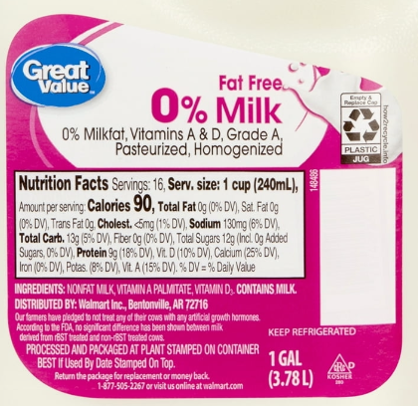
From healthy cow(s)
Starts with –
> 8.25 % milk solids and fat
> 3.25 % milk fat
Can be adjusted (e.g., remove milk fat)
Can be homogenized
Can add vitamins –
Minimum levels of Vitamins A and D
Week 2 – Topic
…standardized foods – 2…
19
Notes:
Slide #19B – Labeling specifics – standardized foods – 2…milk...
Week 2 Topic –
Milk -…
FDA defines milk in final package form as a beverage, pasteurized or not, that contains not less than 8.25 percent milk solids and fat and not less than 3.24 percent milk fat.
Milk is the lacteal secretion, practically free from colostrum, obtained by the milking of one or more healthy cows.
Milk may have been adjusted by separating part of the milk fat or by adding cream, concentrated milk, dry whole milk, skim milk, concentrated skim milk, or nonfat dry milk.
Milk may be homogenized.
If Vitamin A added, then must be of a quantity of a minimum of 2,000 International Units (IU).
If Vitamin D added, must be at no less than 400 IU.
In the slide picture, the product is not “0 % milk.”
The product is nonfat or fat free milk, as noted in the ingredient statement.
The percentage of milkfat must be stated, which is what the 0 % is referencing.
Vitamin A is listed with its technical name of palmitate.
Grade A refers to the minimum sanitary inspection standard that commercially marketed fluid milk must meet for human consumption in the USA –
Also referred to as fluid grade milk or market milk).
Note that farmers supplying milk to this manufacturer pledged to not treat any of their cows with artificial growth hormone and, thus, must also add the statement – according to the FDA, no significant difference has been shown between milk derived from rBST treated and non-rBST treated cows.
rBST means recombinant bovine somatotropin – previously called bovine growth hormone.
rBST is a genetically engineered hormone injected into dairy cows to increase milk production.
Contains implied warnings
Allergen – contains milk.
Keep refrigerated.

Slide 20
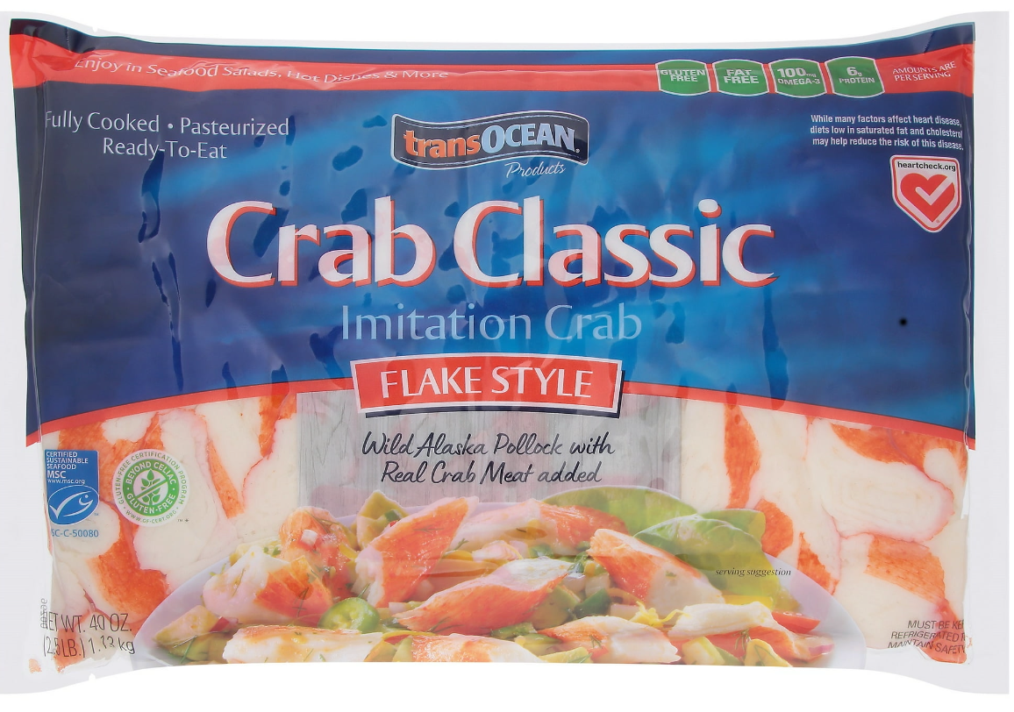
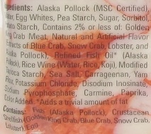
Must say “imitated” if –
Resembles another food and
Contains less nutritional value
E.g., protein or essential vitamin
“Imitation” followed by food imitated
Not less than ½ size of name
If artificially flavored, must say so in name
Week 2 – Topic
…imitation foods…
20
Notes:
Slide #20B – Labeling specifics – imitation foods…imitation crab with “meat” tissue”...
Week 2 Topic –
The standard of identity is the legally required name of the food.
If the name of a food mentions ingredients, the ingredients must be listed in order of predominance in the name of the food (e.g., “apple-strawberry pie”).
The form of the food must be described unless the form is visible through the container or is depicted in an appropriate vignette (e.g., whole, sliced, or diced).
A brand name can be used instead if the nature of the food is obvious and understood by the public (e.g., Pepsi Cola, Coca Cola).
A common or usual name must be used if there is no standard of identity.
If there is no common or usual name, a descriptive phrase must be used.
The descriptor must include, in simple and as direct terms as possible, the basic nature of the food or its characterizing ingredients or properties (e.g., “chocolate-flavored caramel corn” but not “praline cruncher”).
If the nature of the food is obvious and understood by the public, then a fanciful name (e.g., “submarine sandwich” for a large sandwich made with a small loaf of bread and containing lettuce, condiments, and a variety of meats and cheeses) can be used.
If the product is an imitation of a traditional food item, an imitation food name must be used.
This is any product that resembles and substitutes for a traditional food and contains less nutritional value (e.g., protein or a lesser amount of any essential vitamin) than the traditional food.
Such a food must be labeled in type of uniform size and prominence with the word “imitation” immediately followed by the name of the food imitated.
If artificially flavored components are used, these components must be part of the product name and be not less than one-half the size of the name of the food.
If a beverage purports to contain juice, then the total percentage of juice must be declared on the information panel.
If a multi-juice beverage states one or more – but not all – juices are present and the predominant juice is in minor amounts, the product’s name must state that the beverage is flavored with that juice or declare the amount of the juice in a 5 % range (e.g., “raspberry-flavored juice blend” or “juice blend, 2-7 % raspberry juice”).

Slide 21
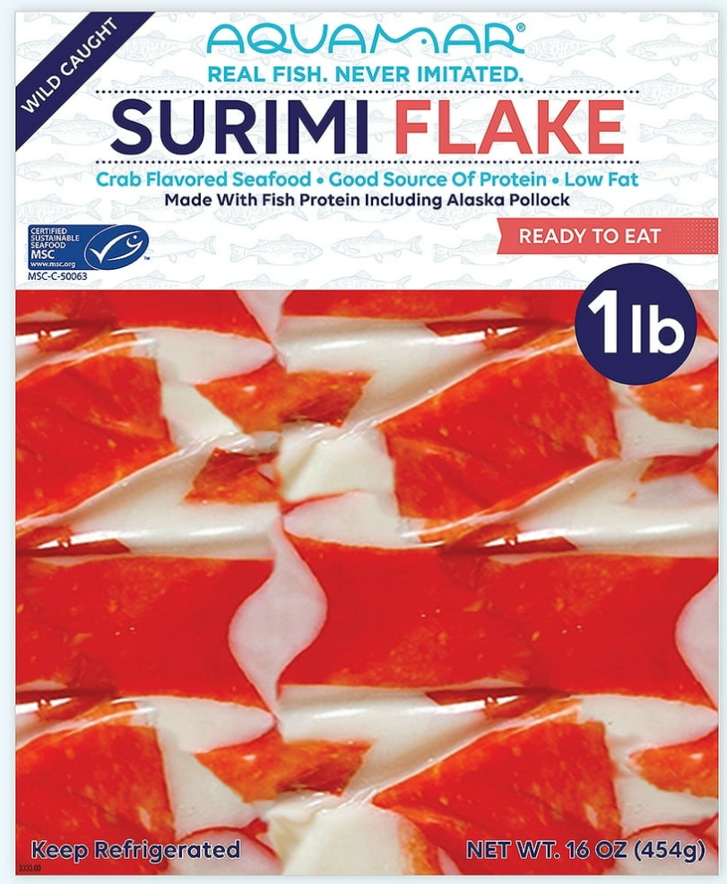
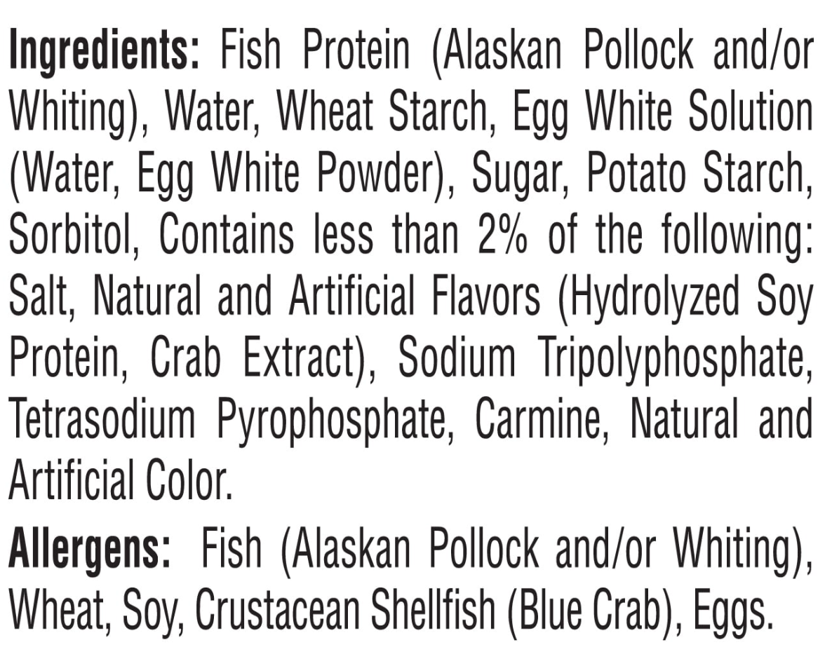
Say “imitated” if –
Resembles,
Substitutes, and
Contains less nutritional value
Protein or essential vitamin
“Imitation” followed by food imitated
If artificial flavored, must say so name
Not less than ½ size of name
Week 2 – Topic
…non-standardized food – 1…
21
Notes:
Slide #21B – Labeling specifics – non-standardized food – 1…surimi…
Week 2 Topic –
In 2014, FDA published guidance on the labeling for processed and blended seafood products made primarily with fish protein (CPG Sec. 540.700).
This guidance is not in the form of a regulation enforceable by law; FDA will use enforcement discretion on pursuing misbranding non-compliance with the guideline.
Processed and blended seafood product made primarily with fish protein often are fabricated from one or more fish species.
Surimi –
A fish protein product consisting primarily of the myofibrillar protein fraction from one or more fish species.
This is an intermediate processed seafood product that is further processed into a product that resembles (and labeled to highlight) as a substitute for a variety of seafood -- crabmeat, shrimp, lobster, and scallops.
It is made from minced fish meat (e.g., pollock, cod, or Pacific whiting) that has been washed to remove fat and undesirable matter (such as blood, pigments, and odorous substances), and then mixed with cryoprotectants (such as sugar or sorbitol) to improve its frozen shelf life.
In formulating finished seafood products made with surimi, the surimi is typically thawed and blended with other ingredients such as the seafood being imitated, seafood flavoring, salt, water, and starch or egg white.
This mixture is then heat processed and extruded to make fibrous, flake, chunk, and composite-molded consumer products.
The finished processed seafood products are marketed frozen or unfrozen and may be breaded.
Such product must be labeled as imitation if it is nutritionally inferior to the product it resembles.
Note, the front label states “real fish, never imitated” –
This surimi product is technically not nutritionally inferior to crab and, thus, not labeled as imitation even though the product looks like crab but contains many other fish proteins and less than 2 % of crab extract.
This surimi product is not purporting to be crab or any other seafood
Surimi flake is priced at 20.7 cents per ounce; crab classic imitation crab is priced at 24.8 cents per ounce; and lump crab meat (canned) is priced at 77.7 cents per ounce.

Slide 22
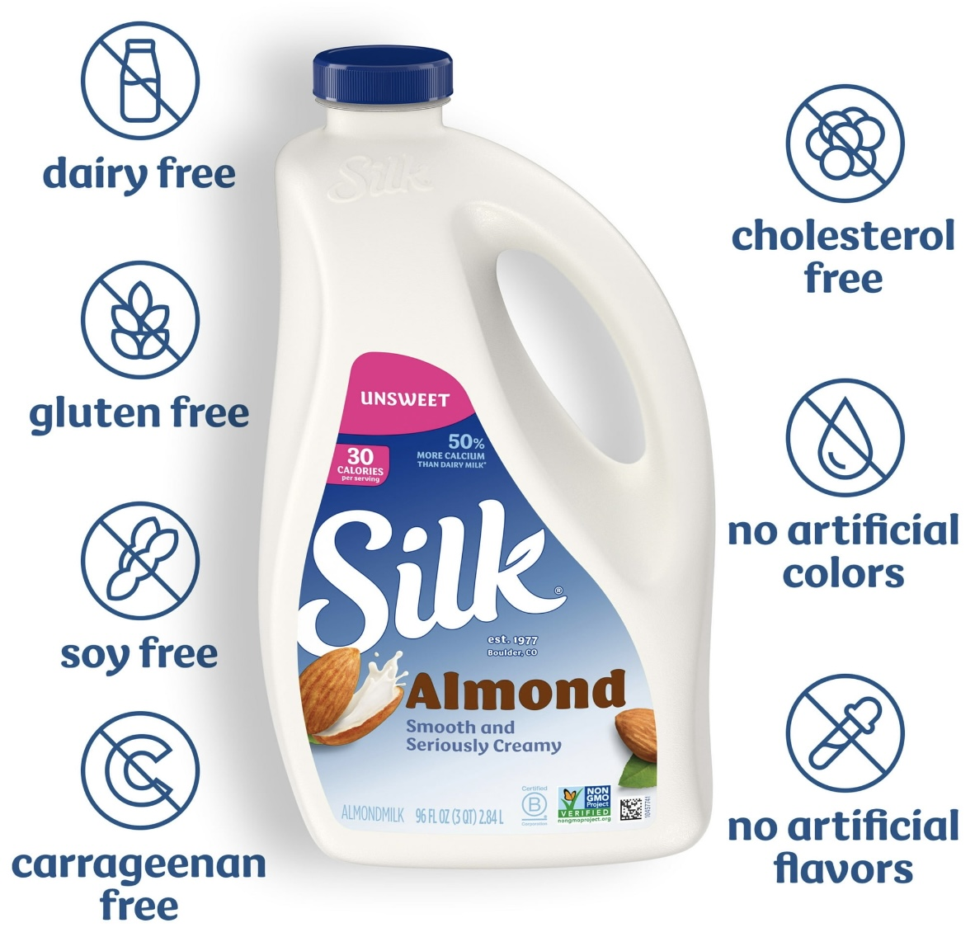
PBMAs –
Except soy, not dairy substitutes
Soy is fortified
Not imitations
Nutrients differ
Not “regulated”
Under 2023 guidance
Consumers --
Understand not milk
Don’t understand what’s lacking
3 quarts, not 4;
4.6 cents per fluid ounce, not 2.2 to 2.6
Week 2 – Topic
…non-standardized foods - 2…
22
Notes:
Slide #22B – Labeling specifics –non-standardized food – 2…why is almond milk not imitation?...
Week 2 Topic –
Almond milk…
In September 2018, FDA requested comments to gain understanding as to how consumers use plant-based milk alternatives (PBMA) from nuts (e.g., hazelnuts, walnuts, coconuts, cashews, and almonds), seeds (e.g., sesame, flax, and hemp), rice, oats, or legumes (including soy), recognizing that their composition varies but that their use is like that of milk
More than 13,000 comments were received, including research studies that demonstrate that consumers generally understand that PBMA do not contain milk and choose PBMA because they are not milk.
However, many consumers may not be aware of the nutrient differences (e.g., the calcium content, except for fortified soy, is not similar and is, thus, not included as a milk-substitute).
The Dietary Guidelines for Americans, currently only includes fortified soy beverages in the dairy group due to having key nutrients like those of milk (e.g., calcium, protein, vitamin A, vitamin D, magnesium, phosphorus, potassium, riboflavin, and vitamin B-12, as well as zinc, choline, and selenium).
February 2023, FDA noted that the common or usual name of some PBMA have been well established by common usage (e.g., soy milk, almond milk).
FDA’s guidance also recommended voluntary nutrient statements on PBMA, noting how the BPMA’s nutrient composition differs from milk based on the USDA’s Food and Nutrition Service (FNS) fluid milk substitutes nutrient criteria.
My perspective on container size is that it is 3 quarts rather than 4 quarts because the price per fluid ounce is more than double that of dairy milk, whether whole, reduced fat, or fat free
4.7 cents/fluid ounce for almond milk versus 2.2 cents/fluid ounce for whole milk; 2.6 cent/ fluid ounce for the reduced fat milks (fat free, 1 %, and 2 %).
Milk -- FDA defines milk in final package form as a beverage, pasteurized or not, that contains not less than 8.25 percent milk solids and fat and not less than 3.24 percent milk fat.
Milk is the lacteal secretion, practically free from colostrum, obtained by the complete milking of one or more healthy cows. Milk may have been adjusted by separating part of the milk fat or by adding cream, concentrated milk=l, dry whole milk, skim milk, concentrated skim milk, or nonfat dry milk. Milk may be homogenized.
If Vitamin A added, then must be of a quantity of a minimum of 2,000 International Units (IU); Vitamin D must be at no less than 400 IU.

Slide 23
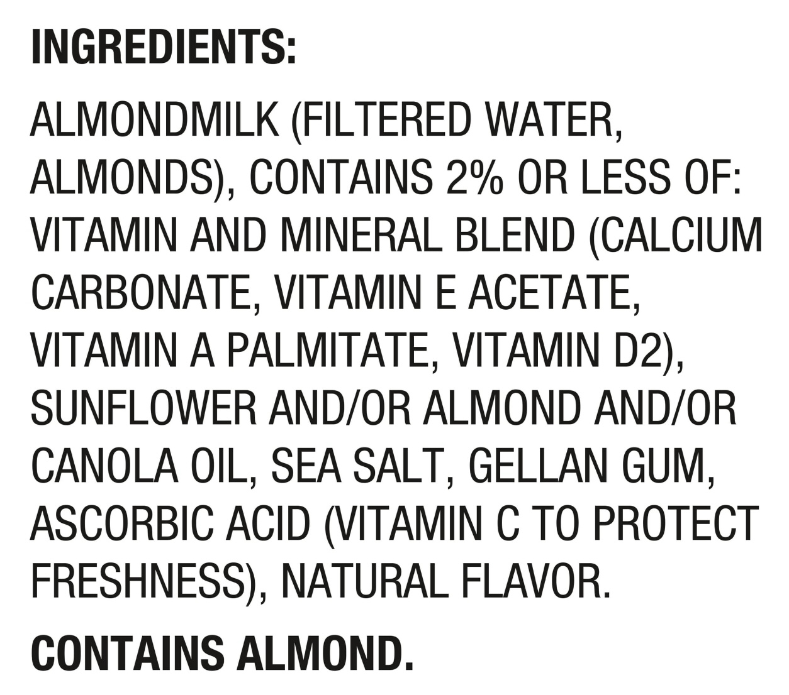
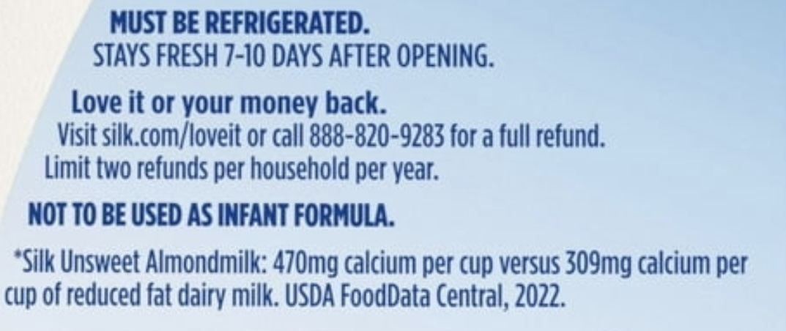
Say “imitated” if –
Resembles,
Substitutes, and
Contains less nutritional value
Protein or essential vitamin
“Imitation” followed by food imitated
If artificial flavored, must say so name
Not less than ½ size of name
Week 2 – Topic
…non-standardized foods - 3…
23
Notes:
Slide #23B – Labeling specifics –non-standardized food – 3…almond versus milk...
Week 2 Topic –
Almond milk…
As a stand-alone ingredient, almondmilk is filtered water and almonds.
Other added ingredients are 2 % or less of formulation.
Of note, the calcium content is compared to reduced fat dairy milk rather than whole dairy milk or fat free dairy milk; it would seem the “better” comparison is fat free albeit there is no difference in calcium between reduced fat and fat free dairy milk
Reduced fat dairy milk has 309 mg calcium (25 % DV)
Unsweet almond milk has 470 mg calcium (35 % DV)
Whole dairy milk has 300 mg calcium (25 % DV
Fat free milk has 300 mg calcium (25 % DV)
Implied warning –
Not to be used as infant formula
Nutrients are inadequate to support growth
Must be refrigerated
Regular milk says “keep refrigerated”
Not sure why the more emphatic “must”
No artificial flavor, just natural flavor added
Whole milk (1 cup serving) is –
Calories -- 150
Total fat – 8 g (10 % DV)
Saturated fat – 5 g (25 % DV)
Trans fat – 0 g
Cholesterol – 35 mg (12 % DV)
Sodium – 125 mg (5 % DV)
Total carbohydrates – 12 g (4 % DV)
Fiber – 0 g (0 % DV)
Total sugars – 12 g (including 0 g added sugars, 0 % DV)
Protein – 8 g (16 % DV)
Vitamin D – 2.5 mcg (15 % DV) – with Vitamin D3 added
Calcium – 300 mg (25 % DV)
Iron – 0.1 mg (0 % DV)
Potassium – 400 mg (8 % DV)
Vitamin A – 100 mcg (10 %)

Slide 24
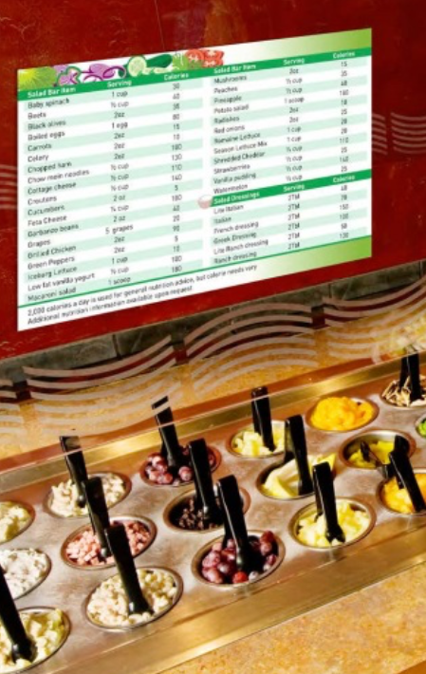
Menu labeling –
Chains (20 or more; similar items)
Post –
Menu/menu boards
Price of menu item
Calories next to price
Caloric intake statement (e.g., 2,000 calorie advisory)
Nutrition info upon request, written
Nutrition Facts except vitamins and minerals
Also, self-serve and take-out
Week 2 – Topic
…menu labeling…
24
Notes:
Slide #24B– Labeling specifics…menu labeling….
Week 2 Topic –
Since 2018, certain restaurants and similar retail food establishments have been required to include calorie labeling on their menus.
If the restaurant is –
Part of a chain with 20 or more locations;
Doing business under the same name;
Offering for sale substantially the same menu items; and
Offering for sale “restaurant type foods”
Examples of these type of facilities include --
Chain restaurants (quick service and sit-down),
Grocery and convenience stores that serve restaurant-type food,
Food take-out establishments and pizza delivery chains,
Entertainment venues such as movie theaters and amusement parks,
Chain cafeterias, and
Chain coffee shops and bakeries.
These facilities are required to—
Maintain menus and menu boards and include,
Name,
Price of the menu item, and
Calorie information.
The calories must be displayed adjacent to the name or price of the menu item in a type size no smaller than that of the name or price of the menu item, whichever is smaller, with certain color and contrast requirements.
If there are only two options available for the menu items, then the calories are presented with a slash between the two calorie declarations (e.g., “150/250 calories”).
If there are three or more options, a range can be presented (e.g., “150-300 calories”).
A succinct statement concerning suggested daily caloric intake is required
For example -- “2,000 calories a day is used for general nutrition advice, but calorie needs vary”.
Optional phrasing can be used for children’s menus and menu boards.
Importantly, written nutrition information for standard menu items must be provided upon request by the consumer.
This written nutrition information statement of availability must be on the first page of the menu or the bottom of the menu board either above, below, or beside the succinct statement.
For the written nutrition information, the nutrients currently required in the Nutrition Facts label on packaged foods (except vitamins and minerals) is required (i.e., total calories, total fat, saturated fat, trans fat, cholesterol, sodium, total carbohydrate, dietary fiber, sugars, and protein).
For self-serve foods and food on display in which there is not an ordinary expectation of further preparation by the consumer before consumption –
For example –
Bagels,
Buffet line,
Cafeteria line,
Donuts,
Ice cream, and
Salad bars,
A sign must be placed near the food with the number of calories per serving or per item.
For labeling of grab-and-go foods –
A front-of-pack sticker can include the calories.

Slide 25
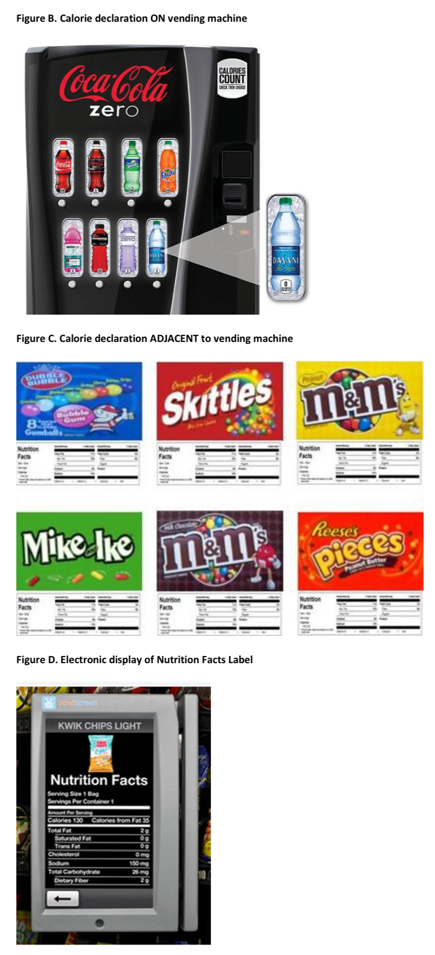
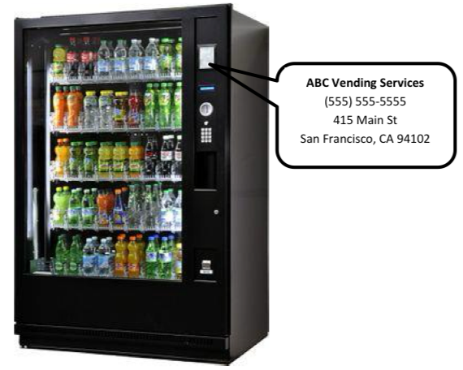
1/3 of calories from away from home
Thus, to help with dietary pattern planning, vending operator must label
If operate >/= 20 machines
Provide calories
On a sign nearby selection button
Contact information of owner
Week 2 – Topic
… vending machines…
25
Notes:
Slide #25B – Labeling specifics…vending machine labeling….
Week 2 Topic –
Americans eat and drink about one-third of their calories away from home.
To assist consumers in having access to clear and consistent nutrition information, the Food and Drug Administration requires calorie labeling for foods in vending machines.
Not all vending machines are required to contain nutrient-labeled food.
Disclosing calorie information of foods sold in vending machines is required by a person owning or operating 20 or more machines.
Calorie information may be placed on a sign (e.g., small placard, sticker, poster) near the article of food or selection button.
Electronic or digital displays may also be used.
The posting of calorie information for foods sold from bulk vending machines (e.g., gumball machines, mixed nut machines) is acceptable.
To help ensure that the Food and Drug Administration can contact the operator for enforcement purposes, the contact information must be disclosed on the machines or otherwise with the required calorie declarations.

