Slide 1
Influence on consumers
Labeling expectations
Labeling perceptions
Understanding of ingredients and their use
Week 3 – Topics
…consumer awareness…
1
Notes:
Slide #1C – major topics – influence, expectations, perceptions, and understanding…consumer awareness…
Week 3 Topics –
Overview
Influence on consumers about food,
Consumer expectations of food labels,
Consumer perceptions of food labeling, and
Consumer understanding of ingredients and their use.

Slide 2
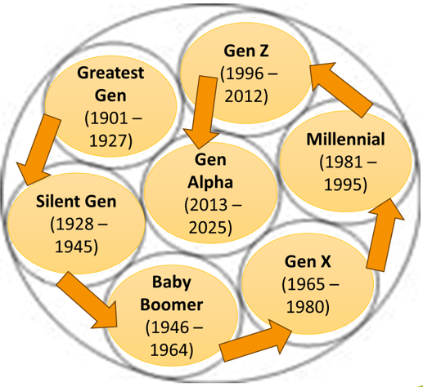
Food and nutrition seen by 42 % --
71 % Gen Z,
58 % Millennials,
36 % Gen X, and
22 % Boomers
Gen Z will get new focus by food marketers
Week 3
… social media influence…
2
Notes:
Slide #2C – influence, expectations, perceptions, and understanding…social media influence on consumers about food …
Week 3 Topic–
Consumers have a right to choose the products that match their desires and values.
Food labeling and the associated advertisements, including the “puffery” contained on labels, are known to impact purchasing choices.
Regardless, when making food purchases, it is the label on the product that consumers turn to when making their selections; oftentimes, a social influencer’s opinions provide a lasting impression.
Social media influencers likely are not as well informed about nutrition and dietary habits as trained experts, including registered dieticians and medical professionals.
Numerous entities conduct national and international surveys on what consumers want regarding types of foods and how they use labeling information in making their decisions.
Results of national and international non-government surveys include –
The 2023 Food and Health Survey (by the International Food Information Council -- IFIC) --
Four in ten Americans (42 %) have come across social media content on food and nutrition in the past year.
Exposure was heightened differently among the various generational groups –
71 % of Gen Z or Zoomers -- born between 1996 and 2012 – saw content;
58 % of Millennials -- born between 1981 and 1995 – saw content;
36 % of Gen X — born between 1965 and 1980 – saw content;
22 % of Boomers — born between 1946 and 1964 – saw content; and
No data were obtained from “others” – Gen Alpha -- born between 2013 and 2025; Silent Gen -- born between 1928 and 1945; and Greatest Gen -- born between 1901 and 1927.
Manufacturers convert survey findings into marketing campaigns.
Oftentimes, marketing campaigns result in the addition of wording to labeling and advertisements that are more puffery than fact.
For example, if consumers are looking for ways to reduce stress and a food package simply states, “reduce your stress by enjoying “X,” some consumers will interpret this statement to be factual.

Slide 3
70 % trusted top 3
Facebook -- 64 %,
YouTube -- 57 %, and
Instagram -- 51 %.
67 % trusted food and nutrition information.
Week 3
…trust in platforms…
3
Notes:
Slide #3C – influence, expectations, perceptions, and understanding…trust in social media trust regarding food advice…
Week 3 Topics –
From the 2023 Food and Health Survey (by the International Food Information Council -- IFIC) --
Although confusion is generated by social media content focused on food and nutrition, social media remains a popular place to obtain information.
For platforms –
Number 1 is Facebook at 64 %,
Number 2 is YouTube at 57 %, and
Number 3 is Instagram at 51 %.
Trust in social media content is high,
Two-thirds (67 %) trust this information;
At least seven in ten said they trust each of the top social media platforms.

Slide 4
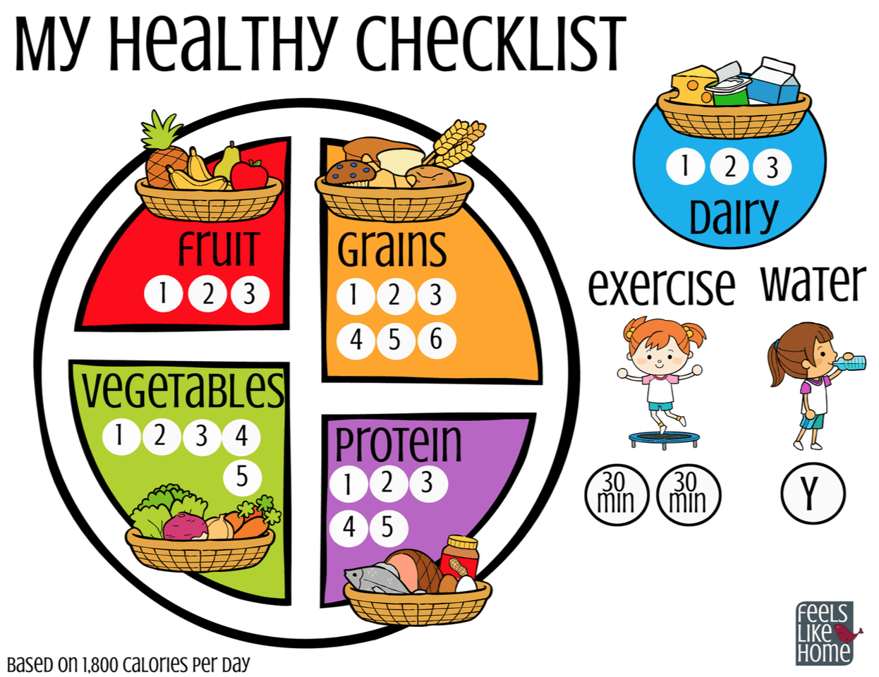
60 % -- made healthier choices
68 % -- conflicted on what to eat
42 % -- tried a new product
29 % -- tried a new restaurant
10 % -- changed their diet
72 % -- snacked daily
41 % -- ate until satisfied
24 % -- ate a pre-set amount.
This Photo by Unknown Author is licensed under CC BY-NC-ND
Week 3
…focus on healthy eating habits…
4
Notes:
Slide #4C – influence, expectations, perceptions, and understanding…healthy eating habits promoted by social media…
Week 3 Topic –
From the 2023 Food and Health Survey (by the non-governmental International Food Information Council -- IFIC) --
Social media tends to focus on healthier eating habits –
Six in ten Americans (60 %) say the content they find on social media about food and nutrition has encouraged healthier choices.
68 % said they have seen conflicting information on social media about what foods to eat or avoid, and
60 % agree that the conflicting information makes them doubt how to select foods for their eating choices.
As a result of social media content --
Half of Americans (51 %) said they have tried a new recipe
42 % said they have tried a new brand or product
29 % said they have tried a new restaurant
28 % said they have reevaluated their relationship with food
One in ten (10 %) said a recommendation or advertisement from an influencer on social media platforms has been a motivation for their eating pattern or diet
Snacking remains part of many people’s eating pattern –
18 % said they started a diet or eating pattern because of a social media post
Seven in ten Americans (72 %) snack at least once a day in addition to their main meals –
Reasons include –
Hunger and thirst being most important
Seeing the snack as a treat
Having a desire for something sweet and salty.
For the snack, when choosing the portion size --
41 % ate until they felt satisfied
24 % ate a pre-planned portion amount

Slide 5
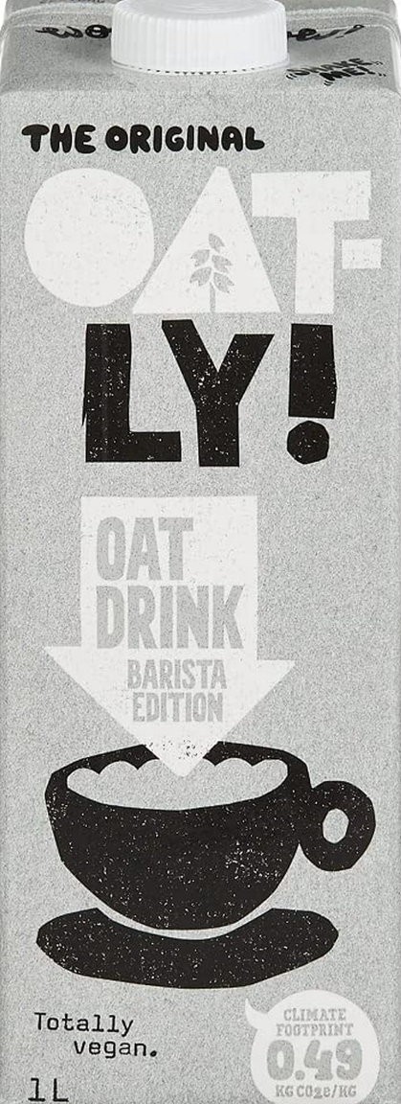
75 % -- were concerned
25 % -- made purchases based on climate impact
> 50 % -- aware of climate friendly actions --
Fruits and vegetables, not beef or dairy
Looked at packaging
Recyclable potential
Sustainability logos
Waste amount and type
Reusability
This Photo by Unknown Author is licensed under CC BY-NC
Week 3
…climate change influence…
5
Notes:
Slide #5C – influence, expectations, perceptions, and understanding…climate change and food choices…
Week 3 Topic –
Another International Food Information Council (IFIC) survey that was conducted in June 2022 but was published in October 2023 focused on consumer food purchasing decisions and climate change (“Perceptions and Purchase Impacts”).
This survey was not focused on social media’s impact on consumer decision-making.
Rather, this survey simply focused on consumer purchasing based on this relevant and timely social justice issue.
The survey identified –
There is a strong concern about climate change and food choices.
1,000 adults were interviewed.
Three in four Americans were concerned about climate change.
The majority were at least somewhat concerned about the diverse ways that food and beverages can impact climate change.
Of these, one in four consider climate impact when purchasing food and beverages.
Fruit and vegetables are considered more climate friendly than dairy and beef –
Livestock management and packaging waste were at the top of consumer concerns.
Labels stating recyclable or reusable best communicate climate friendliness.
Three in ten consumers perceived products with an “earth-friendly” label to be much higher in cost.
Consumers would seek out information on the package itself to learn more about choosing foods that are part of a climate-friendly diet.
Consumers most commonly make efforts to reduce food waste when eating or drinking at home.
Consumers were more likely to do their own in-person grocery shopping than getting take-out or on-line delivery of groceries (presumably due to added non-recyclable waste).
For food and beverage packaging, the most important determinants for deciding whether a food is climate-friendly are –
Recyclability,
Packaging amount, and
Reusability.
Most consumers think that not generating packing waste is among the top determinants of a climate-friendly food or beverage.
Plant-based alternatives are being sought for meat and dairy products.
These alternative products (e.g., plant-based pasta, rice, snacks, algae- or kelp-based foods) are now well integrated into the US food system.
These products focus on sustainability and innovation –
For example, upcycling -- taking plant-based components that ordinarily would have gone to waste and processing them for other use in other products, including pulp and spent grain from soy milk or oat milk being added to flour. Hopefully, such actions also include the upcycled products as ingredients – a legal requirement.
This process reduces food waste and contributes to sustainable food production.

Slide 6
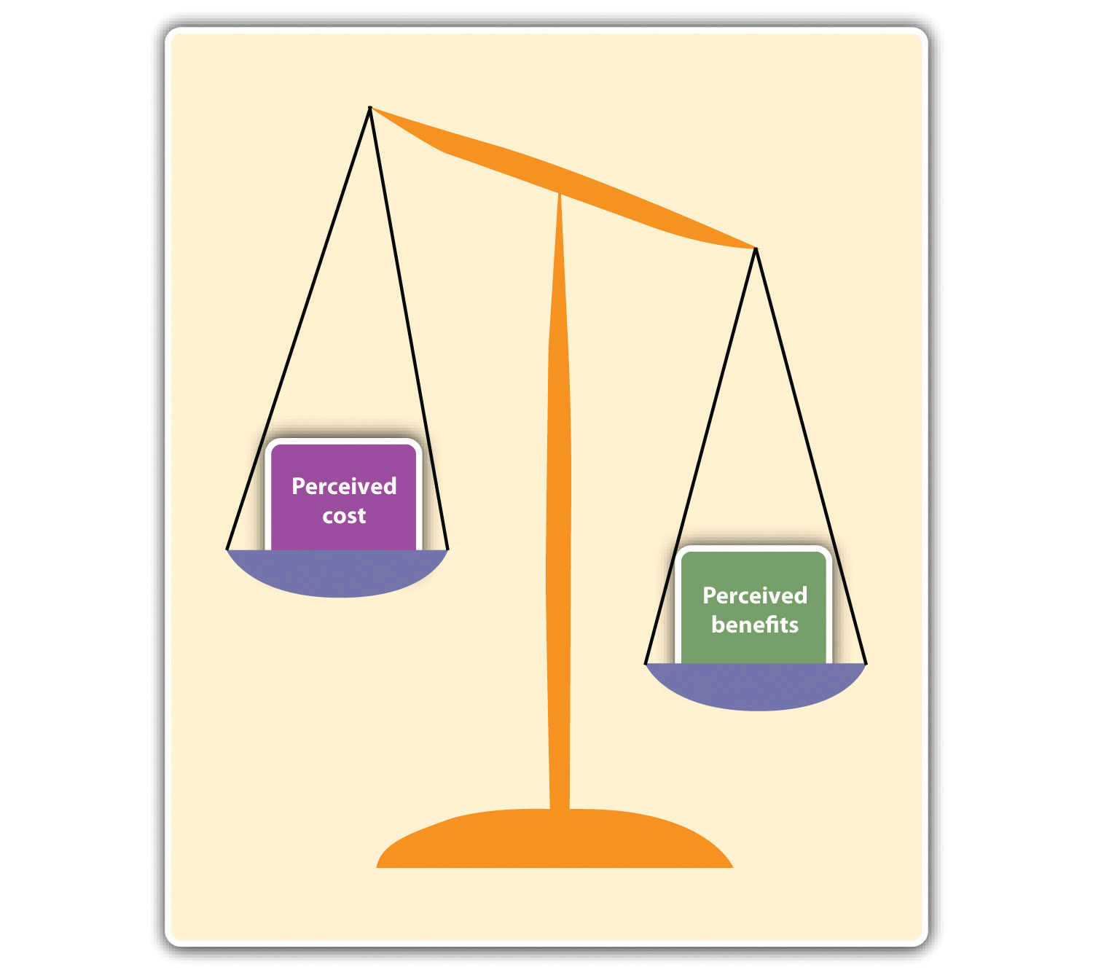
Price is the deciding factor
Then,
97 % are looking for what they want to see
Where from
56 % think sugar is hidden by manufactures
78 % want less than 5 ingredients (i.e., “simple food”
This Photo by Unknown Author is licensed under CC BY-SA-NC
Week 3
… cost versus benefit…
6
Notes:
Slide #6C – influence, expectations, perceptions, and understanding…perceived cost versus benefit…
Week 3 Topic –
Limitations on reliably delivering on what is preferred —
According to a survey conducted by OnePoll in 2024 –
The top concerns for consumers when buying food are –
Price, then
Preference for information consumers want to see on the label –
Where the product is from,
Number of ingredients, and
Packaging.
78 % of consumers want less extraneous information on the packaging surrounding the label in order to decrease confusion; and
97 % are looking for packaging that caters to their specific lifestyle —
Natural,
Non-GMO,
Organic,
Grass-fed, and
Pasture raised.
Overall,
There is a belief that manufacturers hide sugar in their products by –
Using different words for sugar on the actual label,
56 % of surveyed consumers say that have eaten something they later realized contained sugar.
78 % are looking for simple ingredients –
Americans find five ingredients to be the maximum for a “simple” food.

Slide 7
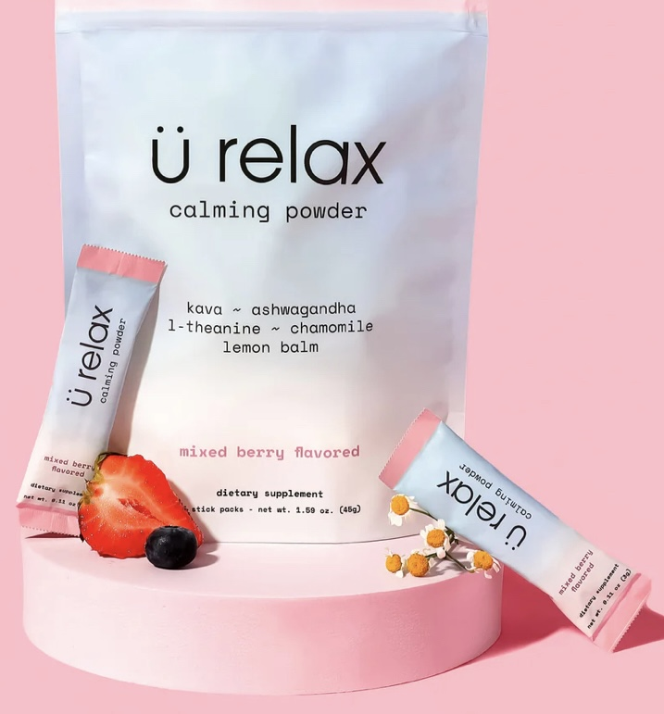
Liquid drinks and wellness
37 % wanted stress reduction
33 % wanted an energy booster
Alternative caffeine drink
Yerba mate
Yaupon tea
33 % wanted gut health
Probiotics
Prebiotics
Week 3
… trends in caring for mind and body…
7
Notes:
Slide #6C – influence, expectations, perceptions, and understanding…trends in caring for mind and body…
Week 3 Topic –
From “Food Trends for 2023 Will Include Wellness Drinks, Gut Health, Plant-Based Food Innovations, Confusion Around New Labels and Terminology” — Published January 2023, International Food Information Council - IFIC –
Liquid drinks appear to be the new focus for wellness, with added benefits like energy, mental health, and gut health support.
37 % said they wanted benefits of “more energy and less fatigue” from foods and beverages.
“Alt caffeine” choices rank high (e.g., yerba mate and yaupon tea, a lower-caffeine alternative with a sweet flavor profile that is derived from a species of holly native to the deep South).
Mocktail and nonalcoholic cocktail options are popular.
Note: There was a spike in alcoholic sales during the pandemic.
For Gen Z responders, “emotional/mental health” was among the top three benefits from food.
For those who wanted to reduce their stress --
33 % said they consumed foods/beverages that reduce the effects of stress, and
24 % said they drank less alcohol.
Rather than a focus on the effects on their minds, other consumers were interested in how food affected their gut.
Liquids are viewed as a positive way to add both probiotics and prebiotics.
Wellness drinks are sought out by –
25 % consume probiotics,
A probiotic is defined as live microorganisms that, when administered confer a health benefit on the host.
Probiotics have been steadily growing in popularity, with digestive/gut health being the third most commonly sought-after benefit among Americans.
Products beyond the yogurt section likely will begin to appear (e.g., added to chocolate, ice cream, juices, sauces, and nutrition bars).
Criteria for probiotics include:
It should be resistant to the acidic pH of the stomach,
It cannot be hydrolyzed by mammalian enzymes, and
It should not be absorbed in the gastrointestinal tract.;
It can be fermented by intestinal microbiota; and
The growth and/or activity of the intestinal bacteria can be selectively stimulated by this compound and this process improves host’s health.
23 % consume prebiotics.
A prebiotic is a substrate that is selectively utilized by host microorganisms conferring a health benefit;
They are a group of nutrients that are degraded by gut microbiota.
Prebiotics include: Fructans, galacto-oligosaccharides, starch and glucose-derived oligosaccharides, other oligosaccharides, and non-carbohydrate oligosaccharides.
In the slide picture of the “U Relax” product, the product name is quite targeted to draw individuals looking for a drinkable stress-reliever – “just add water”

Slide 8
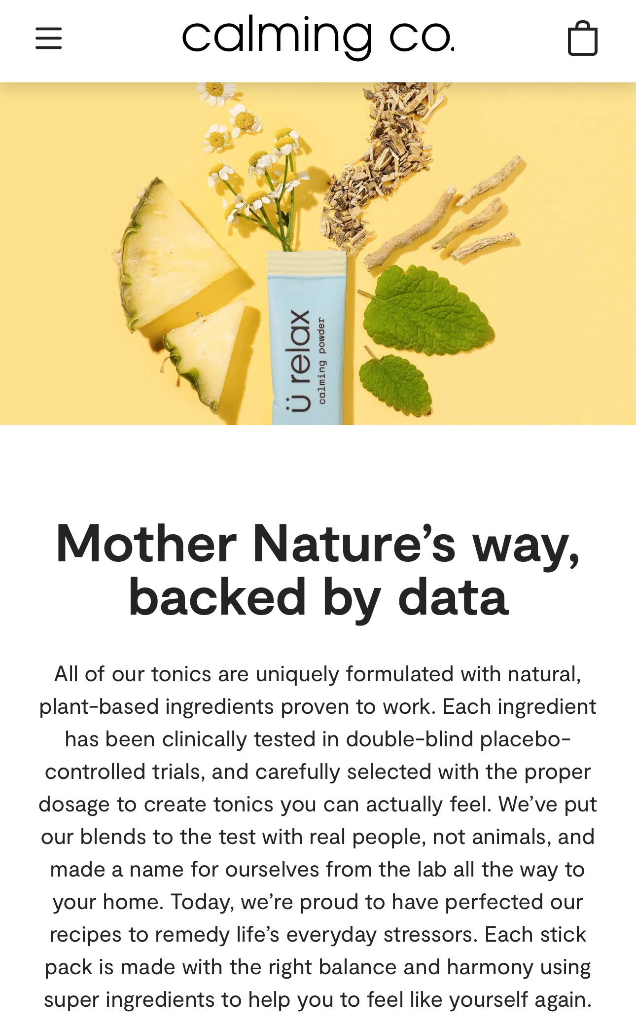
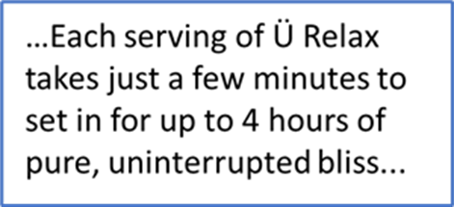
Over-the-counter
“Based on strong science”
But, not reviewed by FDA
“Testing on humans only”
Some ingredients were tested on rats
Week 3
…stress-reducing drink…
8
Notes:
Slide #8C –influence, expectations, perceptions, and understanding…stress-reducing drinks…
Week 3 Topic –
More about the Ü Relax calming powder by Calming Co.
The advertisement is very compelling regarding informing the consumer about the natural ingredients used, as well as the clinical trials conducted to “prove” that the product is effective in reducing stress.
However, since the data were not submitted to the DA for evaluation, the cautionary statement is required –
*Statements made in this site have not been evaluated by the FDA. These products are not intended to diagnose, treat, cure, or prevent any disease. These products are not recommended for children or pregnant/nursing women and should be used only as directed on the label. Do not combine with alcohol, drive, or operate heavy machinery after consumption. Ask a healthcare professional before use if you have or have had liver problems or are taking any medication.”
The manufacturer is required to document why it believes that the wording is not misleading.
The FDA has the authority to conduct its own testing on the product.
However, it is unlikely that FDA would have reason to believe that there is anything unsafe regarding the ingredients.
Thus, the product likely will remain in the marketplace without interruption.
The consumer must decide whether the statements are reasonable and not misleading.
Litigation is likely not fruitful due to the mandatory cautionary statement about the FDA not reviewing the data; the consumer has been adequately put on notice.
Other assertions made in the ad –
“Our naturally soothing formula promotes deep relaxation, calms your nerves, and brightens your mood.
Made with delicious fruit flavors for life’s everyday stressors.
Just add 1 packet to 4-6 ounces of cold water and feel your stress slowly slip away…
A long, deep breath in every sip
Each serving of Ü Relax takes just a few minutes to set in for up to 4 hours of pure, uninterrupted bliss.
DESTRESS & UNWIND
Come back to your center.
Take on the day with a clearer, calmer mindset.
SLOW THE MIND CHATTER
Quiet any racing thoughts.
Find stillness no matter what’s going on.
FEEL LIGHTER AND BRIGHTER
Shake off whatever’s weighing on you and get in a happy headspace.”
Some consumers are looking for product labeling that asserts health benefits.
Truthfulness gets iffy in such circumstances.
For full disclosure, I, the instructor, consume numerous dietary supplements everyday (e.g., turmeric, flax seed oil, saw palmetto, red rice yeast).
All are consumed under the belief that a positive health outcome will result from each individual supplement, affecting different aspects of health.
In addition, all carry the same required cautionary statement as the “U Relax” supplement) –
That is, the known health benefits have not been evaluated and affirmed by the FDA.
Regardless, the cost-benefit of risks, outcomes, and monetary outlay are deemed acceptable to me.

Slide 9
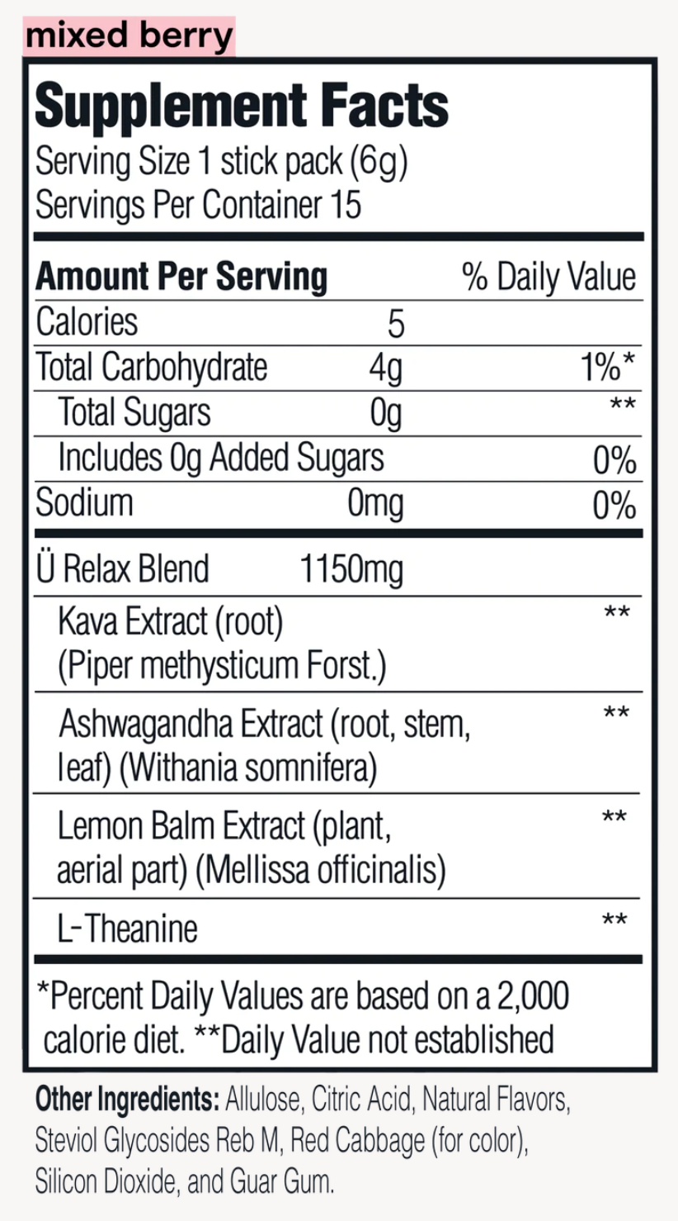
Zero sugar but
Allulose listed 1st
FDA permits exclusion sugar
Must use 0.4 cal/g
Negligible rise in blood sugar; no dental caries
Reb M also a sweetener
Natural flavor and color
Week 3
…flavored sweetener…
9
Notes:
Slide #9C –influence, expectations, perceptions, and understanding…flavored sweetener…
Week 3 Topic –
More about the Ü Relax calming powder by Calming Co.
This product is, in essence, “sugar.”
Note that the “blend” is fully described in terms of source of what is used to make the natural flavoring.
Allulose –
In 2019, FDA published guidance on the Nutrition Facts panel labeling for the sweetener Allulose.
Allulose is different from sugar in that it is not metabolized by the body in the same way as table sugar.
It has fewer calories, produces only negligible increases in blood glucose or insulin levels, and does not promote tooth decay.
Allulose is excluded from the total and added sugars declarations on the Nutrition Facts panel and Supplement Facts labels when used as an ingredient.
Allulose counts towards the caloric value of the food on the label, but enforcement discretion will allow use of a revise calorie count.
This is the first time FDA has allowed sugar to not be included as part of the total or added sugars declarations on labels.
Manufacturers must still include allulose in the total carbohydrates declaration.
A general factor of 0.4 calories per gram can be used.
Steviol glycosides from the leaves of Stevia rebaudiana (Reb M) are classified by FDA as high-intensity sweeteners.
FDA has received multiple Generally Recognized As Safe (GRAS) notifications on these substances from numerous manufacturers and has not objected to the intended uses in foods.
The GRAS notifiers established limits on use, including daily consumption amounts.
The Joint Food and Agricultural Organization/World Health Organization Expert Committee on Food Additives (JECFA) has established an acceptable daily intake (ADI) for steviol glycosides (i.e., 0-4 mg/kg bw/d), based on a no observed adverse effect level of 970 mg/kg bw/d (383 mg/kg bw/d, as steviol equivalents) from a two-year rat study, and the application of a safety factor of 100 to account for intra- and inter-species differences.
Use is self-limited due to organoleptic factors and consumer taste considerations.
Note that coloring is by red cabbage and is, thus, a natural color.
Flavors, as defined in regulation by FDA (21 CFR 501.22) –
Artificial flavor – a substance to impart flavor, which is not derived from a spice, fruit, vegetable, edible yeast, herb, bark, bud root, leaf or similar plant material, meat, seafood, fish, poultry, eggs, dairy, or fermented products therefrom.
Natural flavor – the essential oil, oleoresin, essence or extractive, protein hydrolysate, distillate, or any product of roasting, heating, or enzymolysis, which contains the flavoring constituents derived from these whose primary function is flavoring rather than nutritional.
In this case, a mixture of berries is used to derive the flavoring.
Labeling is permitted to simply state natural flavor without naming the source.

Slide 10
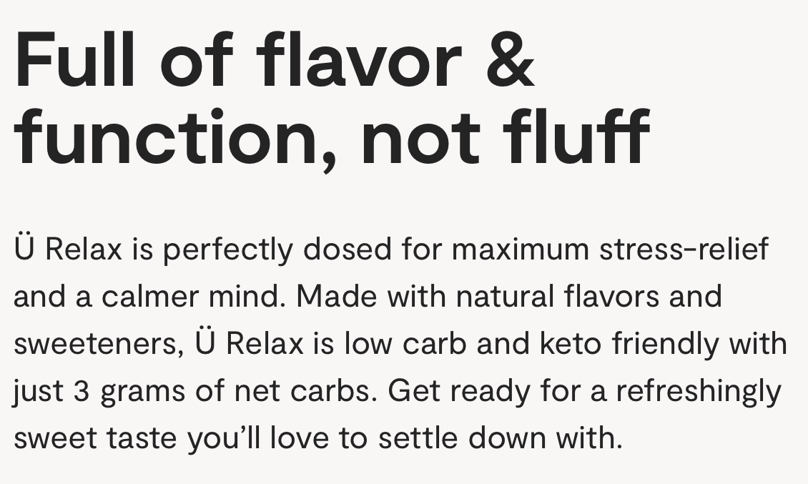
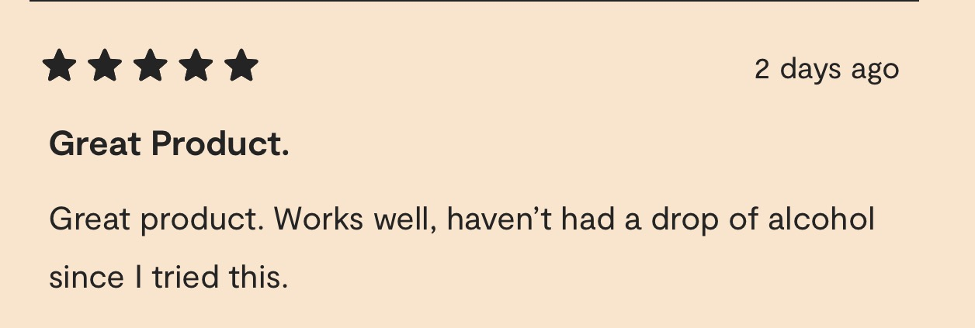
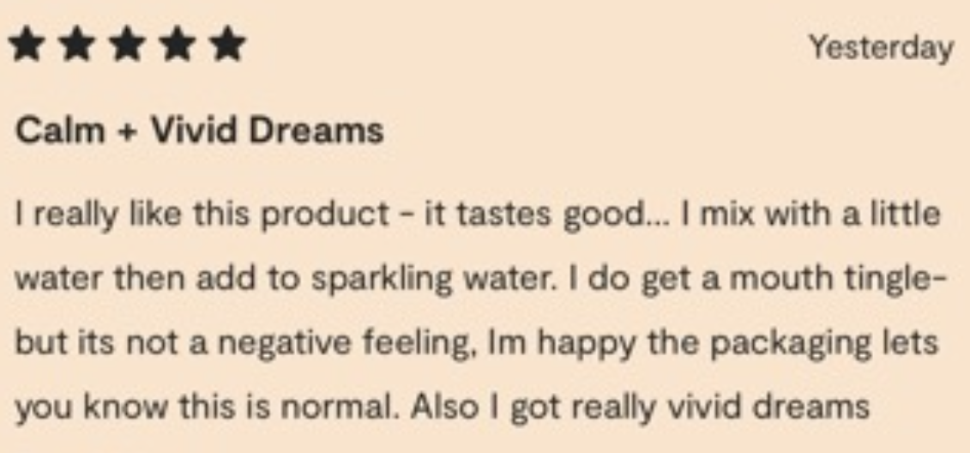
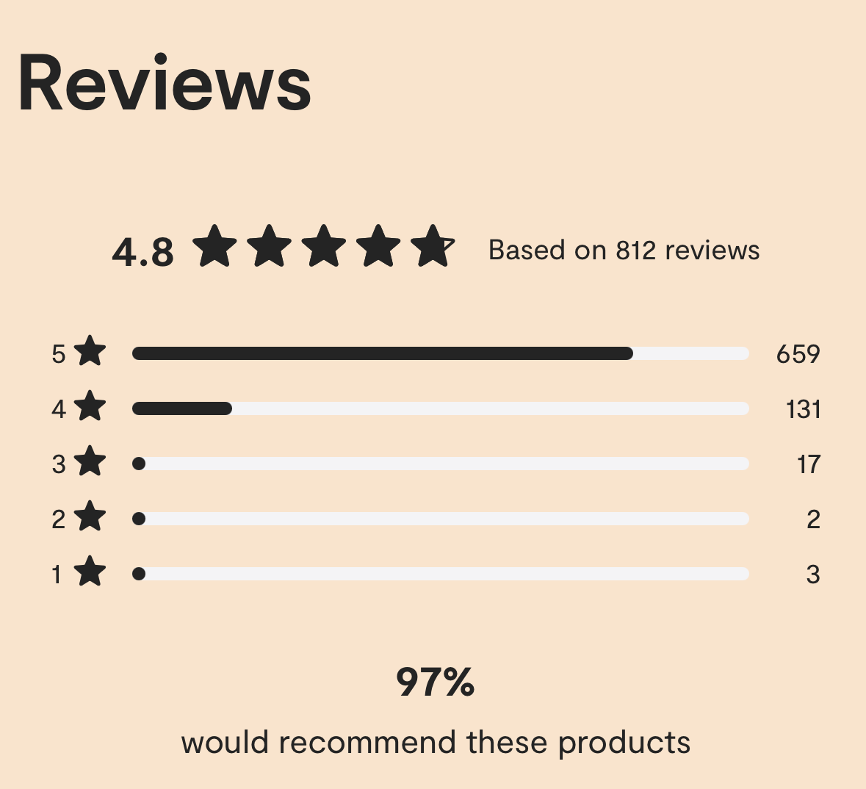
Week 3
…personal attestations…
10
Notes:
Slide #10C – influence, expectations, perceptions, and understanding…personal attestations…
Week 3 Topic –
The internet provides opportunity for individuals to weigh in on likes and dislikes regarding products and services.
In this situation, the manufacturer provides a forum on its sites, which maintains consumer ratings and comments.
Note the reference to vivid dreams and cessation of alcohol consumption.
There are consumers looking for over-the-counter remedies for a host of issues; some will read the reviews for this product and purchase the product based on those review.
It is uncertain as to how the court will view such attestations when the attestations are included on the sales portion of the manufacturer’s website; some courts may view such attestations as part of the advertisement and “labeling.”

Slide 11
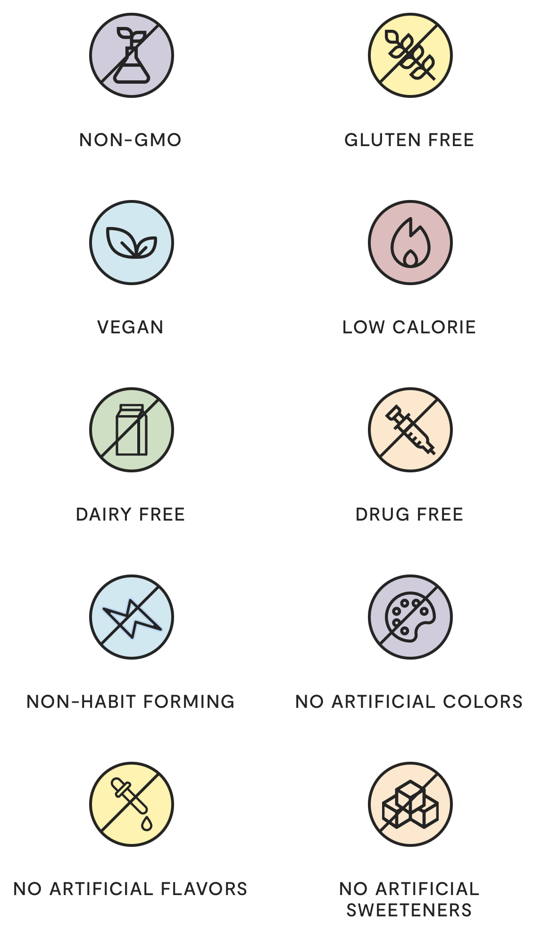
Possible confusing items --
Non-habit forming
Not sure is meant or how assessed
No artificial colors, flavors, or sweeteners
In this case, true but do you really understand?
Week 3
…catchall list…
11
Notes:
Slide #11C – influence, expectations, perceptions, and understanding…catchall list of product attributes…
Week 3 Topic –
Possible confusing items --
Non-habit forming
Not sure is meant or how assessed
No artificial colors, flavors, or sweeteners
In this case, true but do you really understand?

Slide 12
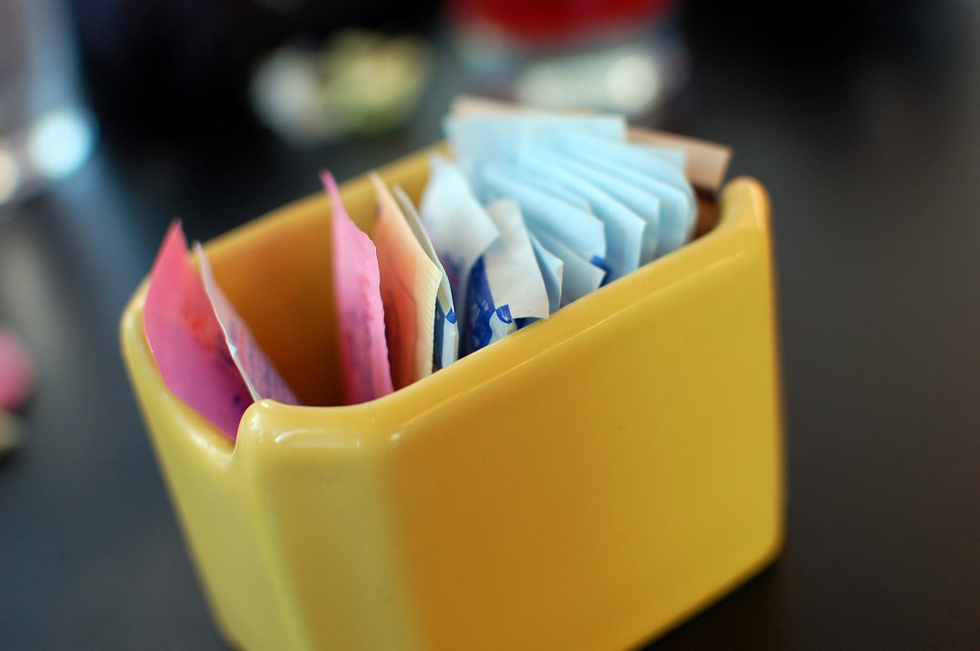
Acesulfame potassium (Sweet One, Sunett)
Advantame
Aspartame (NutraSweet, Equal)
Neotame (Newtame)
Saccharin (Sweet'N Low)
Sucralose (Splenda)
All other sweeteners are NOT artificial
This Photo by Unknown Author is licensed under CC BY
Week 3
…artificial sweetener list…
12
Notes:
Slide #12C – influence, expectations, perceptions, and understanding…artificial and other sweetener list…
Week 3 Topic –
Artificial sweeteners are many times sweeter than table sugar (sucrose).
The caloric content generally is negligible, which is why they are sometimes referred to as non-nutritive.
FDA has approved six artificial sweeteners as food additives –
Saccharin
Aspartame
Acesulfame potassium (acesulfame-K, or Ace-K)
Sucralose
Neotame
Advantame
FDA has received GRAS notifications on a host of plant- and fruit-based sweeteners
Steviol glycosides from the leaves of the stevia plant (Stevia rebaudiana (Bertoni) Bertoni) or fermentation-based processes
Extracts from Siraitia grosvenorii Swingle fruit (Luo Han Guo or monk fruit)
Thaumatin
FDA permits use of sugar alcohols, another class of sweeteners, as sugar substitutes (slightly lower in calories than sugar and do not promote tooth decay or cause a sudden increase in blood glucose)
Erythritol
Lactitol
Maltitol
Mannitol
Sorbitol
Xylitol
Another class of sweeteners are sugars that are metabolized differently than traditional sugars
These meet the clinical definition of a sugar, but they are metabolized by the body differently than sucrose
FDA has evaluated GRAS notices for –
D-allulose (also referred to as D-psicose)
D-tagatose
Isomaltulose
There are sweeteners not allowed in the US due to safety concerns –
Cyclamates and their salts (e.g., calcium, sodium, magnesium, potassium)
Whole-leaf and crude stevia extracts – which differ from the highly purified steviol glycosides from stevia leaves

Slide 13
10-minute break
Take a stretch…
Week 3
13
Notes:
Slide #8C – Take a stretch…
Week 3 Topics –
10-minute break

Slide 14
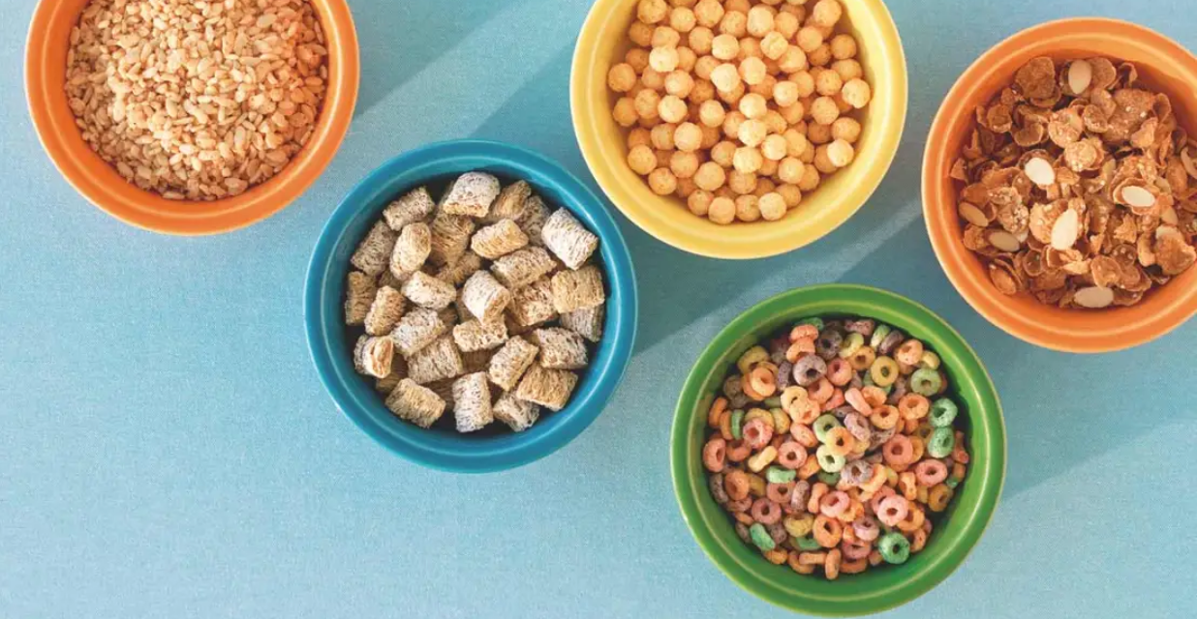
Claims inflate healthfulness of nutritionally poor foods –
“free,” “high,” “lite,” “low,” “more,” “reduced,” and added nutrients (e.g., folic acid)
FDA discourages use for snacks--
Consumers –
Disregard elevated, less healthful nutrients like cholesterol
Reliance on the Nutrition Facts panel was not consistent
High Iron
Added Folic acid
More Riboflavin
Week 3
…fortified snacks…
14
Notes:
Slide #14C – influence, expectations, perceptions, and understanding…fortified snacks…
Week 3 Topic –
The U.S. government conducts surveys to assess the effectiveness of existing regulations.
Use of survey results from within the past ten-year period is a common, acceptable practice.
Nutrient content claims have been regulated since 1990.
These are label claims that characterize the level of a nutrient in a food (e.g., nutrient content claims) if they have been authorized by FDA in accordance with regulatory criteria.
Nutrient content claims describe the level of a nutrient in the product, using terms such as free, high, and low, or they compare the level of a nutrient in a food to that of another food, using terms such as more, reduced, and lite.
An accurate quantitative statement (e.g., 200 mg sodium) that does not otherwise “characterize” the nutrient level may be used to describe the amount of a nutrient present.
However, a statement such as “only 200 mg of sodium” characterizes the level of sodium by implying that it is low.
Therefore, the food would have to meet the nutritional criteria for a “low” nutrient content claim or carry a disclosure statement that it does not qualify for the claim (e.g., “not a low sodium food.”
Most nutrient content claim regulations apply only to those nutrients that have an established Daily Value.
The requirements that govern the use of nutrient content claims help ensure that descriptive terms, such as high or low , are used consistently in all types of food products and are thus meaningful to consumers.
Healthy is an implied nutrient content claim that characterizes a food as having “healthy” levels of total fat, saturated fat, cholesterol, and sodium, as defined in the regulation authorizing the use of the claim.
Percentage claims for dietary supplements are another category of nutrient content claims.
These claims are used to describe the percentage level of a dietary ingredient in a dietary supplement and may refer to dietary ingredients for which there is no established Daily Value, provided that the claim is accompanied by a statement of the amount of the dietary ingredient per serving.
In “Vitamin-Fortified Snack Food May Lead Consumers to Make Poor Dietary Decisions,” 2016 —
The FDA policy of fortification of foods discourages fortification of foods such as snack foods and carbonated beverages (Note – FDA authority does not permit FDA to prohibit such use).
However, some manufacturers add vitamins and minerals to some of these foods.
Results from the approximately 5,000 responses showed that when the snack food carried a nutrient content claim for vitamin fortification, participants were less likely to look for nutrition information on the Nutrition Facts label.
In addition, participants were more likely to select the product for purchase and consider the product as healthier while also being less likely to correctly choose the healthier product.
The overall conclusion was that snack foods fortified with vitamins may cause consumers to make poor dietary decisions.
In “Nutrient Content Claims: How they Impact Perceived Healthfulness of Fortified Snack Foods and the Moderating Effects of Nutrition Facts Labels,” 2017 –
This survey was a follow-up to the “Vitamin-Fortified Snacks…” survey of 2016.
Results from the approximately 5,000 responses showed --
When nutrient content claims are present, such claims may inflate perceived healthfulness of nutritionally poor foods.
Respondents believed the foods contained some healthful nutrients and were, thus, intending to purchase the items.
The claims decreased perceptions of the presence of certain less healthful nutrients.
The Nutrition Fact Panel had mixed effects on the impact of nutrient content claims.

Slide 15
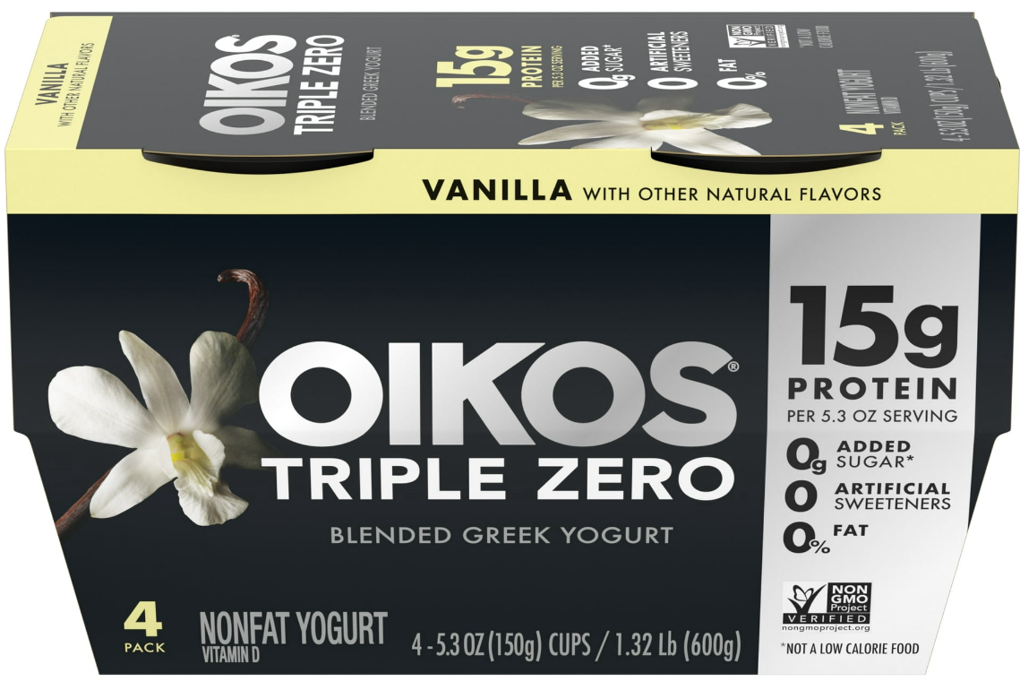
Females and the more educated
Whites less so than Blacks and Hispanics
Health-conscious types also want Nutrition Facts
Cancer patients want convenient snacks beyond nutritional supplements –
Cheese
Fruit juice
Soup
Yogurt
Week 3
…who prefers fortification…
15
Notes:
Slide #15C – influence, expectations, perceptions, and understanding…who prefers fortification…
Week 3 Topic –
In “As Much Calcium as a Glass of Milk! — Understanding American Consumers’ Preferences for Fortified Food,” 2016 —
This study focused on socio-demographic, as well as psychological correlates.
Results from the approximately 6,700 responses revealed that females and the more educated have greater preferences for fortified foods.
White Americans held the least favorable views on fortified foods when compared to Black and Hispanic Americans.
For the psychological predictors, people who were more health-conscious were more likely to prefer fortified foods, as well as find the Nutrition Fact Panel useful. S
Still, there was general confusion about healthy food choices.
In “Fortified Snack Preferences among Patients with Cancer,” 2022 –
This study was conducted by the Department of Agricultural Food and Nutritional Sciences, University of Alberta, Edmonton, Alberta, Canada.
The study of 150 patients with cancer was designed to identify snack foods preferred as potential vehicles for essential nutrient fortification.
Patients had breast, gastrointestinal, lung, or colorectal tumors.
Suitable snacks included –
Cheese,
Egg products,
Fruit juice,
Protein bars,
Soup, and
Yogurt.
Desired characteristics for snacks included –
Convenient,
Easy to chew,
Easy to swallow,
Flavorful,
Nutritious, and
Ready to eat.
Patients with High and Moderate symptom clusters were more likely to have reduced food intake and higher consumption of oral nutritional supplements.
The study provides insight to guide development of fortified snacks and possibly government intervention to facilitate access to essential nutrients for medical reasons.
As a reminder, the FDA discourages industry from fortifying snack foods.
Manufacturers read the survey results, even from FDA’s own surveys and from academia, and respond to consumer desires.
Ultimately, FDA likely will be petitioned to regulate fortification of snacks.

Slide 16
Guiding Stars Program™, a shelf-tag nutrition system --
Influences demand (3-Star as “Best” versus 1-Star as “Good”) –
Simulated nutrient changes affecting diet quality versus a 10 % price change --
Lower cost choices selected regardless of nutrient changes
Good
Better
Best
More whole grain
Less added sugars
Lower calories
Lower Sodium
Week 3
…nutrient vs price changes…
16
Notes:
Slide #16C – influence, expectations, perceptions, and understanding…nutrient versus price changes…
Week 3 Topic –
In “Simulating the Potential Effects of a Shelf-Tag Nutrition Information Program and Pricing on Diet Quality Associated with Ready-to-Eat Cereals,” 2014 —
Research has shown that the Guiding Stars Program™, a shelf-tag nutrition system used in some U.S. grocery stores increases consumer demand for products that the Program considers more nutritious.
Note: The U.S. government discourages use of such systems but cannot prohibit them; thee are no standards for describing, consistently, what is “good” and what is “bad.”
Such systems often place emphasis on nutrient profiles that are not consistent with healthy regulatory criteria and upon non-standardized environmental criteria.
Such rating systems are shown to cause consumer confusion and mistrust in labeling.
The Program analyzes foods and provides a 1-, 2-, or 3-Star rating to indicate foods with Good, Better, and Best nutrition.
In this project, a program Star change and/or price change of up to 10 % greater was simulated and the impact on intakes of whole grains, added sugars, sodium, and calories were assessed.
The results showed a small effect on the program Star change but a larger effect for a 10 % price change.

Slide 17
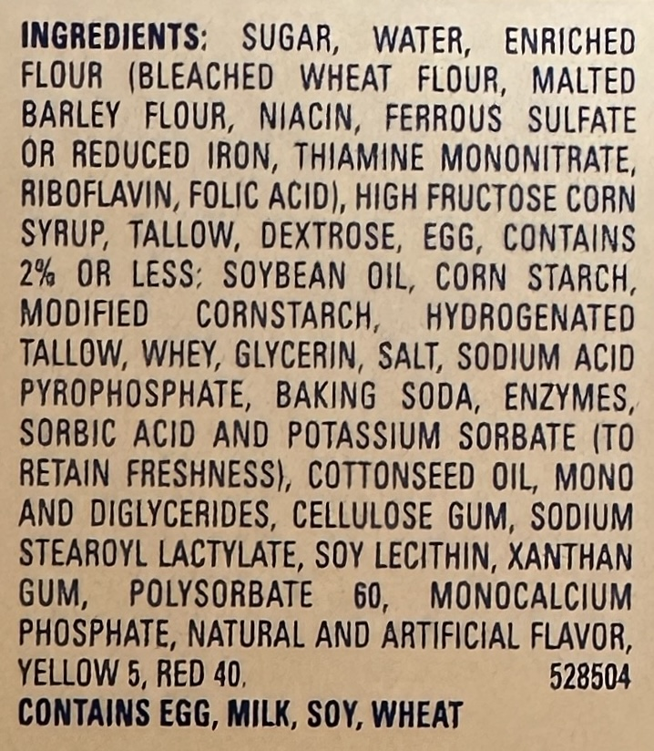
Study of 2,300 adults –
1,500 with celiac disease
Relied on statement
800 with sensitivity
Relied on the voluntary placement of a logo and not on the mandatory ingredient statement
Note: This product has more than one gluten-containing grain
But, if no wheat …
This Photo by Unknown Author is licensed under CC BY-NC-ND
Week 3
… gluten ingredient vs logo…
17
Notes:
Slide #17C – influence, expectations, perceptions, and understanding…gluten ingredient versus logo…
Week 3 Topic –
In “Food Label Usage and Reported Difficulty with Following a Gluten-Free Diet Among Individuals in the USA with Coeliac Disease and Those with Non-Coeliac Gluten Sensitivity,” 2013 —
The study was conducted with approximately 1,500 adults with coeliac disease (celiac) and approximately 800 adults with non-coeliac gluten sensitivity.
Individuals with non-coeliac gluten sensitivity relied more on the gluten-free claim associated with labeling whereas individuals with coeliac disease relied more on the ingredient list for finding gluten-free foods.
Note that wheat is one of the “Big Nine” allergens causing >90 % of allergic reactions from foods.
Only the “Big Nine” are required to be identified in the “contains” statement relative to allergens.
If other food allergens are present, such items do no get singled out and listed in the “contains” statement.
Thus, if the Slide pic was of a product that did not contain wheat but did contain barley, there would be no designation of barley in the “contains” statement; there may or may not have been a gluten-free logo.

Slide 18
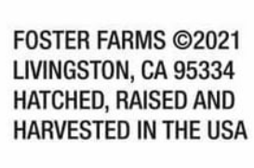
Consumers still want product of USA
Notice voluntary raising “ad”
Misunderstanding about USDA logos with product of the USA
Consumers will pay more for product of USA (up to 43 %)
Beef and pork industries are still unwilling to invest in label control; other industries do and label as product of USA
Week 3
…COOL and USDA …
18
Notes:
Slide #18C – influence, expectations, perceptions, and understanding…value of COOL and other USDA logos…
Week 3 Topic –
From a recent study on the value of labeling for COOL (Country-of-Origin-Labeling) and other USDA labels –
An assessment was made regarding consumers’ value of the voluntary use of “product of the USA” labeling claims.
A web-based survey was conducted (4,834 respondents) in July-August 2022.
The survey population consisted of adults who do at least half of the grocery shopping for their household and have purchased beef or pork products within the past 6 months.
Research questions included —
Do consumers notice the “Product of USA” labeling claim?;
Do consumers understand the current “Product of USA” definition and other “USDA labeling (e.g., USDA Prime) as it relates to country of origin?; and
How much are consumers willing to pay for meat products bearing the “Product of USA” labeling claim for the current definition and potential revised definitions (e.g., if the meat were from an animal that was born, raised, slaughtered, and processed in the U.S.)?
Key findings were –
Consumers do notice the “Product of USA” claim when present and noticeability is strengthened when a flag icon is included.
Since meat products all are required to have the USDA mark of inspection on every package and some also have a U.S. grade shield and/or organic shield, some consumers incorrectly believed that the required mark of inspection and grade shield (if present) also meant that the product qualified for “Product of USA.”
Imported product into the USA and then further processed in the USA may have the USDA mark of inspection and the USDA grade shield would not necessarily qualify for the USA COOL labeling.
The USDA grade shields reflect product quality, as assessed by USDA graders.
Product may or may not be from the USA.
Finally, consumers are willing to pay more for meat products with the “Product of USA” labeling claim.
Consumers also were willing to pay more (i.e., 32 – 43 %) if it is known that more production steps take place in the U.S.
Importantly, the willingness to pay more was not affected by lower versus higher household income.
Recall from Week 2, when discussing international impacts on US labeling, the US was sued by Canada and Mexico ($4B) for unfair trade practices.
The US congress then repealed the law and regulations specific to beef and pork whole muscle cuts of meat.
The US beef and pork slaughter/processing industries were unwilling to invest in control procedures to segregate the foreign-born product from the US-born product similarly as for poultry and for fresh produce.
Part of the reason for this is that the US imports a significant amount of beef and pork
The consumer still prefers US born and raised product and is willing to pay more but the industry is not yet willing to make the investment.
Consumer demand is not yet strong enough to persuade industry.

Slide 19
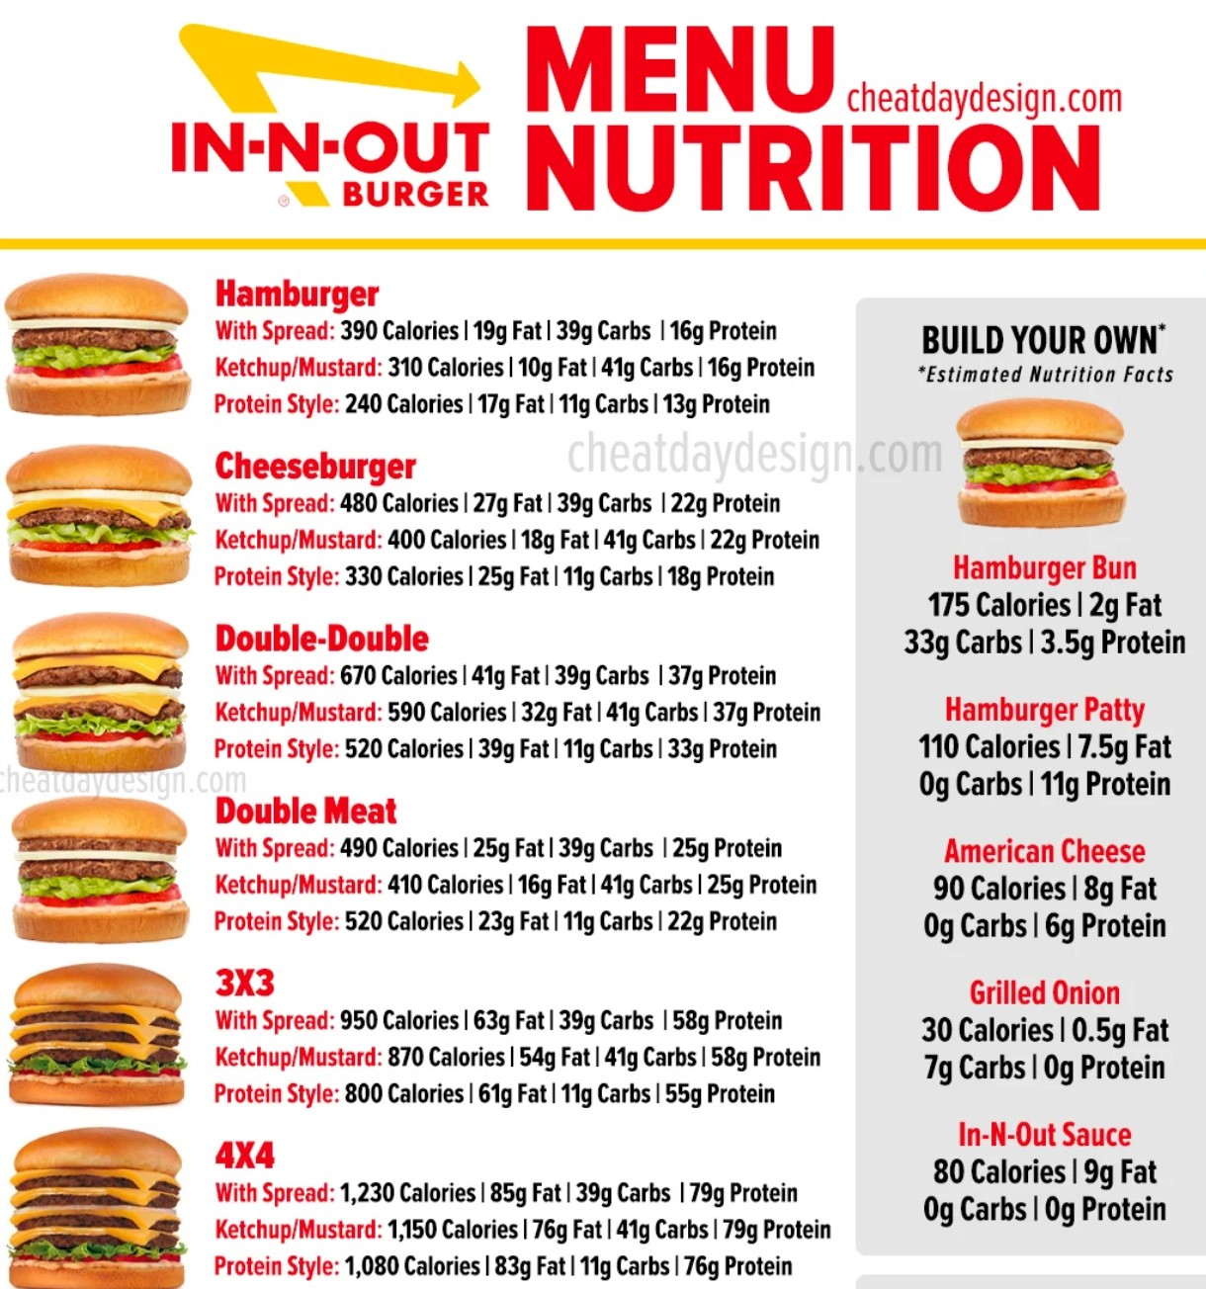
Nutrition Facts panel use
Grocery
~ 80 % of consumers
Fast-food restaurant
40 %, up from 20 % in 2008
Increasing caloric intake away from home
> 30 % of food energy, up since 2011
Bought fast-food in past year
~ 93 % of consumers
Ate at sit-down restaurant
~ 83 % of adults
Week 3
…getting factual information…
19
Notes:
Slide #19C – influence, expectations, perceptions, and understanding…getting factual information…Nutrition Facts panel…
Week 3 Topic –
In “National Health and Nutrition Examination Survey (NHANES),” the Economic Research Service, US Department of Agriculture conducted this recurring survey.
The results from through March 2020 showed –
Nearly 80 % of US adults regularly used the Nutrition Facts panel on food labels in buying decisions.
Through additional surveying of consumers through the Flexible Consumer Behavior Survey --
The share of calories from “Food Away From Home” has increased since 2011 to more than 30 % of the total food energy intake.
Through March 2020 –
About 93 % of adults bought food from a fast-food restaurant, and
83 % of adults ate in or got take-out from a sit-down restaurant in the past twelve months.
The percent of consumers that saw nutrition information on a fast-food restaurant menu increased significantly from 20 % in 2008 to 40 % in 2020.

Slide 20
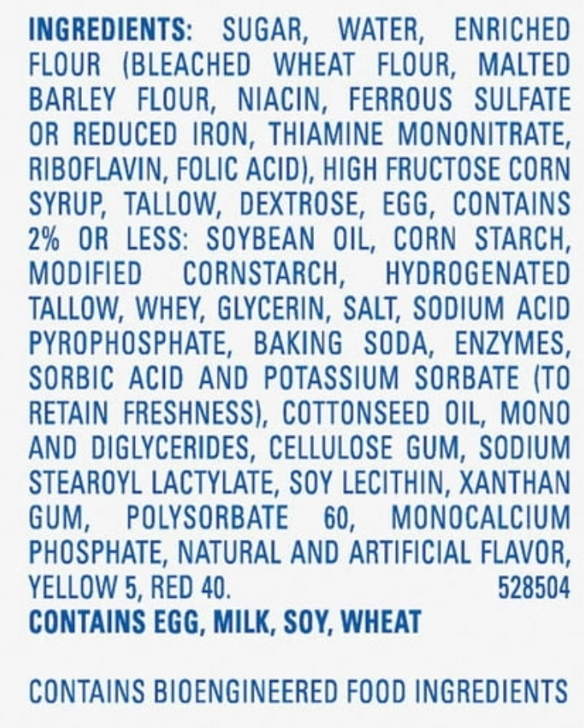
Safety by FDA
Directly added
Indirectly added
Cookware, containers for storage, packaging
Ingredient
Has a purpose
All listed –
Descending order by weight
Standard of safety –
Reasonable certainty of no harm under conditions of intended use.
For “Twinkie”
Week 3
…ingredients…
20
Notes:
Slide #20C – influence, expectations, perceptions, and understanding…ingredients and their use …
Week 3 Topic –
Shifting focus away from survey information to inform labeling policy to factual content on the label.
The FDA regulates the safety of ingredients added –
Directly to food and
Added to substances that come into contact indirectly with food through –
Cookware,
Containers that store food, or
Packaging materials.
Food manufacturers are responsible for
Marketing safe foods.
Ingredients (whether added directly or indirectly) are held to the standard of –
“There must be a reasonable certainty of no harm under the conditions of its intended use.”

Slide 21
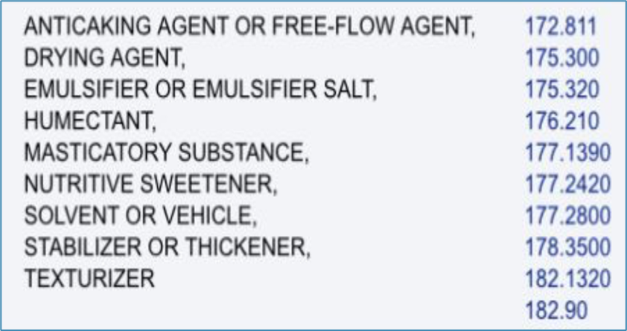
“Substances Added to Food Inventory”*
~ 4,000 approved
Publicly available
Search by ingredient
Get technical use
Link to definitions for use
In 17 languages
Gold standard worldwide
https://www.cfsanappsexternal.fda.gov/scripts/fdcc/?set=FoodSubstances
Glycerin
Week 3
…ingredient dataset…
21
Notes:
Slide #21C – influence, expectations, perceptions, and understanding…publicly available ingredient dataset …
Week 3 Topic –
FDA maintains a list of –
Approximately 4,000 substances in its public database that potentially could be used as ingredients, including --
A listing of those no longer authorized for use in food,
Search the listing for a particular additive and find its technical effect(s) --
see “Substances Added to Food Inventory” – formerly EAFUS — https://www.cfsanappsexternal.fda.gov/scripts/fdcc/?set=FoodSubstances
Here, find –
Chemical Abstract Service (CAS) Registry Number for the substance or
Numerical code assigned by FDA to those substances that do not have a CAS Registry Number.
Substance –
The name of the ingredient as recognized by FDA..
Used for – technical effect –
The physical or technical effect(s) the substance has in or on food; see 21 CFR 170.3(o) for definitions..
21 CFR --
The Code of Federal Regulations where the item is listed.
Flavor and Extract Manufacturers Association (FEMA) –
This organization has established expert panels to evaluate and make independent determinations on the GRAS – Generally Recognized as Safe – stat us flavoring substances.
The FEMA number is provided here as a reference to FEMA’s GRAS assessments.
Joint Expert Committee on Food Additives (JECFA) –
An international expert scientific committee that is administered jointly by the Food and Agriculture Organization of the United Nations (FAO) and the World Health Organization (WHO).
Color Additives –
For a substance to be used as a color additive in the US, it must be authorized by a regulation in 21 CFR Part 73, 74, or 82.
Page last updated:
Date (e.g., 12/22/2023).
Language Assistance Available –
At least 17 options
On Class Notes, see also a copy of the actual page when searching “glycerin.”

Slide 22
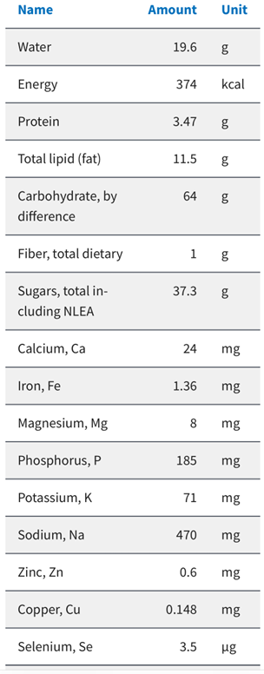
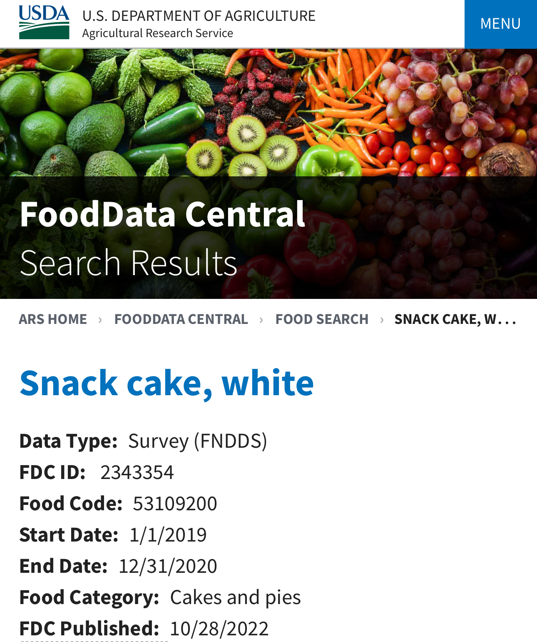
Supports nutrition delivery
Maintains quality
Characterizes a food
Makes foods affordable
Becomes a food –
The food has a nutrient profile
see FoodData Central https://fdc.nal.usda.gov
Week 3
…ingredient use…
22
Notes:
Slide #22C – influence, expectations, perceptions, and understanding…reasons for use and effects of ingredient…
Week 3 Topic –
Food ingredients are used for a variety of reasons, including to –
Support nutrition delivery;
Maintain product quality and freshness;
Prevent spoilage during transport, storage, and sale;
Make foods more appealing;
Ensure that familiar foods have consistent qualities;
Extend self-life and prevent food waste;
Make some foods more affordable; and
To aid in the processing and preparation of foods.
Ingredients can impact health --
Some may be healthful or unhealthful to people with medical limitations --
Table salt (sodium chloride composed of two minerals, sodium at 40 % and chloride at 60 %) --
Plays a role in enhancing the flavors in foods.
It is the sodium that is detrimental to health
People with high blood pressure or heart disease are at higher risk for elevating blood pressure with too much sodium.
Most healthy adults should try to eat less than 2,300 mg of sodium per day.
African Americans, middle-aged and older adults, and people with high blood pressure, diabetes, and/or kidney disease should eat less than 1,500 mg of sodium each day.
In the body of humans (and possibly animals) the proteolytic processing of the epithelial sodium channel (i.e., proteolyzed ENaC) is believed to function as the human salt tase receptor.
Thus, if sodium was replaced by potassium and combined with chloride, the new “ingredient” becomes a sodium substitute that works exactly like sodium chloride and is known to be more environmentally friendly than sodium chloride in helping plants grow.
Sugar or sucrose –
Best known for the sweetness it brings to food.
It provides texture and structure to baked goods;
Certain sugars like glucose react with proteins to create desirable flavors and the brown color through a process known as the Maillard reaction.
It can negatively impact diabetes, gout, obesity, high blood pressure, heart attack, stoke, cancer, asthma, tooth decay, depression, and early death outcomes.
Natural and artificial high intensity sweeteners bind to taste receptors of “buds” on the tongue (T1R2+T1R3)
Natural sweeteners bind to different portions of the buds than the artificial sweeteners;
This is the reason different levels of sweetness result based on the artificial sweetener.
Artificial sweeteners (sugar substitutes) formally approved and named as artificial sweeteners by FDA and included within the regulations with specific limitations on use include:
Acesulfame potassium (Sweet One, Sunett).
Advantame.
Aspartame (NutraSweet, Equal).
Neotame (Newtame).
Saccharin (Sweet'N Low).
Sucralose (Splenda).
Sweeteners not formally approved by FDA but permitted –
Luo han guo (Monk Fruit in the Raw).
Purified stevia leaf extracts (Truvia, PureVia, others).
Other countries, such as those in the European Union, have more sugar substitute options than does the US.
The FDA allows product-makers to use sugar alcohols –
Erythritol,
Lactitol,
Maltitol,
Mannitol (which requires the label to state “excess consumption may have a laxative effect),
Sorbitol (which requires the label to state “excess consumption may have a laxative effect), and
Xylitol
If you're living with a rare genetic disease called phenylketonuria. Foods and drinks with aspartame can lead to serious health problems.
If you have a bowel disease. Using sugar substitutes might make your symptoms flare up.
Dietary guidelines for Americans say adults shouldn't give sugar substitutes to children under 2 years old. In general, experts need to do more studies to learn what long-term health effects sugar substitutes might have on children. Most studies have looked at the effects in adults.
Health benefits linked to sugar substitutes
If you replace added sugar with sugar substitutes, it could lower your risk of getting tooth decay and cavities.
Sugar substitutes also don't raise the level of sugar in the blood.
For adults and children with overweight or obesity, sugar substitutes also might help manage weight in the short term. That's because sugar substitutes often are low in calories or have no calories. But it's not clear whether sugar substitutes can help people manage their weight over the long term.
Over time, it's most important to eat a healthy diet and get exercise.
Health concerns linked to sugar substitutes
Health agencies have clarified that sugar substitutes do not cause serious health problems.
Sugar substitutes also are not linked to a higher risk of cancer in people. Studies dating back to the 1970s linked the artificial sweetener saccharin to bladder cancer in rats. Since then, research has shown that those findings don't apply to people.
Some research on long-term, daily use of artificial sweeteners suggests a link to a higher risk of stroke, heart disease and death overall. But other things people do, or healthy habits that people don't do, may be the cause of the higher risk.
Other research is looking at long-term use of sugar substitutes and the gut. Many focus on how the gut and brain communicate. Researchers are checking to see if sugar substitutes affect cravings for sweets, the way people feel hunger and how the body manages blood sugar.
Sugar alcohols, stevia and luo han guo can cause bloating, gas and diarrhea. The amount of sugar alcohol that causes these symptoms varies from person to person.
In general, it is safest to take in small amounts of sugar substitutes. And it's best to use sugar substitutes for a short time, or just every once in a while. So try to cut back if you use them a few times a day.
Fat –
Provides flavor and a creamy texture to foods known as mouthfeel.
There is not a well-known taste receptor for fat, --
This is why it is hard to mimic in foods.
There are several types of fat –
Saturated fat (e.g., naturally contained in animal sourced foods like lard or butter) –
Important for creating the flaky texture in baked goods, and
Remain solid at room temperature.
Are perceived as “unhealthy” because –
They can lead to heart disease and stroke and can elevate cholesterol levels.
Unsaturated fats (e.g., monounsaturated fat and polyunsaturated fat found in olive oil and canola oil) –
Perceived as “healthy” fat and
Important for providing mouthfeel in products but not the same texture or structure as saturated fat;
Liquid at room temperature.
Since January 2020, the addition of artificial trans fats (i.e., partially hydrogenated oil) have been banned from being added to foods made or sold in the US.
Trans fat is reduced but not eliminated from foods and,
Must be declared on the food label.
There is a loophole in defining “free of trans fat” –
The label can say “0 trans fat” if there is less than 0.5 grams per serving.
High fat animal products may have natural sourced trans fat,
These animal products do not have detectable trans fat –
Lean beef, lamb, and pork,
Fish high in omega-3 (salmon, albacore tuna, sardines, lake trout, mackerel, herring), and
Skinless poultry.
The identification of trans fat on meat and poultry products is voluntary, at this time because the USDA must issue separate regulations; the FDA regulations were not applicable to USDA products.
Some manufacturers are including this nutrient on the label.
Acid –
May not be a specific ingredient but it plays a role in flavor and food processing.
Acidic ingredients include –
Acetic acid,
Citric acid (in fruit),
Malic acid (in apples), and
Vinegar.
Gives food a tart flavor.
Acid also is critical to food safety in that some pathogens cannot survive in an acidic environment.
Public access to nutrient profiles of foods, including entrée items —
Consumers and manufacturers can access FoodData Central (https://fdc.nal.usda.gov) –
An integrated data system that provides expanded nutrient profile data, including –
Commonly consumed foods and fast-food restaurant meals.
Manufacturers not able to have nutrient composition performed on their prepared foods can use data from this dataset for the Nutrition Facts panel.
Still, both the FDA and USDA may conduct their own, more definitive analysis of foods in commerce to verify compliance.
See last page of “Class Notes” for a copy of the type of data available for an individual product.

